Slide 1

SIXTH FORM @ UPTON
UCAS Parent Seminar
Tuesday 9 June 2026
The UCAS Process at Upton Hall School
with Miss L Griffiths (Director of Sixth Form), Mr B Fitzgerald (UCAS co-ordinator)

Slide 2
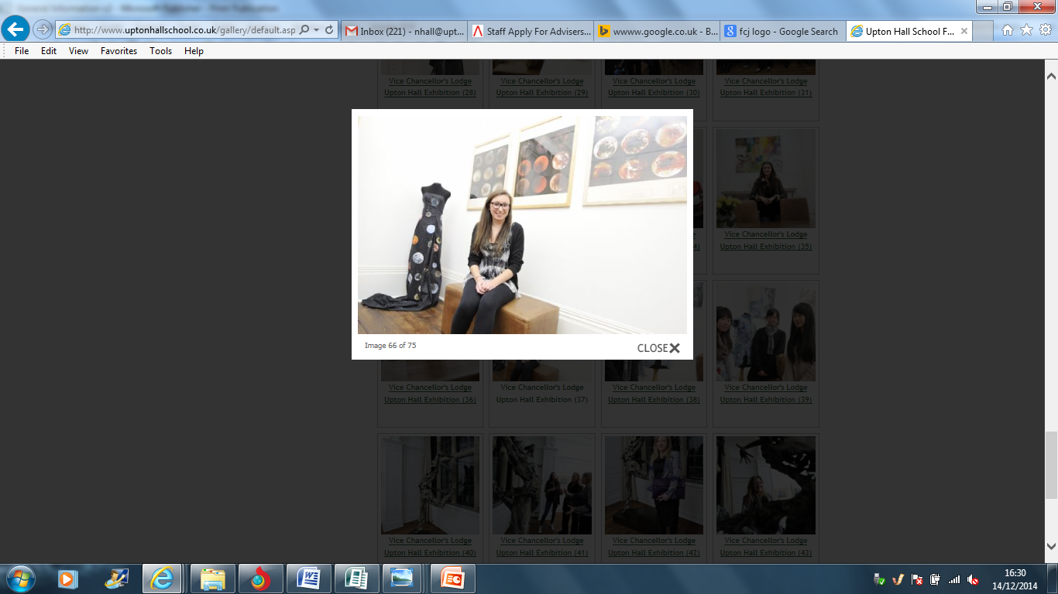
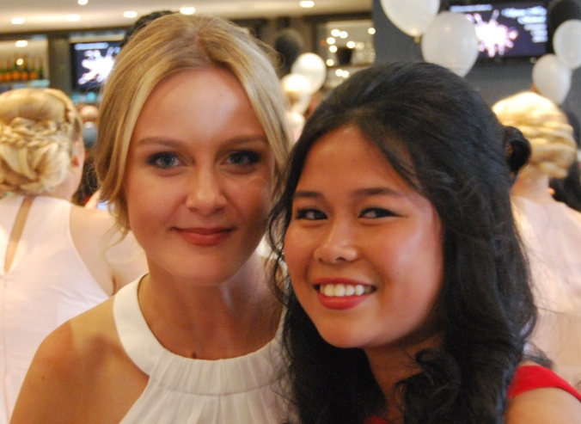
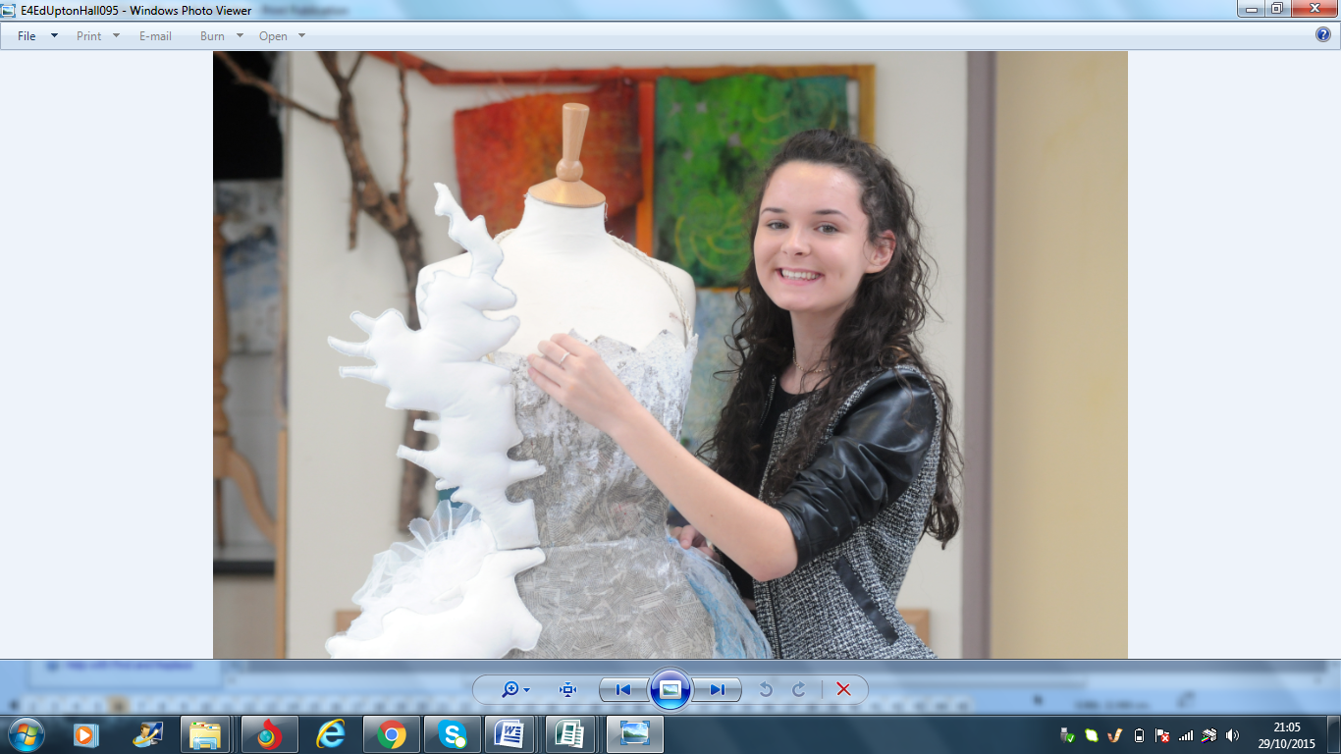
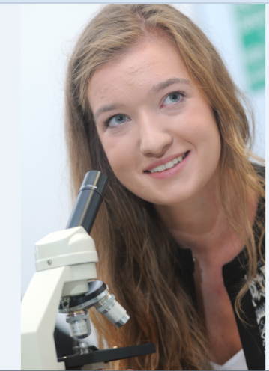
SIXTH FORM @ UPTON
The UCAS Process at Upton Hall School
1
2
3
4
Choose
courses
Apply at
www.ucas.com
Track the application
Confirm
choices
UCAS Hub
Unifrog
- Sunday Times ‘Good University’ Guide
- Russell Group?
Which? University
Open Days
5 choices (range)
Set up an application online
Personal statement submitted
Pay UCAS directly online (£34.50) and press ‘send’- Fee waived for FSM and care leavers. ​
Reviewed by school and reference added.
Admissions Tests for some courses (at test centre)
Offers
‘Conditional offers’ most common
Interviews
Offers come in by 31 March. Confirm choices by deadline in May.
Firm
Insurance
‘Extra’
- Apply for Student Finance

Slide 3

SIXTH FORM @ UPTON
When?
These are our internal deadlines; national deadlines are different and set by UCAS.
‘Early entry ‘undergraduate courses
PERSONAL STATEMENT DEADLINE:
Mon 14th September
FINAL DEADLINE:
Mon 28th September
Deadlines: All other undergraduate courses
PERSONAL STATEMENT DEADLINE:
Mon 19th October
FINAL DEADLINE:
Mon 2nd November
* Any students wishing to apply to read Music through the Conservatoire route, should see Mr Fitzgerald as an earlier deadline will also apply.

Slide 4

Choosing a University Course
SIXTH FORM @ UPTON
1
Choose
courses
There are over 150 universities in the UK, offering a total of almost 40,000 undergraduate courses.
Some you may not have heard of include:
BA Animation
BSc Audiology
BSc Ecotourism and Adventure Tourism
BA Arabic and Persian
BA Special Effects
BA Packaging design
BA Playwork
BSc Police Studies
BSc Disaster Management
BA Viking studies
So how do students select a course?

Slide 5
Choosing a University Course
SIXTH FORM @ UPTON
1
Choose
courses
Top tips:
Is there a profession that they want to pursue?
Which subject do they feel passionate about?
How far do they want to travel?
Would they prefer a campus/city-based university?
What are the job prospects like?
Check the course content and structure.

Slide 6
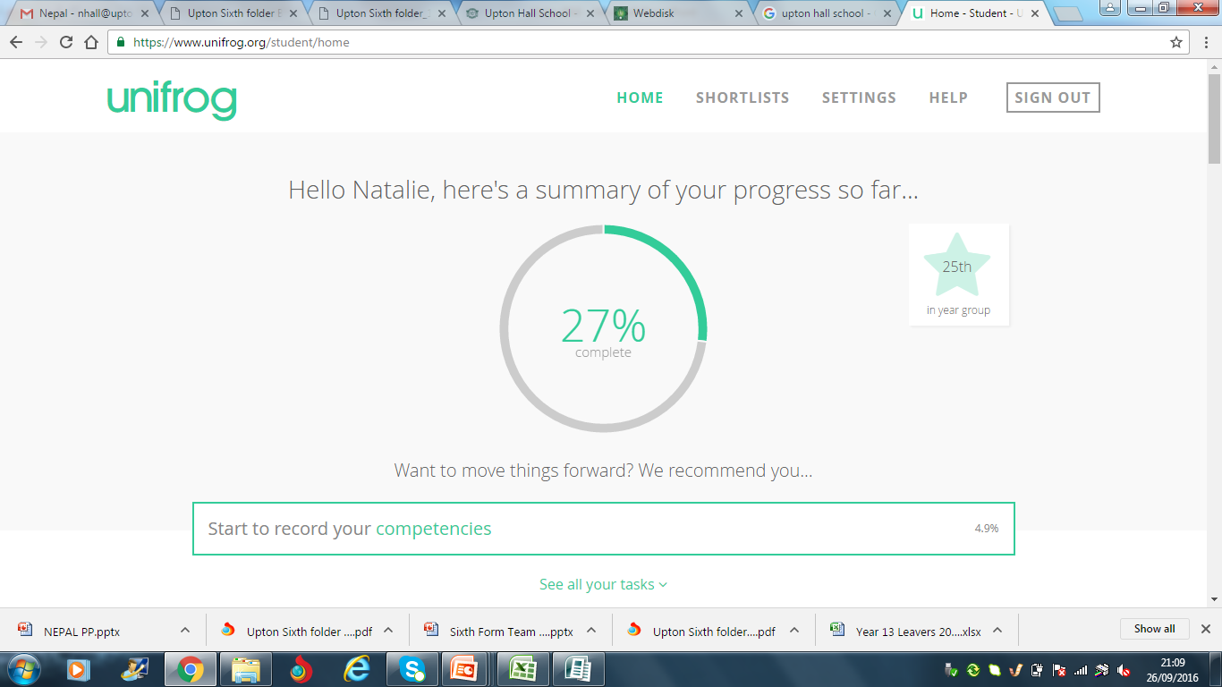

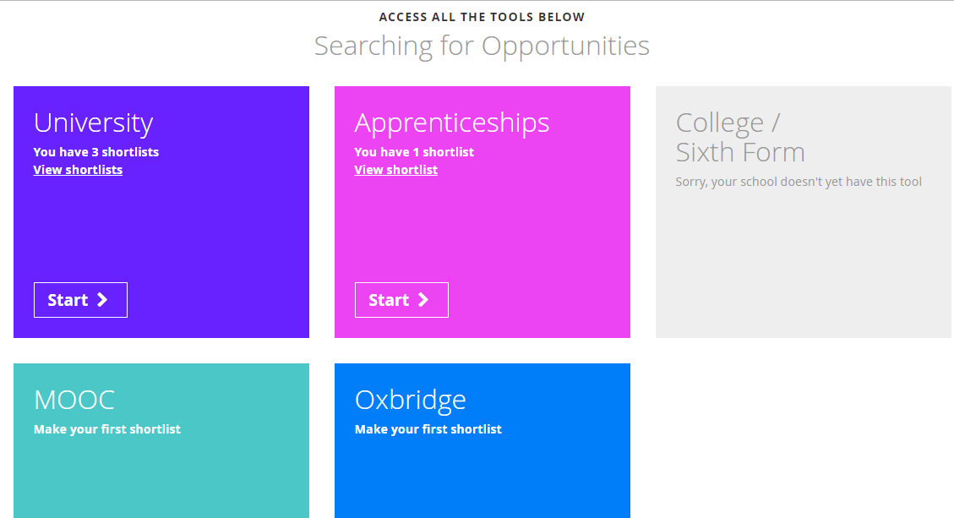
Choosing a University Course
SIXTH FORM @ UPTON
1
Choose
courses
Students have access to this excellent tool, Unifrog.
This is a ‘Destinations Platform’ for which students have log on details. It lists both university/non university destinations.
Unifrog sources its information from a range of websites, including UCAS, university league table providers, UniStats etc.

Slide 7
University Testing for Apply 2027
Some Cambridge tests are completed at interview and others are completed beforehand.
Test | Registration and booking | Test dates | Location of test
UCAT For medicine and dentistry | Register now (including any access arrangements) booking open 23rd June | 13 July – 24 September 2026 | Pearson Vue Test Centre
LNAT (for Law in Oxbridge, LSE, Glasgow, King’s, UCL, Bristol, Durham, SOAS) | Registration opens 1 August | 1 September onwards (for Oxbridge, take before 15 October) | Pearson Vue Test Centre
TMUA, ESAT, TARA Required for certain courses at Oxbridge, Imperial, LSE, Warwick, Durham, UCL | Register now and request any access arrangements. Booking opens 20th July and closes 28th September. | 12-16 October | Pearson Vue Test Centre

Slide 8
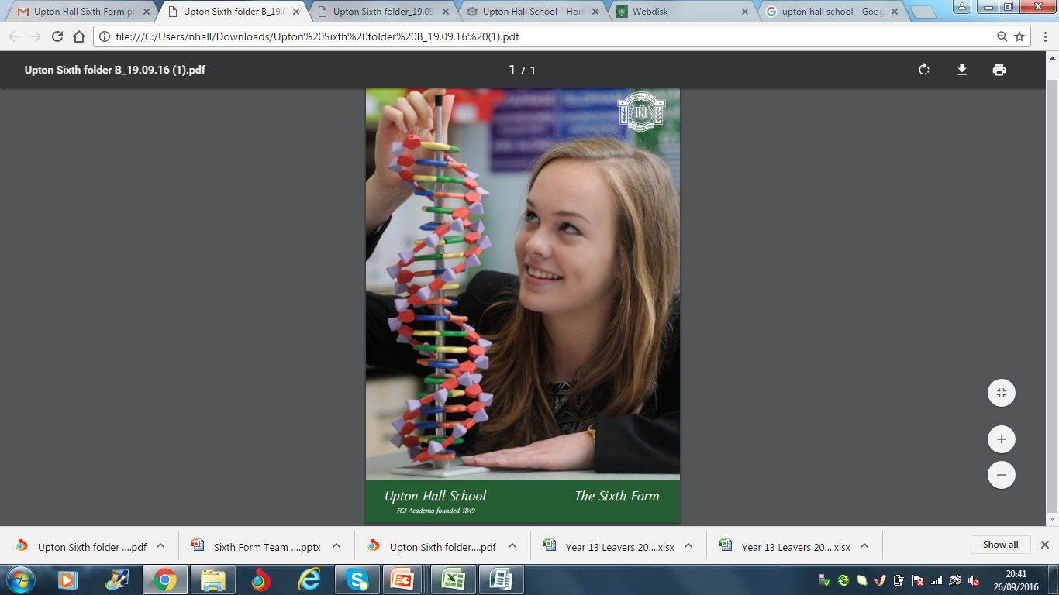
SIXTH FORM @ UPTON
UCAS ‘Tariff’ Points
AS Level | A Level | New Tariff points
 | A* | 56
 | A | 48
 | B | 40
 | C | 32
 |  | 28
 | D | 24
A |  | 20
B | E | 16
C |  | 12
D |  | 10
 |  | 8
E |  | 6

Slide 9

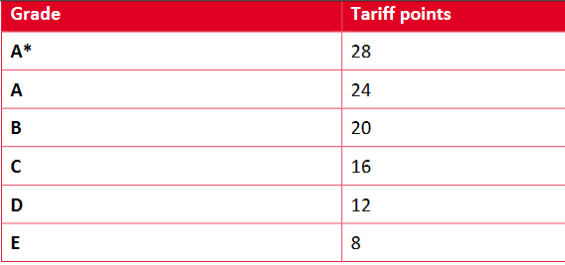
SIXTH FORM @ UPTON
UCAS ‘Tariff’ Points
For the BTEC Extended Certificate
For the AQA Extended Project (EPQ)

Slide 10

The Application Form
All completed via UCAS Apply 2027
Personal details
Student finance Education/qualifications
Courses (x5)
Deferred entry?
Personal statement
Reference and predicted grades

Slide 11
Personal Statement
The statement is split into three sections. The overall limit is 4000 characters (including spaces and blank lines), which is approximately 600 words. Each section has a minimum character count of 350 characters.
The same personal statement is used for all courses applied for.
Notes:
Info from UCAS competitive admissions conference (June 2013 CD)

Slide 12
Question 1: Why do you want to study this course or subject?
Give your motivation for studying the course. Show the reader that this is something you are really interested in, and are committed to studying in depth. If your likely future career depends on this course, mention it here.

Slide 13
Question 2: How have your qualifications and studies helped you to prepare for this course or subject?
Give evidence of what you have done which is relevant to your future course. This might include:
- a particular part of your A Level course which is something you would like to study further
- anything you have come across in your wider reading which is relevant to the course you want to study. Don’t just list books or articles- in each case, give details about what appealed to you, or what you would like to learn more about. Try and show an awareness of current developments or debates in the subject.

Slide 14
Question 3: What else have you done to prepare outside of education, and why are these experiences useful?
- any relevant work experience (particularly if you are applying for medicine, veterinary medicine, dentistry, nursing, physiotherapy, radiography, or other NHS careers)
Write about anything extra-curricular which is not directly relevant to the course, but shows skills like teamwork, organisation or responsibility. It might include D of E, employment, mentoring younger students or other voluntary work.

Slide 15
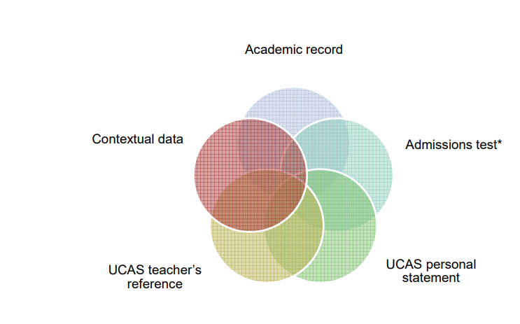
Personal Statements
SIXTH FORM @ UPTON
How is it used?
Notes:
Info from UCAS competitive admissions conference (June 2013 CD)

Slide 16

Pay and Send
SIXTH FORM @ UPTON
Students pay for their application individually with a credit/debit card online and then send it to school.

Slide 17

Predicted Grades/References
SIXTH FORM @ UPTON
Subject references and predicted grades from subject teachers.
Full reference written by Sixth Form Team.
Predicted grades from teachers entered on UCAS form.

Slide 18
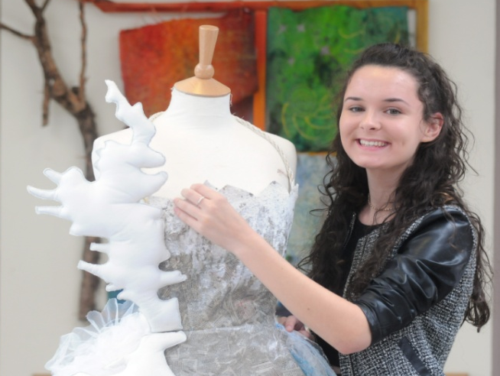

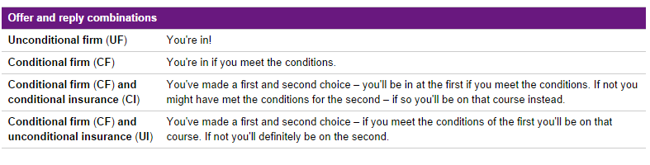
SIXTH FORM @ UPTON
3
Track the application
University Offers
There are different types of offers: Conditional and Unconditional. Once students decide on their offers, they mark one as FIRM and one as INSURANCE. They have a significant amount of time to decide.

Slide 19
Student Finance
This is not done through the school. It is completed in March on gov.uk website.
Students can borrow a tuition fee loan (likely to be £10,050 each year) and a maintenance loan (from £5,048 to £10,830 for a student not living with parents and living outside London). It is being rebranded as LLE (lifelong learning entitlement).
Interest, based on what is currently on gov.uk, is 3.2%.
Repayment is 9% of income above £25,000. Written off after 40 years.

Slide 20
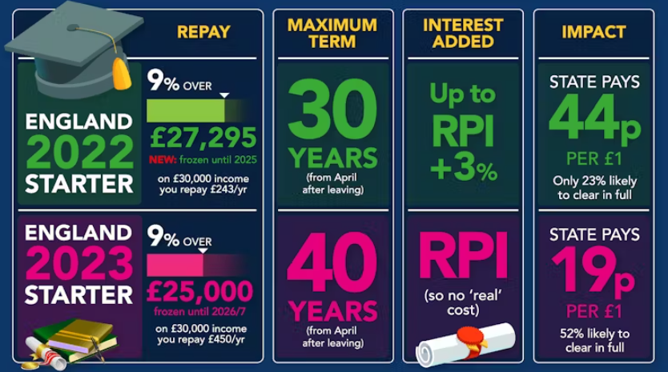
A graphic from Martin Lewis’s website on the current system.

Slide 21
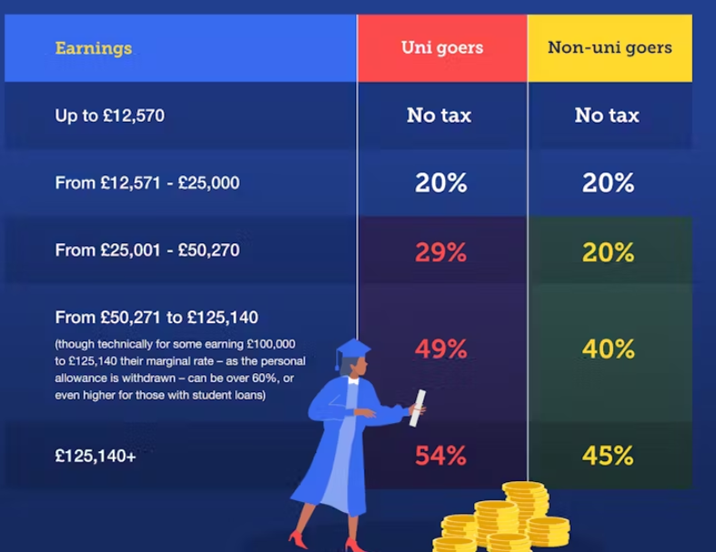

Slide 22
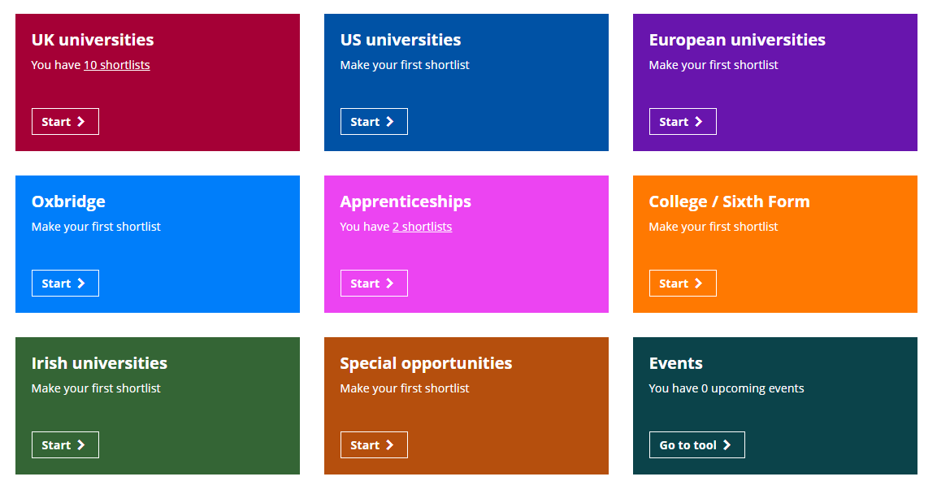
Bursaries/scholarships
SIXTH FORM @ UPTON
Most universities run scholarships/bursaries. They also offer contextualised offers (also known as ‘widening participation programmes).
It can be difficult to find information about bursaries but students can search on their Unifrog accounts for these in the ‘Special opportunities’ tab (shown below).
Healthcare professions
Allied healthcare professions can get the NHS Bursary. Information available here: NHSBSA Landscape Document or for further opportunities in Wales, please click here.

Slide 23
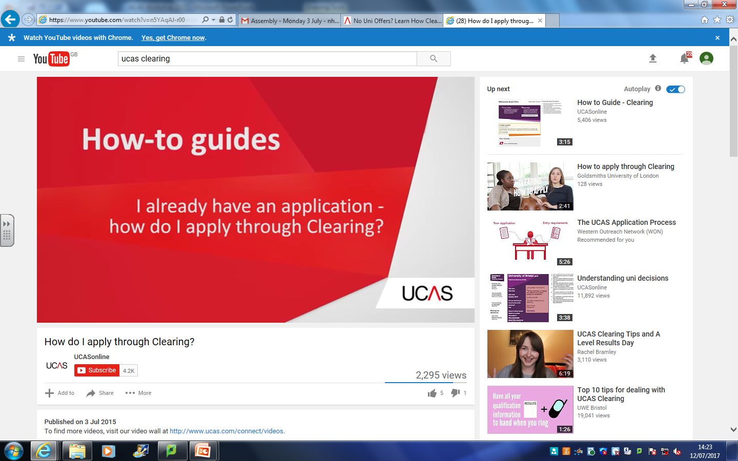
What if my child doesn’t get the grades?
SIXTH FORM @ UPTON
Click image to play clip.
https://www.youtube.com/watch?v=n5YAqAJ-r00

Slide 24

What if my child wants to take a year out before university?
Check that the university accepts deferred entries (this can be done through a phone call but better through email).
Select deferred entry on the UCAS form in Apply 2027.
Or apply post-results for September 2028 entry.

