Slide 1
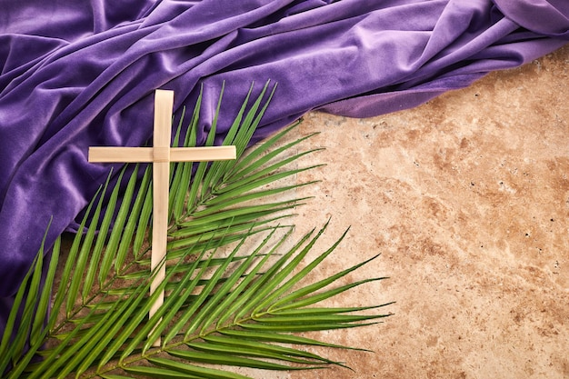
Monday 24th March. AM.
We start our week by reading Sunday’s Gospel from Luke 13 1-9
There were some present at that very time who told Jesus about the Galileans whose blood Pilate had mingled with their sacrifices. And he answered them, ‘Do you think that these Galileans were worse sinners than all the other Galileans because they suffered in this way? No, I tell you; but unless you repent, you will all likewise perish. Or those eighteen on whom the tower in Siloam fell and killed them: do you think that they were worse offenders than all the others who lived in Jerusalem? No, I tell you; but unless you repent, you will all likewise perish.’
And he told this parable: ‘A man had a fig tree planted in his vineyard, and he came seeking fruit on it and found none. And he said to the vine dresser, “Look, for three years now I have come seeking fruit on this fig tree, and I find none. Cut it down. Why should it use up the ground?” And he answered him, “Sir, let it alone this year also, until I dig round it and put on manure. Then if it should bear fruit next year, well and good; but if not, you can cut it down.” ’
________

Slide 2
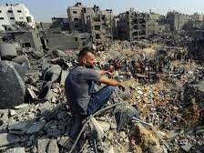
God of all wholeness,
heal our hearts
of all that prevents us responding
to our sisters and brothers
excluded by poverty
and prevented from living a full and healthy life.
This Lent, may we:
implore justice through our prayer,
stand in solidarity through our fasting,
and reach out through our giving.
Send your life-giving power
to revive the weary,
restore the broken
and renew the face of the earth.
We ask this through Christ our Lord.
Amen.
Monday 24th March PM.

Slide 3
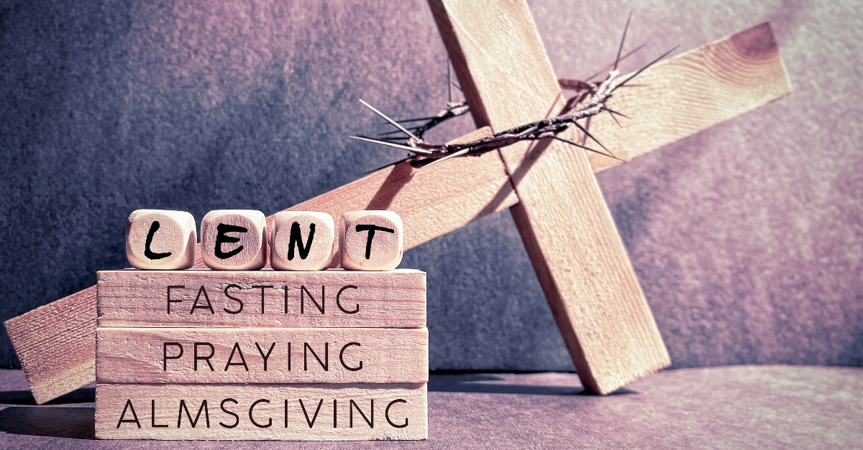
During Lent we are called to pray, to fast and to give. The focus of our prayers this week is fasting.
Why do Christians fast during Lent?
Fasting helps us to focus on God as the greatest importance in our lives.
It unites us with Jesus who fasted for 40 days in the desert.
Often people give something up such as chocolate or sweets. What could you give up?
This is a good time to look at what is ruling your time, and how you could make more space in your life. What is occupying your time and thoughts? Give that thing up.

Slide 4
Tuesday 22nd March PM. Fasting.
As well as fasting we can make some changes for the better, for ourselves or for someone else.
Give up harsh words – use generous ones.
Give up unhappiness – take up gratitude.
Give up anger – take up gentleness and patience.
Give up pessimism – take up hope and optimism.
Give up worrying – take up trust in God.
Give up complaining – value what you have.
Give up stress – take up prayer.
Give up judging others – !nd Jesus within them.
Give up sorrow and bitterness – !ll your heart with joy.
Give up sel!shness – take up compassion for others.
Give up being unforgiving – learn reconciliation.
Give up words – !ll yourself with silence – listen to
God…
and listen to others.
(Anonymous, Latin America CAFOD

Slide 5

Wednesday 26th March. AM.
Be creative in your ‘fasting’…
Fast from electricity, buying unnecessary things, meat (and dairy), social media, using the car.
Fast from silence and ignorance: talk about the climate crisis and raise awareness, learn more about the world around us.
Say Response after each line: God of Creation, help us to respect and renew the Earth.
We pray for the waters of the world, that they may be restored to health and filled with life. R/
We pray for Earth’s soil, that its richness be protected to assure abundant harvests for all. R/
We pray for all creatures who share Earth with us, that their beauty and diversity will be preserved.
We pray for our brothers and sisters around the world who have been and will be directly impacted by the effects of climate change. R/
We pray for future generations, may they learn from our environmental irresponsibility, and be good stewards living simply and in harmony with all your creation. R/
We pray for all human beings, that we will be filled with a spirit of concern for the future of our environment. R/
We pray for wisdom for decision makers around the world, for creative and just solutions to protect all of creation. R/

Slide 6

Wednesday 26th March. PM.
Let us pray…..
Help us to keep Lent a Holy time to focus on Jesus Christ and the sacrifice God made for us.
When we feel ourselves being distracted by material possessions and situations that lead us away from God, we pray to return to you, Our God.
When we forget to fast or do not bother, may we remember those who do not have food and water and make our fast in solidarity with the poor.
When we are selfish and do not give to others, open our eyes to the suffering of Jesus and the suffering in the world and give us generous hearts.
We ask this through Christ our Lord.
Amen

Slide 7

Thursday 27th March. AM.
Lord,
Teach me a new freedom.
Freedom to reject comparison And to embrace uniqueness.
Freedom to cut ties with greed And feast on love. Freedom to abstain from over indulgence
And feast on self-control.
Freedom to leave behind selfish thoughts
And to focus on the needs of others.
Freedom to fend off insecurity
And to embrace grace.
Lord, at this time of Lent,
Thank you for the freedom you bring. Amen.

Slide 8

Thursday 15th February. AM. Prayers of Hope
Dear Lord,
We give thanks for your loving presence and support. Guide us through difficult times and conflicts. Give us hope and strength. May you teach us to work together and unite as a community.
Amen (Layla Year 7)
Dear Lord,
Thank you for our friends and family.
Thank you for our hope and freedom.
Thank you for our happiness and joy.
Thank you for our education.
Thank you for our homes.
Thank you for our food and water.
Thank you for your guidance.
Amen.
(Charlotte Year 7)

Slide 9
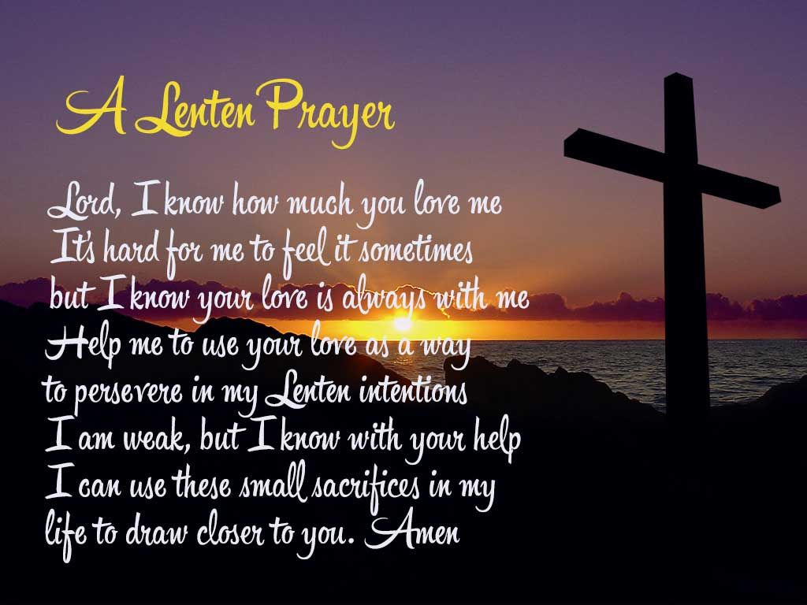
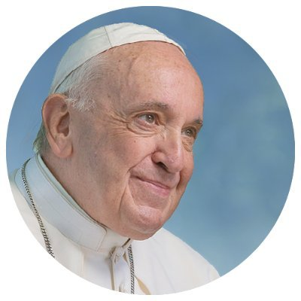
Thursday 27th March. PM.
“Let us set out on the path of fasting and use these 40 days to take stock of ourselves, to free ourselves from the dictatorship of full schedules, crowded agendas, and superficial needs, and choose the things that truly matter,” (Pope Francis)

Slide 10

Friday 28th March
Examen
Be silent and place yourself in God’s loving presence.
Take some time to look back over your week.
How have you lived Lent this week? Have you given anything up?
Think about the good things that have happened and give thanks.​
What have the challenges been?
In the quiet of your heart, tell God about your experiences this week.​
Give thanks for who you are.
As you look ahead, with what spirit will you enter next week? Is there something for which you would like to ask God.
Ask God to help you.

