Slide 1

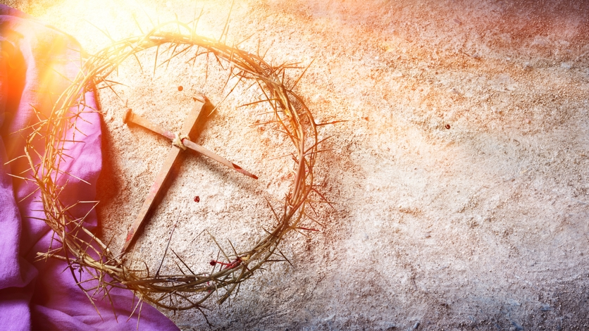
Monday 17th March. AM.
On Sunday the Gospel reading was The Transfiguration, which is when Jesus went up the mountain with his friends and he was altered by the light of God. Read the passage below from Luke 9:28b-36
.
At that time: Jesus took with him Peter and John and James and went up on the mountain to pray. And as he was praying, the appearance of his face was altered, and his clothing became dazzling white. And behold, two men were talking with him, Moses and Elijah, who appeared in glory and spoke of his departure, which he was about to accomplish at Jerusalem. Now Peter and those who were with him were heavy with sleep, but when they became fully awake they saw his glory and the two men who stood with him. And as the men were parting from him, Peter said to Jesus, ‘Master, it is good that we are here. Let us make three tents, one for you and one for Moses and one for Elijah’ — not knowing what he said. As he was saying these things, a cloud came and overshadowed them, and they were afraid as they entered the cloud. And a voice came out of the cloud, saying, ‘This is my Son, my Chosen One; listen to him!’ And when the voice had spoken, Jesus was found alone. And they kept silent and told no one in those days anything of what they had seen.

Slide 2
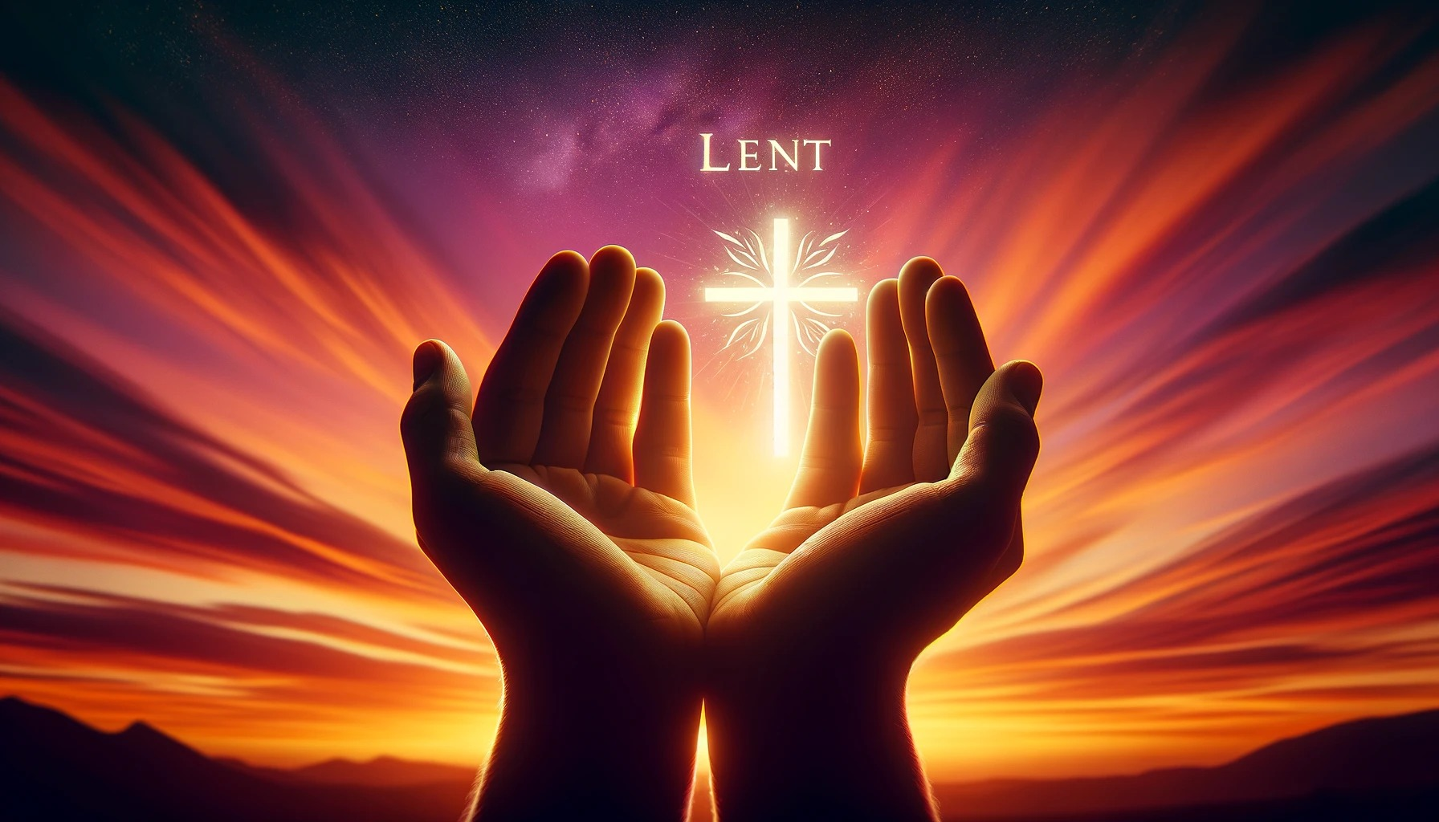
Monday 17th March. PM. This week our theme for Lent is Prayer.
The Transfiguration calls us to live prayerful lives. Jesus showed His glory to Peter, James, and John. This reminds us to try to be close to Jesus every day. We are called to follow Jesus and live like Him.
Do you believe that we can be changed through meeting Jesus in prayer?
Do you believe that through prayer we can grow closer to Jesus?
As we pray, we become more like Christ, we reflect His light. Others can see Jesus in us. Our actions and words can show His love. By living holy lives, we bring Christ’s light to the world.
The Transfiguration gives us hope. It shows that one day we will see God face to face. We will experience His glory fully. This will be a joy beyond anything we can imagine now.
Lord, You revealed Your glory to strengthen our faith. Help us to listen to Jesus and follow His teachings. Open our hearts to see Your presence in our daily lives. Give us the courage to share Your light with others. May we always walk in Your truth and love. Amen.

Slide 3
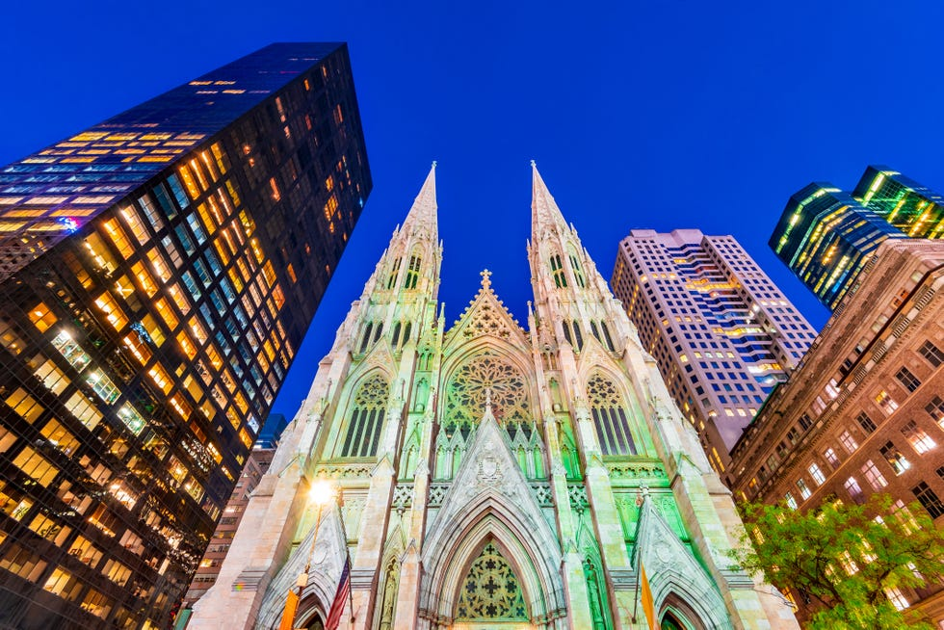
Saint Patrick. Patron Saint Of Ireland. Feast Day 17th March.
Saint Patrick was a missionary who helped spread Christianity throughout Ireland during the 5th century.
He spent 6 years in captivity and it was during this time that he became deeply devoted to Christianity through constant prayer.
Prayer of Saint Patrick.
May the Strength of God guide us.
May the Power of God preserve us.
May the Wisdom of God instruct us.
May the Hand of God protect us.
May the Way of God direct us.
May the Shield of God defend us.
May the Angels of God guard us,
Against the snares of the evil one.
May Christ be with us!
May Christ be before us!
May Christ be in us,
Christ be over all!
May Your Grace, Lord,
Always be ours,
this day, O Lord, and forevermore.
Amen.
Saint Patrick’s Cathedral, New York.

Slide 4
Tuesday 18th March.AM.
During Lent, as well as giving to charity we can also commit more of our time to prayer.
What is prayer?
Prayer is how we talk to God.
It is a way to share our thoughts, feelings, and hopes with Him.
It is also a time to listen for His guidance.
Prayer is not just about asking for things. It is about building a relationship with God.
It helps us stay connected to God. It helps us grow in faith.
There are many ways to pray. Can you think of any?
Which ways have helped you feel closer to God?
During Lent you may want to consider a new way to pray. This week we will consider some different forms of prayer that you may wish to try.

Slide 5
Tuesday 18th March. PM. Prayer.
Prayer can happen anywhere. It can be in a church, at home, or even on a walk. There is no wrong place to pray. Prayer is about being open to God wherever we are.
Sometimes, prayer is planned, like saying the Rosary or going to Mass. Other times, it is spontaneous, like saying a quick prayer for help or saying whatever is in your heart.
During Lent try going for a walk in nature and try to let go of distractions. Ask God to fill your hearts with His peace and say whatever is in your heart.
Dear Lord,
As we embark on this Lenten journey, let us open our hearts to your presence and guidance through prayer. Let us seek your presence and grow in our faith as we journey through this sacred season.
Amen.

Slide 6
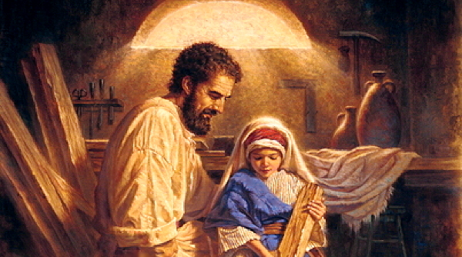
Today is Feast of St Joseph
A man who was known not for his words but for his ACTIONS.
Wednesday 19th March.AM.
Lord, I pray for gifts and talents that will help me to help others.
As I pray for these gifts I know too, that I will need to work hard to develop them;
- to become more patient,
- to grow in wisdom,
- to be faithful in friendship.
I pray Lord that I may be a person of kind action like St. Joseph.
Amen.

Slide 7

Wednesday 19th March. PM.
One of the most common ways to pray is Speaking to God.
This can include through formal prayers such as the Our Father or the Hail Mary and the Glory Be. They help us join our voices with the whole Church. We say together.
Our Father,
Who art in Heaven,
hallowed be Thy name;
Thy Kingdom come,
Thy will be done on earth as it is in Heaven.
Give us this day our daily bread;
and forgive us our trespasses
as we forgive those who trespass against us;
and lead us not into temptation,
but deliver us from evil.
Amen.
Night prayer can be a really peaceful way to end the day. It helps us let go of the cares of the day and put ourselves in our Lord’s gentle care. You may wish to learn and recite this night prayer from the Liturgy of the Hours.
Protect us Lord, as we stay awake, watch over us as we sleep, that awake we may keep watch with Christ and asleep rest in His peace.

Slide 8

Thursday 20th March. AM. Praying for others.
Intercessory prayer is a way to ask God to help others. We can pray for anyone in need—family, friends, strangers, or even the world.
Intercessory prayer builds spiritual solidarity. It reminds us that we are part of a larger community of faith.
Let us pray for those that we know who are sick. We pray for Pope Francis as he continues to be unwell. We pray for his recovery and for the peace of Jesus.
We make our own private prayers for people we know and love, in our hearts in a few moments of silence.
We ask for the prayers of Mary Mother of Jesus to intercede for us as we say,
Hail Mary full of Grace, the Lord is with thee.
Blessed are thou amongst women and blessed is the fruit of thy womb Jesus.
Holy Mary Mother of God,
pray for us sinners now and at the hour of our death
Amen.

Slide 9
Thursday 20th March.PM. Praying for others. Prayers of Hope
We pray for peace around the world. We especially pray for Ukraine and Gaza. Let all who are homeless be sheltered, let the hungry be fed, let the thirsty be filled. Let everyone who is alone be filled with the Holy Spirit.
Amen
(Maisie Year 8)
We hope for everyone to experience having a home, food and clean water. We hope that nobody in the world has to feel the stress or pain of homelessness and starvation.
Amen
(Elsie Year 8)
Dear God,
Please help those who are in countries where their homes are being destroyed and they have no where to go. Please protect them so that they find safely and hope of a better tomorrow.
Amen
(Ava Year 8)

Slide 10
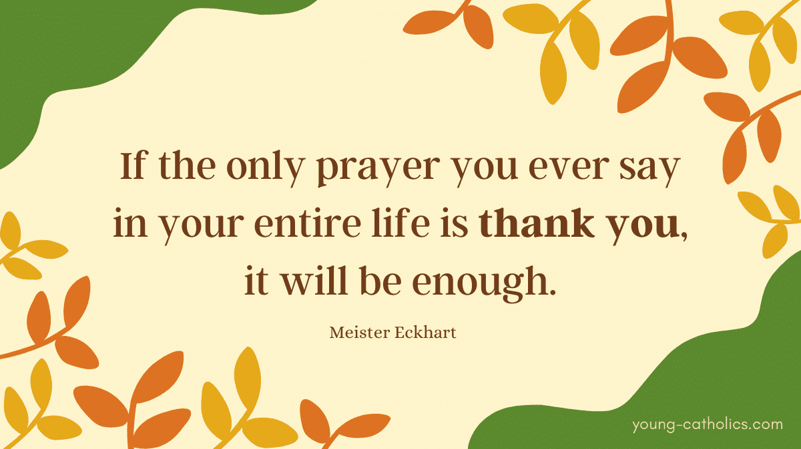
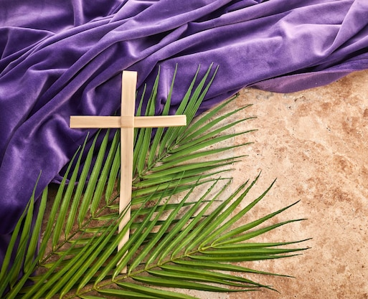
Friday 21st March. AM. Gratitude Prayers.
Another way we can pray during Lent is by saying thank you.
When we express thanks, we’re recognizing God’s role in the events and blessings of our lives. Perhaps during Lent you can make a commitment to paying attention to your blessings.
It could be as simple as noting down three things you’re thankful for every day.
Why not start a prayer journal?
A prayer journal is a great way to stay focused during prayer. It is easy to get distracted while praying.
Writing in a prayer journal helps slow down your thoughts.
It gives you a clear way to express what is on your heart.
When you write down your thoughts, you may begin to understand things in a new way. This can help you grow closer to God.
A prayer journal can also bring comfort. When you are feeling lost or struggling, you can read past entries. You can see how God has been with you before. This can remind you that He is always with you, even when life is hard.
Keeping a prayer journal is a simple but meaningful way of praying during Lent.

Slide 11
Friday 21st March. PM.
A simple Gratitude Prayer. Try this out in form time and then this is something you can try on your own at night
Find a comfortable and quiet place.
Make the Sign of the Cross.
Ask God to show you where He was present in your day.
Think about some things from the past day which you are grateful for.
  It is good to have a minimum number of things to come up with each day – 3 or 5 or 10 for example
  Try to be specific. Instead of being grateful for your family in general, think of a specific interaction with a family member or friend or teacher
Spend a little time enjoying the memories of the things you are grateful for.
Thank God for each of these and any special circumstances which made them possible.
End with the Sign of the Cross.

