Slide 1
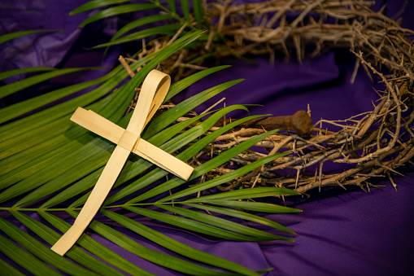
Monday 10th March AM.
Yesterday was the 1st Sunday of Lent. We start our week by reading Sunday’s gospel from Luke 4:1-13
At that time: Jesus, full of the Holy Spirit, returned from the Jordan and was led by the Spirit in the wilderness for forty days, being tempted by the devil. And he ate nothing during those days. And when they were over, he was hungry.
The devil said to him, ‘If you are the Son of God, command this stone to become bread.’ And Jesus answered him, ‘It is written, “Man shall not live by bread alone.” ’
And the devil took him up and showed him all the kingdoms of the world in a moment of time, and said to him, ‘To you I will give all this authority and their glory, for it has been delivered to me, and I give it to whom I will. If you, then, will worship me, it will all be yours.’ And Jesus answered him, ‘It is written, “You shall worship the Lord your God, and him only shall you serve.” ’
And he took him to Jerusalem and set him on the pinnacle of the temple and said to him, ‘If you are the Son of God, throw yourself down from here, for it is written, “He will command his angels concerning you, to guard you”, and “On their hands they will bear you up, lest you strike your foot against a stone.” ’ And Jesus answered him, ‘It is said, “You shall not put the Lord your God to the test.” ’
And when the devil had ended every temptation, he departed from him until an opportune time.

Slide 2

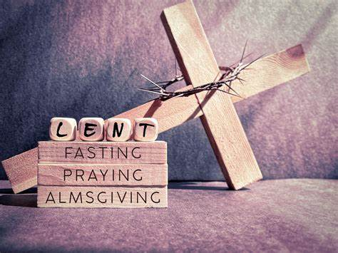
The Season of Lent ~ Pray, Fast, Give
Monday 10th PM
During the 40 days of Lent, we are called to turn away from sin and turn towards God. It is an opportunity for us to detach ourselves from worldly distractions and focus on what truly matters.
There are three things which Christians are asked to do during Lent: to pray, to fast and to give (almsgiving).
We will make these the focus of our prayers over the next few weeks.
This week our focus will be almsgiving.
Dear Lord,
help us to remember that the most important part of Lent is what happens in our hearts,
in our relationship with you, and in our relationship with others & all of creation.
Amen

Slide 3

Tuesday 11th March AM. Almsgiving
Almsgiving is the act of giving to those who are in need during Lent. Through Almsgiving we share God’s love with others and we recognize that the gifts we have are not really our own.
As a school we are committing to almsgiving this Lent through our charity work. The two charities we are fundraising for are CARITAS and CAFOD (Catholic Aid for Overseas Development).
Watch the following clip highlighting some of the global outreach work that CAFOD do.
Find out more at: https://cafod.org.uk/about-us/what-we-do

Slide 4


Tuesday 11th March PM.
‘With your help, we reach out to people living in hard-to-reach places, in war zones and those who are discriminated against.
We believe that if one of us is hurt, hungry or abandoned, we all are hurt, hungry and abandoned. No one should be beyond the love and support they need to live a dignified life’ (CAFOD)
Let us pray.
We ask you God to walk with us through this season of Lent.
As we find ourselves challenged,
remind us of our inner strength and give us hope.
As we struggle to engage in acts of charity,
remind us to think of the dignity of others and to act justly.
When we know we have moved away from your
companionship, remind us that you are waiting to
welcome us back.
Inspire us to be generous;
encourage us to be gentle;
and strengthen us on our journey.
Amen.

Slide 5
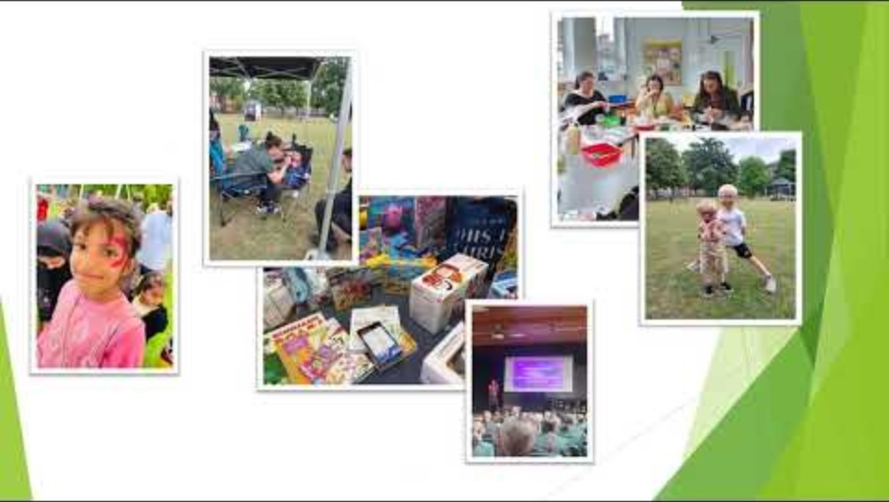
Wednesday 12th March. AM. As well as CAFOD, the other charity we are fundraising for during Lent is Caritas.
Caritas is a social justice agency of the Diocese of Shrewsbury which seeks to develop the Church’s social mission.
Caritas actually means ‘Christian love of humankind’ and we express this in loving service.
They provide community projects, providing parenting programmes, bereavement and family support. They work in schools focusing on wellbeing, counselling and outreach.
Watch the clip which highlights some of the important work of CARITAS.

Slide 6






Wednesday 12th March PM.
Dear God,
We pray for our local community, that it may be a place of support, kindness and understanding. May the people around us, from neighbours to friends be filled with compassion and strength. Help us to be active in caring for each other, offering a hand when someone is in need, and listening with open hearts. May our actions inspire others to work together for the common good. Let us build a community where everyone feels loved, valued, and safe.
Amen
(Prayer of Hope. Written by 10C)

Slide 7

Thursday 13th March. AM. Almsgiving.
Watch the following clip, a prayer for our earth by Pope Francis and think about the purpose of our charity work and how we can reach out with compassion for our world.

Slide 8
Thursday 13th March. PM
Beyond giving money, there are many ways to practice almsgiving during Lent:
Visiting a sick or elderly person who is alone.
Listening and accompanying someone going
through a difficult time.
Volunteering for a charitable organization.
Forgiving someone who has wronged us,
as forgiveness is also a form of almsgiving.
Can you think of any more?

Slide 9
Friday 14th March. AM.
Examen
Be silent and place yourself in God’s loving presence.
Take some time to look back over your week.
How have you lived Lent this week?
Think about the good things that have happened and give thanks.​
What have the challenges been?
In the quiet of your heart, tell God about your experiences this week.​
Give thanks for who you are.
As you look ahead, Is there something for which you would like to ask God?
Ask God to help you.

Slide 10

Friday 14th March. PM. Prayer of Hope written by 10C.
Dear God,
We lift up the world to you, asking for healing and peace. May hope shine brightly in every corner of the world, where darkness often takes hold. Help us to be kind and open minded in our actions. Guide our leaders to make wise decisions and help people to care for the planet. May your love fill every heart, and may we, as young people, rise up with courage to create a better world for all.
Amen

