Slide 1

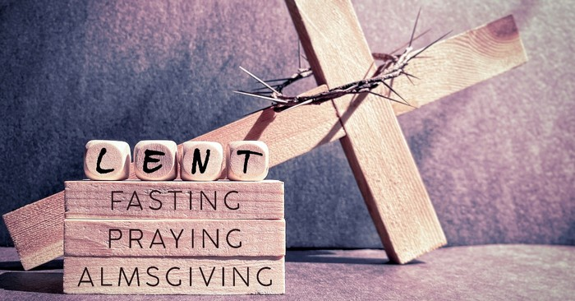
Welcome to the RE Department!

Slide 2

Studying RE at A-level might help you become…..
A counsellor!
This is because…
Studying RE helps you to develop interpersonal skills by considering what others think and even why they might disagree with your own views!
Interpersonal skills are key skills when working in health care!

Slide 3
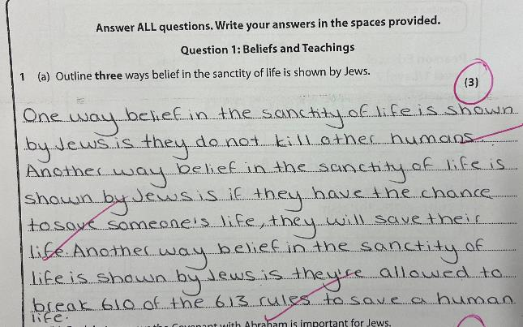
GCSE Paper 1
Judaism – A question
Student gives three clear points directed at the question asked.
Student uses three full sentences.
3/3
Great Work!

Slide 4

What do I like about KS3 RE?
I like studying RE because it helps me to understand Catholic beliefs and teachings.
This year I enjoyed learning about the role of situation ethics, conscience, the Bible, and the Church in making moral decisions.
I also like to learn about other religions and see what they have in common with Christianity and how they are different.
Millie
Y9

Slide 5
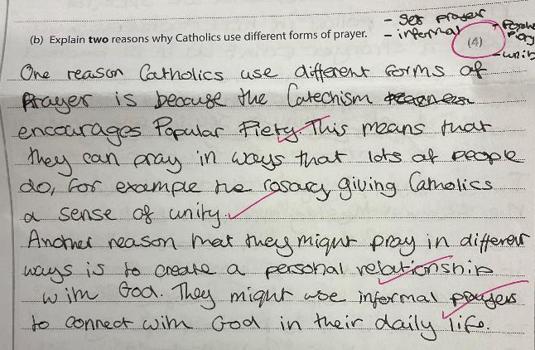

GCSE Paper 1
Catholic Christianity B question
Student gives two clear points directed at the question asked.
The points relevance to the question are explained by the following sentence.
4/4

Slide 6
Welcome to the RE Department!

Slide 7

What do I like about KS4 RE?
I love RE because it helps you learn about different aspects of people’s lives and the world.
You have the chance to form and share your own personal opinion in lesson!
There are also topics like stewardship which helps you to take care of the world and gives ideas of why and how we can protect the planet.
Sarah
Y10

Slide 8
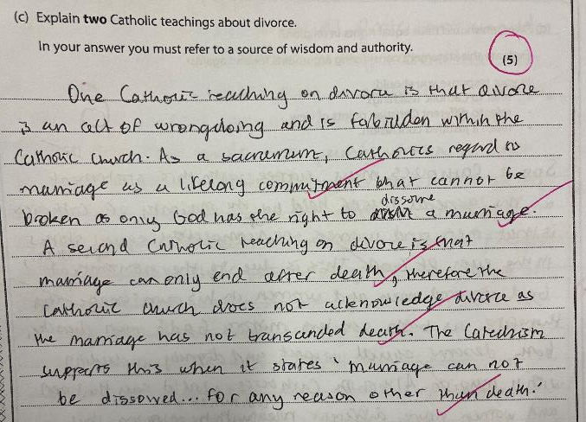
GCSE Paper 3
Philosophy and Ethics
C question
Student gives two clear points directed at the question asked.
The points relevance to the question are explained by the following sentence.
An excellent source of wisdom and authority is clearly linked to the point
5/5

Slide 9

What do I like about A-level RE?
What I like about RE is that we learn about such a wide range of different cultures and opinions.
Since the course is split into three areas, Philosophy, Ethics and Christianity, we really get the chance to learn about each topic in detail.
I particularly enjoy learning about the different kinds of ethical thinking.
Isla
Y13

Slide 10
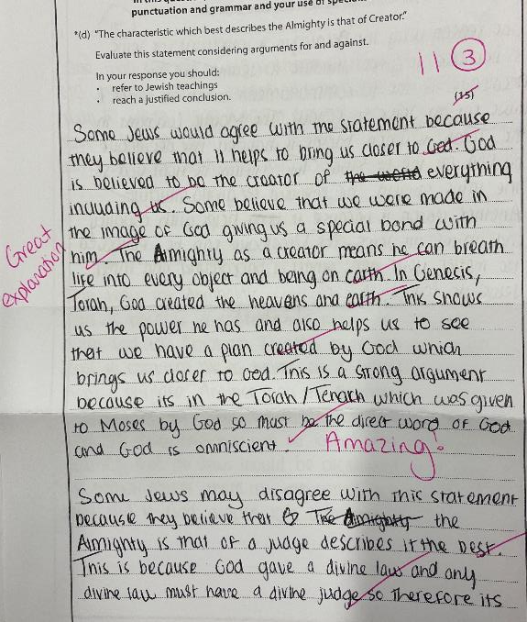
GCSE Paper 2
Judaism - D Question
Student has built up sound logical chains.
Excellent use of SOWAs.
Student has evaluated how strong the argument she has presented is.

Slide 11
Welcome to the RE Department!

Slide 12
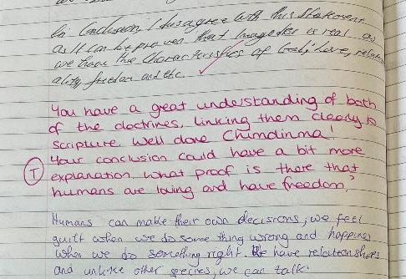
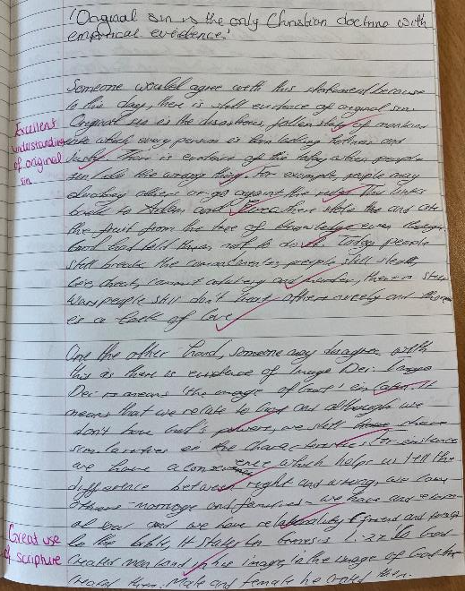
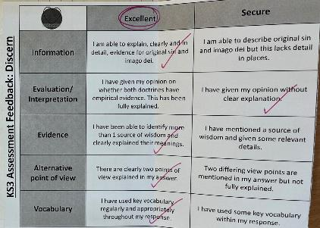
KS3

Slide 13
What do I like about KS3 RE?
My favourite about RE is learning about other people’s beliefs. I also like learning about how Catholics lead their lives
I like learning about other people’s lives and how their faith effects them.
Lily – Y8
My favourite thing about RE is learning about all of the different ways people worship God around the world, especially their festivals.
Olivia M - Y8
I enjoy RE. I have really enjoyed learning about Sophie Scholl and how braves she was.
Olivia J– Y8
Ruby - Y8

Slide 14

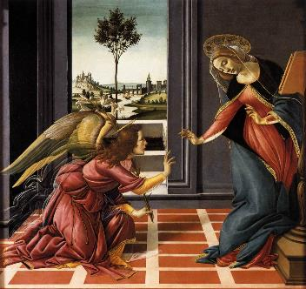

Curriculum links - March
This year Lent begins on 5/3/25. Throughout Lent we journey together towards Easter. We study and reflect on the importance of Lent and Easter in KS3, KS4 and KS5.
March the 25th is the feast of the annunciation. This is where Mary was greeted by the Angel Gabriel and asked to be the Mother of God. We look at this scripture in KS3
The feast day of St Patrick is celebrated on March 17th. When learning about the Trinity in KS3 and KS4, St Patrick’s use of the Shamrock is studied.

Slide 15
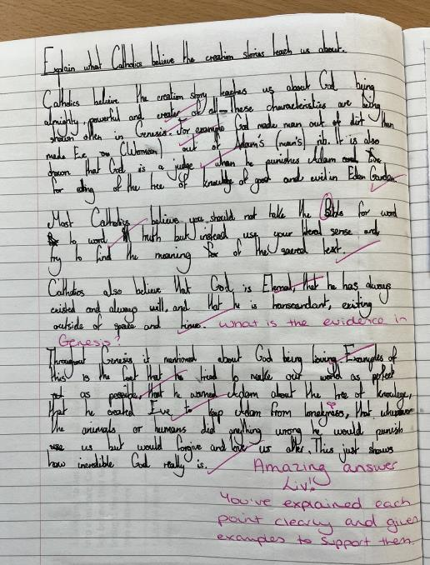
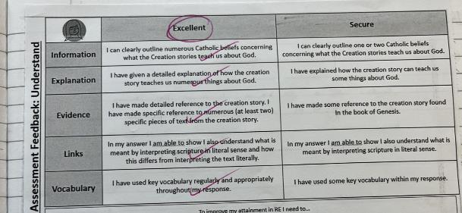
KS3

Slide 16
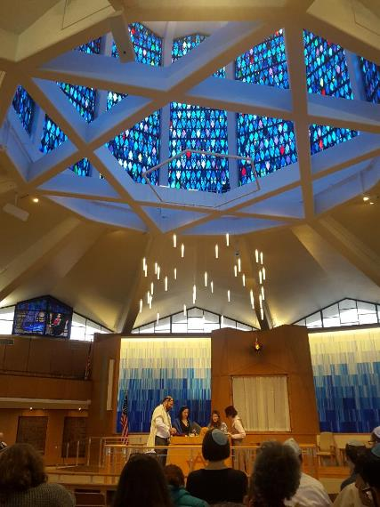
What do I like about KS4 RE - Judaism?
I like learning about the rules that Jews follow, including Kosher food laws as it has a big impact on their life.
Issy – Y11
Ava – Y11
It is intriguing to learn about how Jewish life is so different to Catholics. It is interesting to see their devotion to prayer.
My favourite topics have been learning about the covenants and the primacy of life because of the focus on history.
Hetta – Y11

Slide 17

RE A-level BIG QUESTIONS
What Caused the Universe?

Slide 18

What do I like about CORE RE?
Core RE in Sixth form is really interesting. The curriculum was influenced by past pupils which makes it especially relevant and enjoyable for year 12 and 13 students.
My favourite part was in year 12 when we learnt about cloning. This was something I had never really thought about but the lessons taught us about the ethical and social beliefs surrounding the cloning of animals and people. Throughout the year, we watch videos and films that link to the topics we are learning and engage in class discussions, allowing us to share opinions and hear from other students in our form group.
The lesson itself provides a time for pupils to learn aside from their A Level subjects. This makes them helpful as it means students can set aside their stresses and worries about exams for an hour each week and think about other aspects of life instead.
Susana
Y13

Slide 19
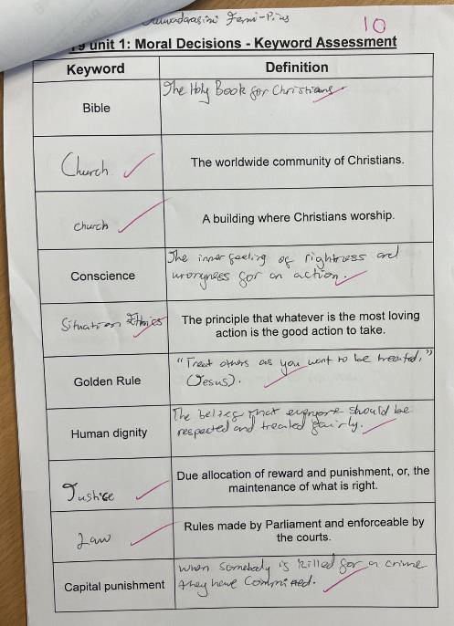
KS3 - Literacy
Student has clearly learnt the key words for this topic.

