Slide 1

Year 11 Parents Information Evening 2021

Slide 2
Exams 2022
What changes have been announced? What happens if exams are cancelled? What is the best advice for my daughter?

Slide 3
Optional topic
Optional topics and content in GCSE English literature, history, and geography.
This means we don’t have to teach the full course
We need more information about this before teachers decide that to leave out. This information is released by exam boards
GCSE Plan A

Slide 4
Advance information about the focus of exams
Exam boards will provide advance information about the focus of the content of the exams for GCSE subjects (except GCSE English literature, history and geography) for the summer 2022 exams.
This is to support students’ revision, not that this is all students need to know
7 February 2022 at the latest.
GCSE Plan A
This is good news but we do not know how detailed the information will be eg ‘key themes in ‘An Inspector Calls’ is not very helpful

Slide 5
Formulae sheets
Students will be given a formulae sheet for GCSE mathematics, GCSE physics and combined science in summer 2022, covering all the equations required in the subject content.
Exam boards will provide copies of the equation sheet for use in teaching and to ensure that students are familiar with it prior to the exams.
Clean copies of the equation sheet will be provided in the exams.
GCSE Plan A

Slide 6
MFL
Exam boards will not have to include vocabulary that’s not on the vocabulary lists for assessments in GCSE MFL.
Exam boards will include an extra optional question in the writing assessment to help students to focus on fewer themes in their writing.
Teachers and students should prepare for spoken language in 2022 to be assessed in the normal way, through formal speaking tests.
We are waiting for more information from our exam board

Slide 7
Art GCSE and A Level
Students taking GCSE and A level art and design will be assessed on their portfolio only
There will be no exam
GCSE Plan A

Slide 8
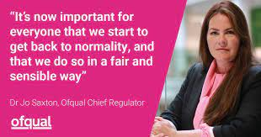
Will there be as many top grades given out?
“Instead, 2022 will be a transition year to reflect that we are in a pandemic recovery period. We will aim, therefore, to reflect a point midway between 2021 and 2019 when it comes to grading. Then in 2023 we want to return to results that are in line with those before the pandemic began.”
GCSE Plan A
The exams will be the same standard but there will be fewer 9-6 grades awarded than in 2021. But there will be more 9- 6 grades awarded than in 2019.

Slide 9
What if the pandemic prevents exams?
Teachers will be asked to assess students and determine grades
If this happens, we will follow guidance
There is a consultation on the proposals for the next two weeks. This includes three important points which may become guidance
  planned assessment points from which to gather evidence (e.g. once in each of the late autumn, spring and early summer terms)
  the use, at these assessment points, of approaches which replicate exam board papers and exam conditions
  The total assessment time should be roughly the amount of time the exams would take
Plan B

Slide 10
How does this affect your daughter?
Mocks could well be used as evidence to contribute to your grade. Topic lists will be issued to guide revision.
If exams go ahead, the best way to be ready for the ‘advance information’ is to have become the best geographer, mathematician, historian, scientist you can be. This means your daughter continuing to work hard, practise key skills, respond to feedback.
At GCSE there are limited reductions to content but pupils still need to learn most of it
The best advice is to keep working steadily; there is a danger students could develop false confidence on topic sheets

Slide 11
Key Dates
Exam Window
Results Days
Full exams 16th May – 30th June (provisional)
Speaking exams will take place earlier
A levels - 18 August
GCSEs - 25 August

Slide 12
How are teachers helping students to be ready?
Teachers are trying to fill gaps in learning. Some girls are being asked to do extra work; some are invited to specific sessions; some teachers have spent time revisiting key topics
Half term holiday revision sessions – likely to be by invite
Sixth form mentoring
Teachers have provided a revision guide – a paper copy will be given to your daughter

Slide 13
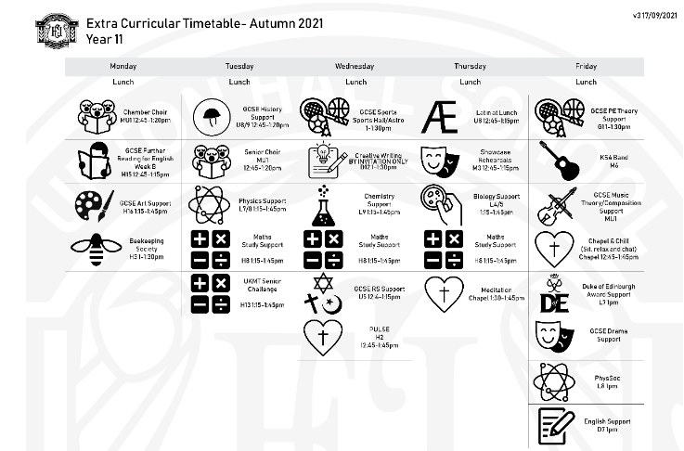
Interventions at lunchtime

Slide 14
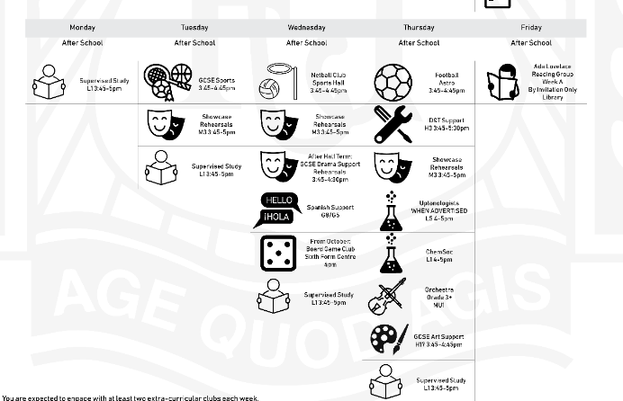
Interventions after school

Slide 15
What are baseline grades?
Baselines are
Baselines are not
A guide to the grades your daughter is capable of achieving with consistent hard work
Based on KS2 data but also on what class teachers know about your daughter
A way to check she is making progress
Likely to be issued later this term
A predicted grade – your daughter could be underperforming
Unrealistic – every year lots of students beat their deadline
Something that we are likely to use to help determine a Teacher Assessed Grade

Slide 16
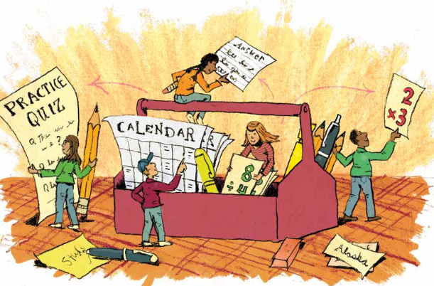
Strengthening the Student ToolBox – revision strategies

Slide 17
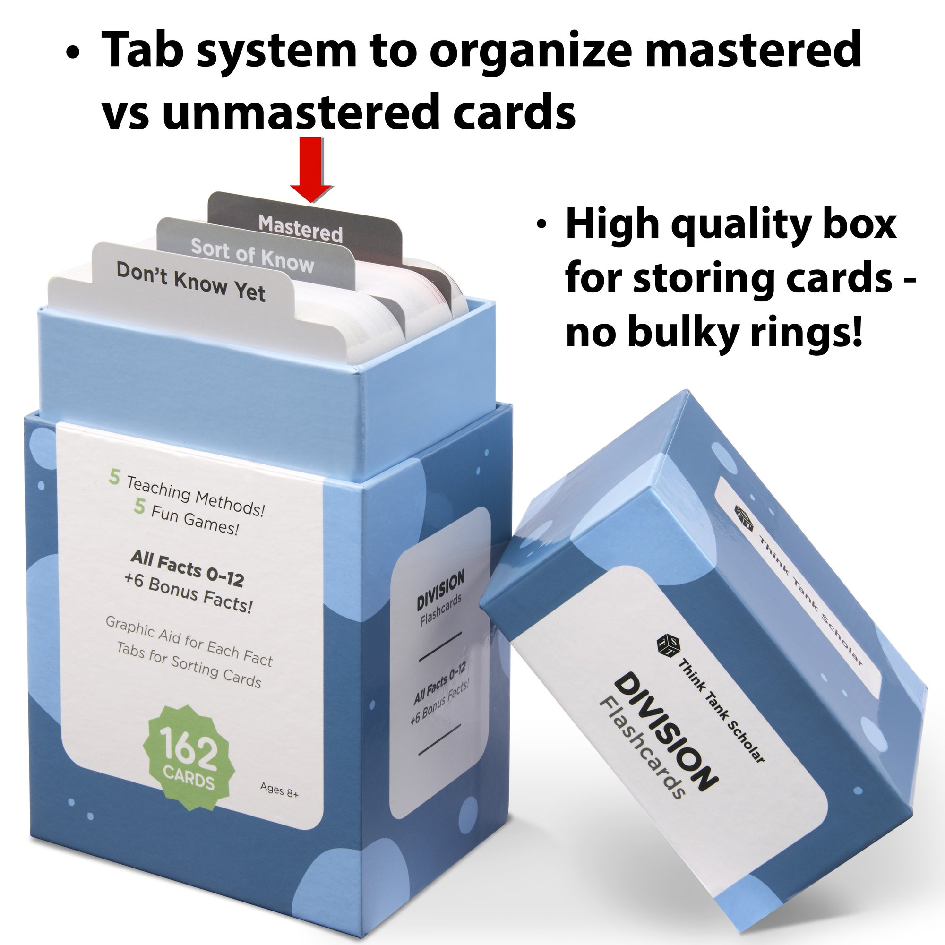
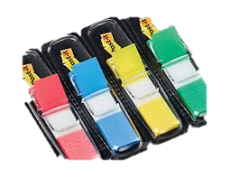
Leitner System for Flashcards
Test yourself on your flashcards
If you answer the questions, move it to the mastered section at the back. Test yourself once a week.
If you can’t recall all of it, put it in the middle section. Test yourself every three days
If you don’t know it, put it at the front and test yourself daily.
You can do this with traffic colour coded tabs

Slide 18
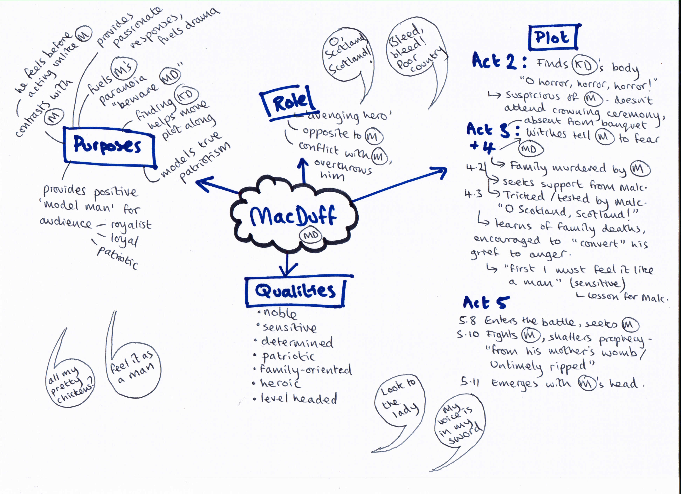
Create a mindmap from memory in one pen colour; then use your notes to add more detail in a second colour.

Slide 19
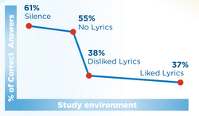
Does listening to music help?
Students who revised in a quiet environment performed over 60% better in an exam than peers who listened to music with lyrics
Students who listened to music with lyrics did better
Students who listened to lyrics they liked performed slightly worse than those who listened to lyrics they disliked

Slide 20
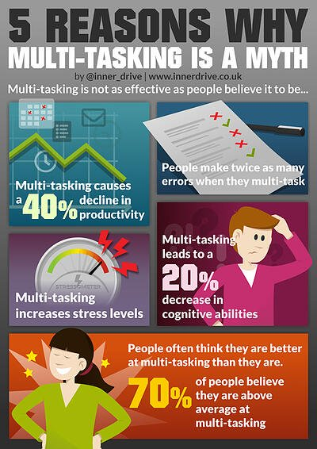
Should I revise with my phone?
Multi-tasking is a myth!
Revising with your phone next to you doesn’t lead to better learning.
Research has found that simply having a phone out while revising causes a decrease in concentration and a reduction of 20% in recall tests

Slide 21
Supervised Study
Supervised Study is a chance to study after school until 5pm.
We use the Sixth Form Common room, a large, spacious area
Students have access to laptops if they need them
Students who use Supervised Study tend to exceed their baseline by roughly a third of a grade
Last year’s Year 11 achieved some of the best Mock results in recent years, despite the pandemic. This is linked to their strong use of Supervised Study- 45 of them used it regularly.

Slide 22
Wider life of the school
Duke of Edinburgh Award
Message from Mrs E. Seed
Year 11: Following the letter Mrs Seed sent out in July students have begun to register for the Silver level. This costs £29 for the Award booklet. If any student still wishes to register, they should see Mrs Seed ASAP. Fees paid last year are for registration to the electronic system and are not refundable if you were provided with a login.
Silver expeditions are run in conjunction with Wirral and West Cheshire Expedition Committee Operating Authority. Expedition registration will be with the committee on 6th February and there will be an additional cost. Information will be sent by the Award manager but a guide for the dates are as follows:
Training will take place in March
Trial in April time
Test will be end of June/ first week in July.
Finally for Year 11, if the qualified for the Certificate of Achievement, students should check the email registered on eDofE as the certificates will be emailed directly from DofE to participants; school are not included in that process.

