Slide 1
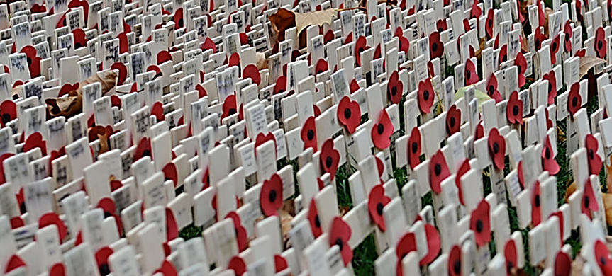
Remembrance
103 years ago the First World War was ended. This week we remember all those who have died during wars.
11th November is known as Armistice Day or Remembrance Day with wreath laying ceremonies across the country.
We continue praying for COP26 in the afternoon. (slide at the end)

Slide 2
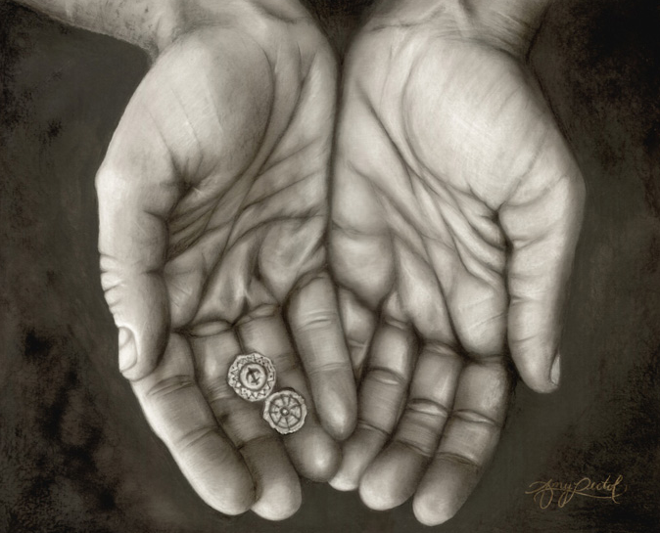
Monday 8th November
Sunday Gospel: Mark 12:41-44
Jesus sat down opposite the treasury and observed how the crowd put money into the treasury. Many rich people put in large sums.
A poor widow also came and put in two small coins worth a few cents.
Calling his disciples to himself, he said to them, “Amen, I say to you, this poor widow put in more than all the other contributors to the treasury.
For they have all contributed from their surplus wealth, but she, from her poverty, has contributed all she had, her whole livelihood.”
Pause for thought: how hard is it for you to share if you only have a little yourself?
Lord Jesus, teach me to be generous; teach me to serve you as you deserve, to give and not to count the cost, to fight and not to heed the wounds, to toil and not to seek for rest, to labour and not to seek reward, except that of knowing that I do your will. Amen.
(St Ignatius of Loyola)

Slide 3
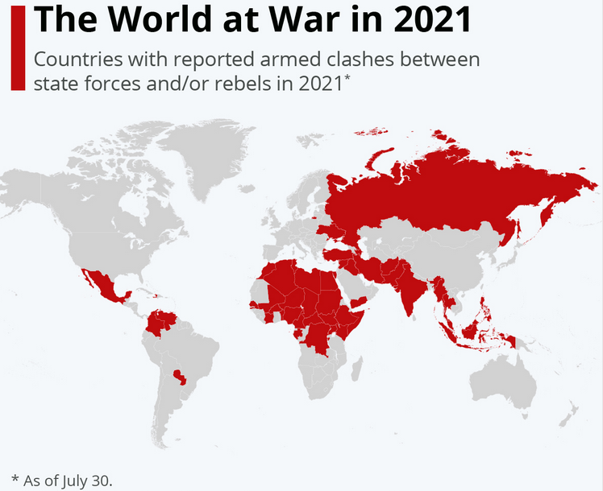
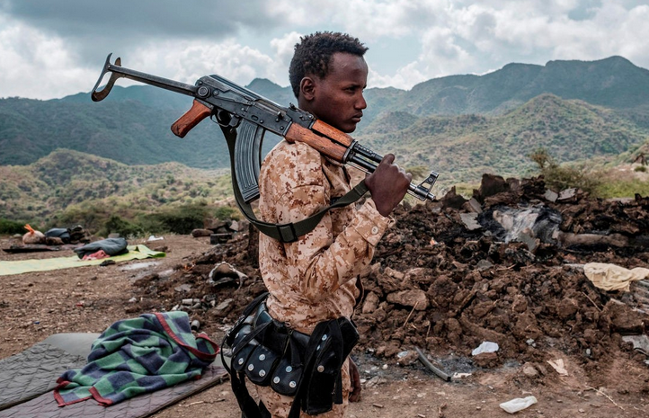
Tuesday 9th November
Look at this map:
of which conflicts were you aware?
Dear God,
We pray for reconciliation between the nations, that all people may, together, live in freedom, justice and peace.
We pray for all who in bereavement, disability and pain continue to suffer the consequences of fighting and terror.
We remember with thanksgiving and sorrow those whose lives, in world wars and conflicts past and present, have been given and taken away.
Amen.

Slide 4
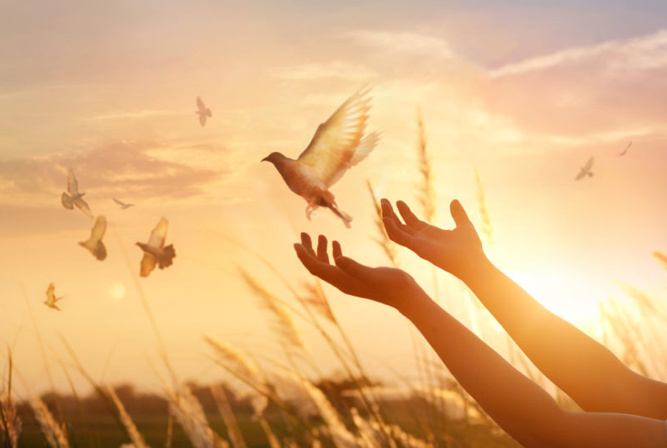
Wednesday 10th November
Let us pray for all who suffer as a result of conflict, and ask that God may give us peace.
For the service men and women who have died in the violence of war, each one remembered by and known to God; May God give peace.
for those who love them in death as in life, offering the distress of our grief and the sadness of our loss; May God give peace.
for all members of the armed forces who are in danger this day, remembering family, friends and all who pray for their safe return; May God give peace.
for civilian women, children and men whose lives are disfigured by war or terror, calling to mind in penitence the anger and hatreds of humanity; May God give peace.
for peace-makers and peace-keepers, who seek to keep this world secure and free;
May God give peace.
for all who bear the burden and privilege of leadership, political, military and religious; asking for gifts of wisdom and resolve in the search for reconciliation and peace.
May God give peace.
O God of truth and justice, we hold before you those whose memory we cherish, and those whose names we will never know. Help us to lift our eyes above the torment of this broken world, and grant us the grace to pray for those who wish us harm. As we honour the past, may we put our faith in your future; for you are the source of life and hope, now and for ever.
Amen.

Slide 5
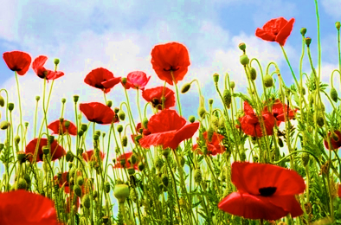
Thursday 11th November
They shall grow not old, as we that are left grow old; age shall not weary them, nor the years condemn.
At the going down of the sun and in the morning, we will remember them.
We will remember them.
2 minute silence
Ever-living God we remember those whom you have gathered from the storm of war into the peace of your presence; may that same peace calm our fears, bring justice to all peoples and establish harmony among the nations, through Jesus Christ our Lord. Amen.

Slide 6
Friday 12th November
God of peace,
We pray for all victims of war, we remember them so that in remembering each new generation will know their sacrifice and work even harder for peace.
We remember the lives lost in mud and carnage of the First World War, and those who came home changed forever.
We remember the great loss of the Second World War, brought home to our towns and cities with bombs falling onto houses, factories and shipyards.
We remember the fallen of all wars since, sometimes very far from home, and all civilians who have lost their lives.
We remember the young men who were called up to serve their country and did not come home.
We remember those who came home bearing the scars of war, physical and psychological, for those today who need support to re-discover peace of mind and purpose.
We pray today, with all our hearts, for peace. Pray that peace takes root in the tender soil of our hearts. Amen.

Slide 7
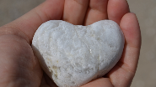
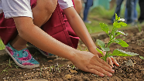
Afternoon: Prayer for Creation
The FCJ Sisters and Companions in Mission invite you to join in this prayer for creation.
#COP26 The Climate Change Conference hosted by the UN Glasgow 1-12 Nov 2021.
Creator God, we give thanks for the wonderful gift of creation and your presence in every part of it.
As we seek to widen our circle of love, help us to rediscover the value, unity and sacredness of all that exists.
We seek forgiveness for the ways in which our actions and choices have damaged the earth, affecting the climate, destroying diversity, and impacting the lives of the poorest of our sisters and brothers.
In your love, lead us into solidarity and companionship, inspire our leaders to courageous decisions, and grant each of us the wisdom and commitment to act.
May we treasure earth’s resources, work to reduce our impact on the climate and be open to a conversion of heart and lifestyle. Amen.

Slide 8
Friday 12th November
Examen
Be silent and place yourself in God’s loving presence. Give thanks for who you are.
Look back over your week. Where have you felt joy and what has been difficult and challenged you? In the quiet of your heart, tell God about your experiences.​
As you look ahead, with what spirit will you enter next week?
Ask God to help you.

