Slide 1
The Body of Christ w/c 8th June

Slide 2
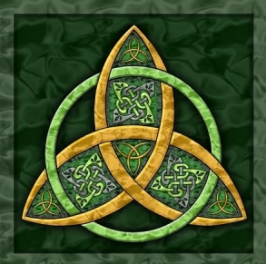
Monday 8th June
A reading from the second letter from St Paul to the Corinthians (from the readings for Trinity Sunday)
Brothers and sisters, rejoice.
Mend your ways, encourage one another,
agree with one another, live in peace,
and the God of love and peace will be with you.
Greet one another with a holy kiss.
All the holy ones greet you.
The grace of the Lord Jesus Christ
and the love of God
And the fellowship of the Holy Spirit be with all of you.
Pause for thought: Is there anyone you should make peace with or encourage?

Slide 3
Monday 8th June
Think of one person in your life that has inspired you in your faith.
Thank God for that person today!
If you are able you could tell that person they have inspired
you.

Slide 4
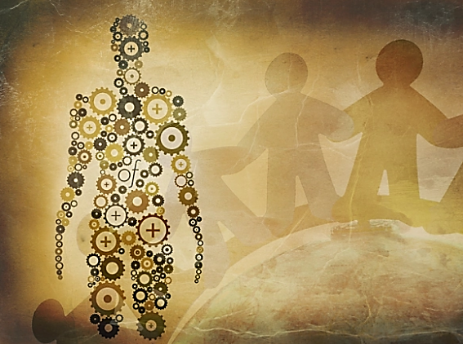
Tuesday 9th June
A reading from St Paul’s first letter to the Corinthians (1 Cor 12, 12-26)
A person’s body is one thing, but it has many parts. Yes, there are many parts to a body, but all those parts make only one body. Christ is like that too. Some of us are Jews, and some of us are Greeks. Some of us are slaves, and some of us are free. But we were all baptized into one body through one Spirit. And we were all made to share in the one Spirit.
And a person’s body has more than one part. It has many parts. The foot might say, “I am not a hand. So I am not part of the body.” But saying this would not stop the foot from being a part of the body. The ear might say, “I am not an eye. So I am not part of the body.” But saying this would not make the ear stop being a part of the body. If the whole body were an eye, the body would not be able to hear. If the whole body were an ear, the body would not be able to smell anything. If each part of the body were the same part, there would be no body. But truly God put the parts in the body as he wanted them. He made a place for each one of them. And so there are many parts, but only one body.
The eye cannot say to the hand, “I don’t need you!” And the head cannot say to the foot, “I don’t need you!” No! Those parts of the body that seem to be weaker are really very important. And the parts of the body that we think are not worth much are the parts that we give the most care to. And we give special care to the parts of the body that we want to hide. The more beautiful parts of our body need no special care. But God put the body together and gave more honour to the parts that need it. God did this so that our body would not be divided. God wanted the different parts to care the same for each other. If one part of the body suffers, then all the other parts suffer with it. Or if one part of our body is honoured, then all the other parts share its honour.

Slide 5
Tuesday 9th June
Help us, Lord, as we work together to build your empire. Help us to be the light that leads the world to you.
God, may we be good role models to the people around us so that when we see you and your love within us, they would want to know you more and more.
God, grant us the patience to work together as a family. Help us to work together with understanding and compassion in our hearts.
The body of Christ is made up out of people from different, race, skin colour, background, …How can racism fit into that?
Let us pray for dignity and justice for all.

Slide 6
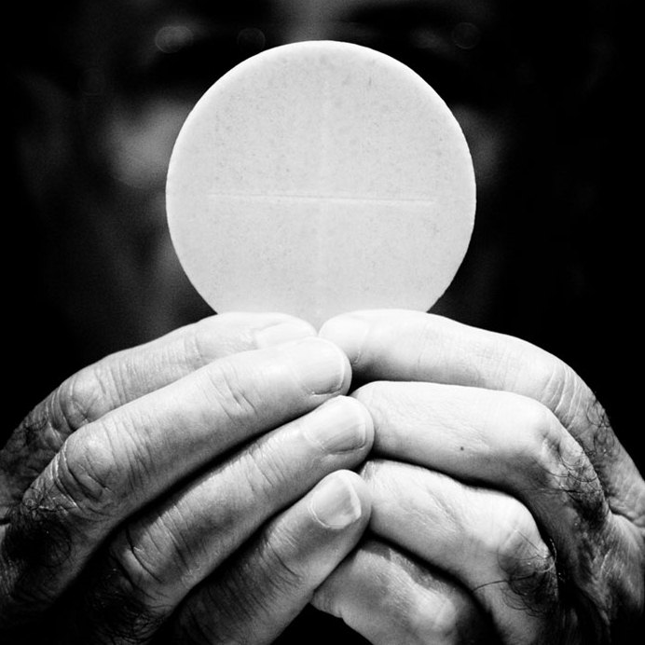
Wednesday 10th June
Lord, today we pray for The Body of Christ, that we will be unified.
At your Last Supper you prayed to the Father that all should be one.
Send your Holy Spirit upon all who bear your name and seek to serve you.
Strengthen our faith in you, and lead us to love one another in humility.
We pray for all our Christian brothers and sisters worldwide that we will focus on what brings us together, rather than what separates us.
Amen.

Slide 7
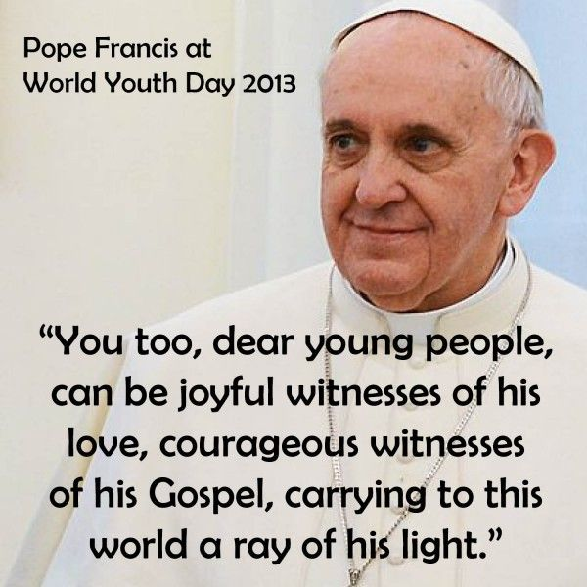
Wednesday 10th June
God calls us to share
friendship with people
of other faiths,
walking with them
on the path of
our common humanity
- The Faithfulness of God

Slide 8
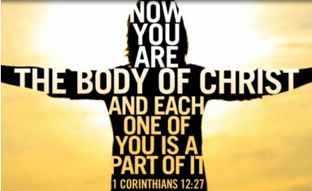
Thursday 10th June
Video on the body of Christ (1 min)
https://www.youtube.com/watch?v=dAkhAW4ReiE

Slide 9
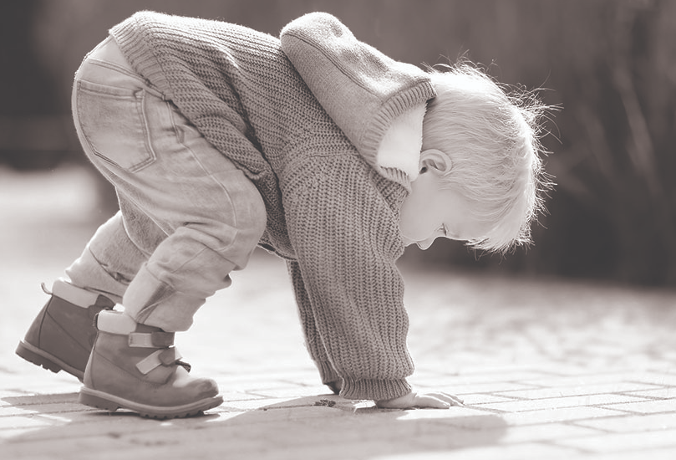
Thursday 11th June
Pope Francis said ‘St Peter committed one of the greatest sins, denying Christ and yet they made him Pope. Think about that’
Let us pause for a moment and reflect on this quote.
We are not the sum of our weaknesses but the sum of God’s love for us.
Are you wanting to be involved in the church but feel like you can’t?
Be inspired by St Peter’s life today, that no matter how many times he fell, he always got back up.

Slide 10
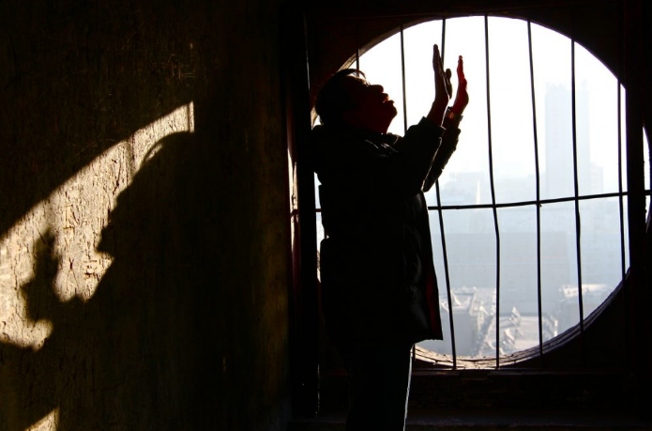
Friday 12th June
Lord, its only right that as our prayer theme for this week is The Body of Christ that today we pray for our brothers and sisters worldwide who are persecuted for their faith.
O God, Hear our prayers and the prayers of our brothers and sisters who, daily, suffer persecution and even death for being faithful witnesses to the truth.
May their love for You and Your Blessed Mother sustain them.
May we, who are so free to practise our Faith,
be inspired by those who suffer persecution, to ever greater Love; may we never refuse God’s invitations to follow Him and witness to others.
Amen.

Slide 11
Friday 12th June
Examen
Be silent and place yourself in God’s loving presence. Think about the good things that have happened this week and give thanks.​
Who have you left a good memory with this week?
Look back over your week. Where have you felt joy and what has been difficult and challenged you? In the quiet of your heart, tell God about your experiences.​ Give thanks for who you are.
As you look ahead, with what spirit will you enter next week?
Ask God to help you.

Slide 12
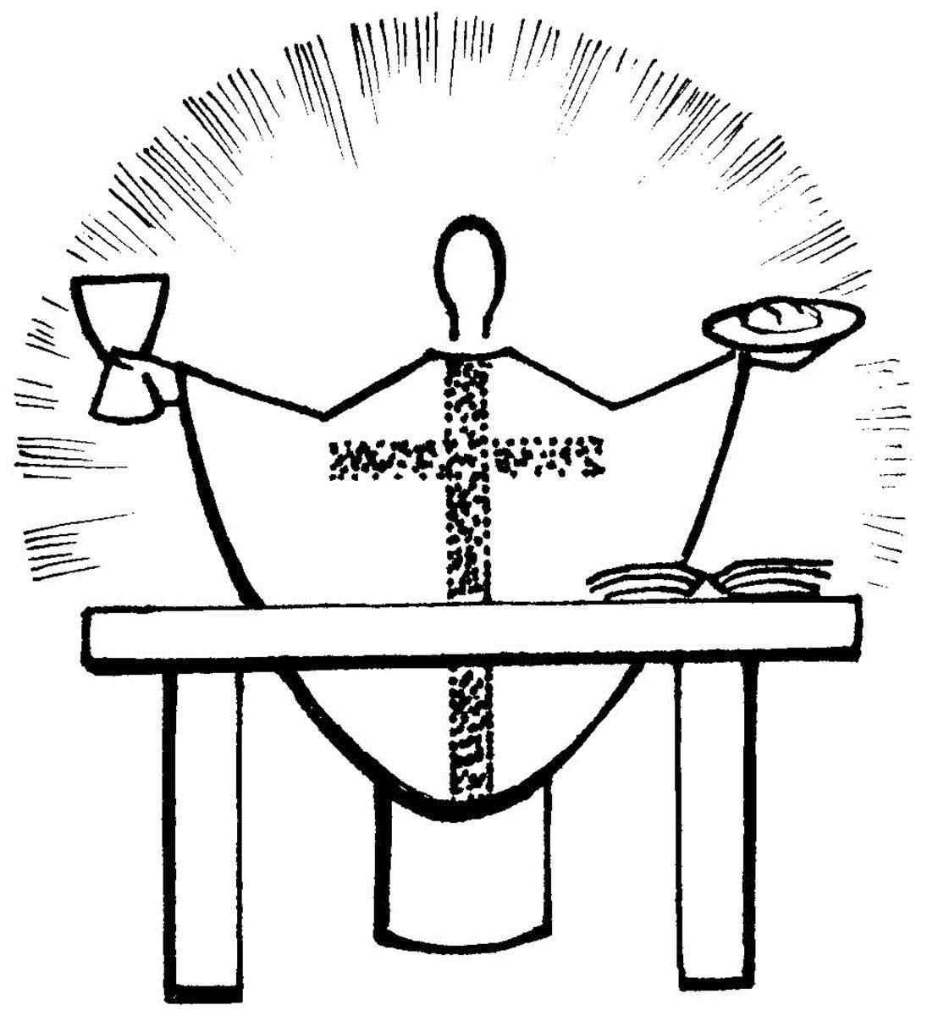
My
Thought for the Weekend:
Feast of Corpus Christi
Holy Communion is the shortest and safest way to Heaven.
— Pope Saint Pius X
Although we can not receive Holy Communion at this time, we invite you to make a spiritual communion this weekend:
Jesus, I believe that You are present in the Most Holy Sacrament.
I love You above all things, and I desire to receive You into my soul.
Since I cannot at this moment receive You sacramentally, come at least spiritually into my heart. I embrace You as if You were already there and unite myself wholly to You. Never permit me to be separated from You. Amen.
Prayer of St Alphonsus

