Slide 1
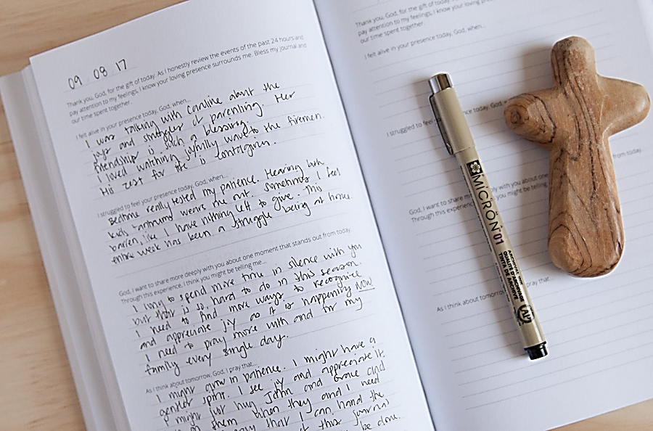
Finding God in school and each other
We believe we can find God in all places and in all things.
That means that our school is full of opportunities to meet God.
Ask yourself the question where you find God and try and pay special attention this week where and how this could happen in school.
This week’s prayers are prepared by Upton Hall FCJ

Slide 2
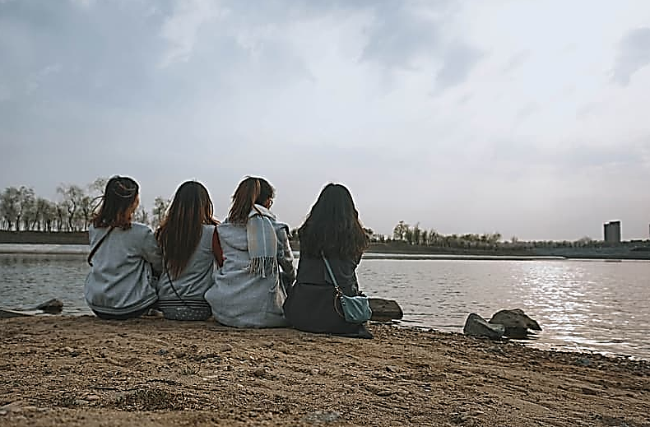
Monday 7th September
Sunday Gospel reading (after MSG Mt18, 15-20)
“If someone hurts you, go and tell her - work it out between the two of you. If she listens, you’ve made a friend. If she won’t listen, take one or two others along so that the presence of witnesses will keep things honest, and try again. If she still won’t listen, tell the church (or an adult). If she won’t listen, you’ll have to start over from scratch, confront her with the need for repentance, and offer again God’s forgiving love.
“Take this most seriously: A yes on earth is yes in heaven; a no on earth is no in heaven. What you say to one another is eternal. I mean this. When two of you get together on anything at all on earth and make a prayer of it, my Father in heaven goes into action. And when two or three of you are together because of me, you can be sure that I’ll be there.”
Pause for thought:
Is there anyone I need to forgive or do I seek someone’s forgiveness?
What does it mean to you that God is in our midst when two or three are gathered in His name?

Slide 3
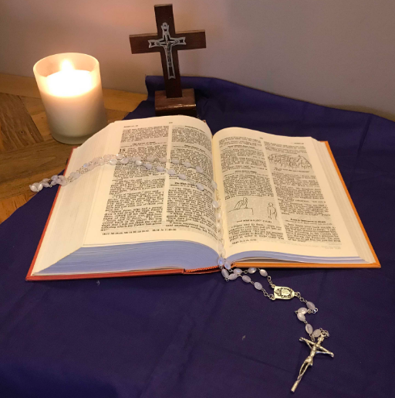
Monday 7th September
Have your supplies ready.
With school, it’s backpacks, notebooks (spiral or computer kind), pencils, and crayons. For finding God, it might be a notebook for reflective journaling, a helpful website for information, or a favourite prayer. We can meet God with nothing, but sometimes it helps to have a few guides on the journey.
Do you have a favourite prayer?
Share some in class and write your personal favourite one in your journal.
May the Lord bless us and keep us from all evil and lead us to everlasting life. Amen.

Slide 4
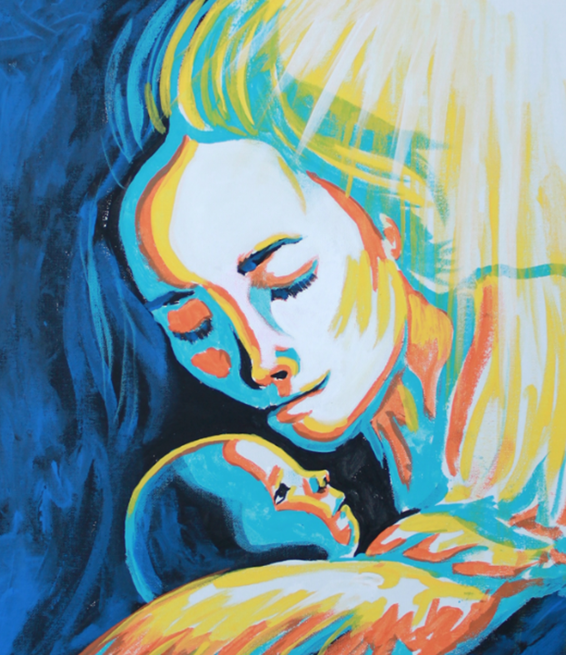
Tuesday 8th September
Celebration of the birth of Mary
Loving God,
We give thanks for Mary, the Mother of Jesus,
for her generosity throughout her life, for her care,
For her example of love.
May she be a model to us as we try and love you
and all our neighbours more perfectly.
Grant this through Christ our Lord.
Amen.

Slide 5
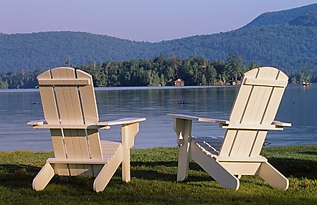
Tuesday 8th September
Do your homework.
A faith life entails more than going to mass occasionally. We need to do some work
between -daily prayer being the most important. A relationship with God also grows from
time spent in learning more about our faith, whether in RE lessons or conversations with other
people of faith, or private time in reading and personal prayer.
Think of Jesus as a friend, who you want to get to know better.
Jesus, You love me always and care for me. You are with me in my trials, my troubles, my temptations, my sorrows and my joys. You are the strength of my life.
I pray that I may welcome you into my heart no matter what is going on in me.
Amen.

Slide 6
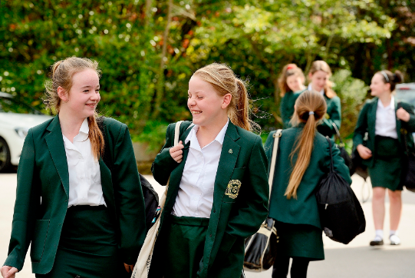
Wednesday 9th September
Meet new people.
The new school year is always a great chance to make new friends.
God can show Himself through the kindness of others.
Loving God,
Bless my life with the gift of friendship.
For those who have chosen to be my friends I am grateful. Let our love, respect and affection for each other flourish.
Make me a good friend, one who is loyal and caring and ready to forgive.
Help me to make new friends and be a good companion to all.
Amen.

Slide 7
Wednesday 9th September
Dedicate time in your day. The school day is marked by a schedule. God doesn’t require a strict
schedule from us, but we have to make the time for God in the midst of our overcrowded days if
we want to recognize God more easily in the everyday. God can show himself in the most ordinary
things.
The Orange
At lunchtime I bought a huge orange—
The size of it made us all laugh.
I peeled it and shared it with Robert and Dave—
They got quarters and I had a half.
And that orange, it made me so happy,
As ordinary things often do
Just lately. The shopping. A walk in the park.
This is peace and contentment. It’s new.
The rest of the day was quite easy.
I did all the jobs on my list
And enjoyed them and had some time over.
I love you. I’m glad I exist.
— Wendy Cope
Dear God,
Open my eyes, my ears and my heart. Help me to pay attention to notice what is going on around me so I don’t miss the chance to encounter you, whether it is in a friendly smile, a chat, sharing lunch, a beautiful flower, cute cat or something else…
We pray through Jesus Christ. Amen.

Slide 8
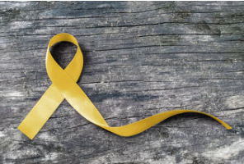
Thursday 10th September
World suicide prevention day
God of the valleys
God of the shadows
God of the pit of despair
We claim your Holy Presence everywhere.
When we see hope dimly, You are there.
When we see life fading, You are there.
When we see life end, You are there.
We pray this day for all who experience suffering because of suicide.
For those who are thinking about suicide,
For those who are recovering from suicide engagement,
For all who fear suicide will touch them,
For all who have known the pain caused by suicide,
Grant us peace.
We pray for the arms of HOPE to enfold all of us, like a soft blanket wrapped
around us, holding our pain, holding our loneliness, holding our sorrow.
Hold onto us, God of love, even when we want to let go. Hold onto us. Amen.

Slide 9
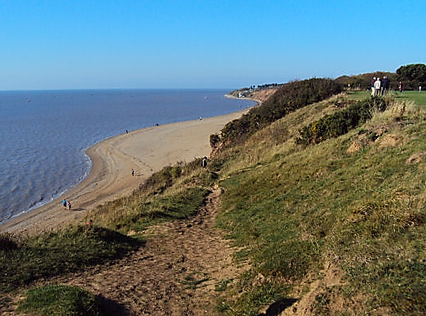
Thursday 10th September
Take a break: Step away from the ordinary to get a fresh perspective.
September is creation month and an excellent place to find God is in the beauty
of nature! Go for a walk or bike ride and pay attention to what’s around you.
Loving Father, Mother and Creator of all, we come to you grateful for your creation.
As we look around us we are amazed at the greatness of all that you have made.
Nature around us speaks of you — the vast expanse of the sky, the mountains, trees, lakes,
and streams…
You have given us such beauty in the colours of the rainbow, the beauty of flowers and fields.
Words cannot express the magnificence of all you have created.
May we show our love and reverence to you, our Lord, by caring for all that you have created.
We humbly give you praise and thanks. Amen.

Slide 10
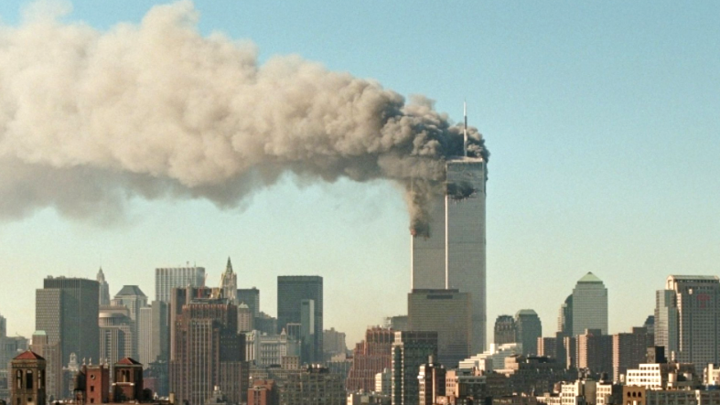
Friday 11th September
God of love,
We place in your loving arms the thousands of innocent lives that were lost on that unforgettable morning of September 11, 2001. We also remember the courage of the countless men and women who put their lives at risk in order to rescue and care for the victims. Help us to continue to work for a world free from every form of hatred, violence and ignorance. May terrorism -- in all its forms -- disappear from the face of the earth.
Amen.
Scenes of conflict, atrocities and crime fill our television screens and newspapers, but remember, even on the darkest day, ‘God’s faithfulness will never fail, nor will he ever withdraw his love’ (Marie Madeleine).
- From The Faithfulness of God

Slide 11
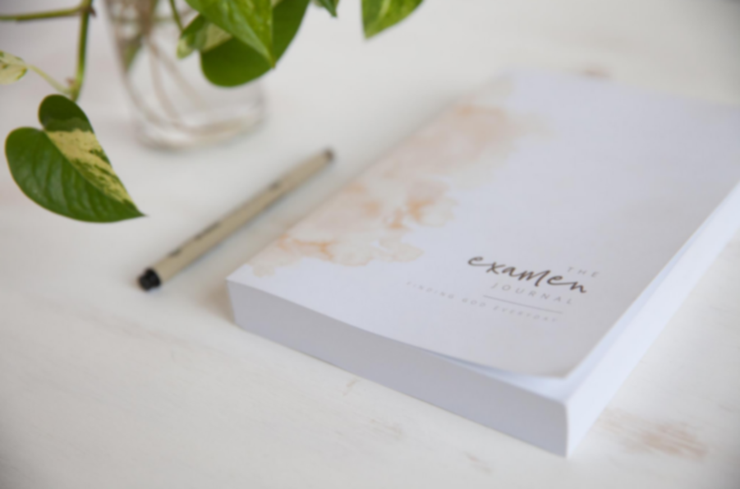
Friday 11th September
Pay attention. To recognize God’s presence, we have to pay attention to the ways—
both big and small—that God is working in our lives and calling us to be our best selves.
The Examen prayer is an excellent way to help us with this.
Be silent and place yourself in God’s loving presence. Think about the good things that have happened this week and give thanks.​
Who have you left a good memory with this week?
Look back over your week. Where have you felt joy and what has been difficult and challenged you? In the quiet of your heart, tell God about your experiences.​ Give thanks for who you are.
As you look ahead, with what spirit will you enter next week?
Ask God to help you.
FCJ sisters pray the examen every day

