Slide 1
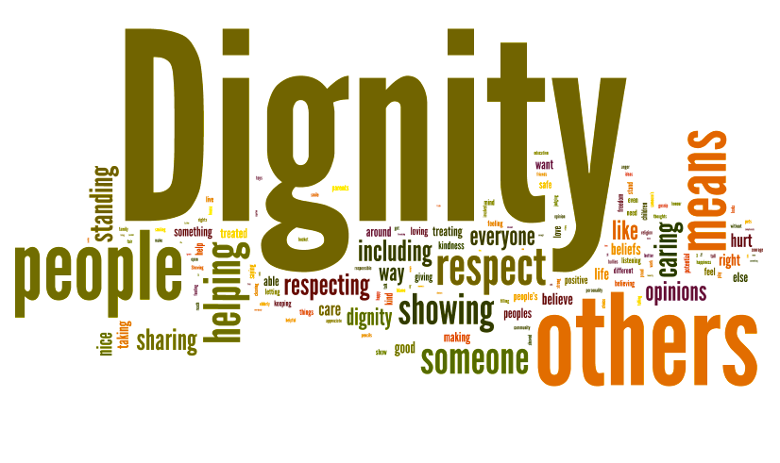
Dignity: It is of the essence that the dignity of each person is recognised, as that of a human being made in the image of God. Everyone is genuinely listened to and what they say is heard.
- Anti-bullying week: ‘One kind word’
- w/c 15th November

Slide 2
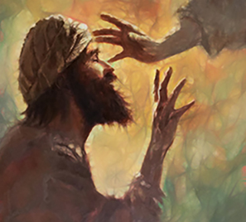
Monday 15th November
Sunday Gospel Luke 18:35-43
Now it happened that as he drew near to Jericho there was a blind man sitting at the side of the road begging. When he heard the crowd going past he asked what it was all about, and they told him that Jesus the Nazarene was passing by.
So he called out, 'Jesus, Son of David, have pity on me.' The people in front scolded him and told him to keep quiet, but he only shouted all the louder, 'Son of David, have pity on me.'
Jesus stopped and ordered them to bring the man to him, and when he came up, asked him, 'What do you want me to do for you?'
'Sir,' he replied, 'let me see again.' Jesus said to him, 'Receive your sight. Your faith has saved you.'
And instantly his sight returned and he followed him praising God, and all the people who saw it gave praise to God."
Pause for thought:
What do you need most? Does it require some courage to pursue this?

Slide 3
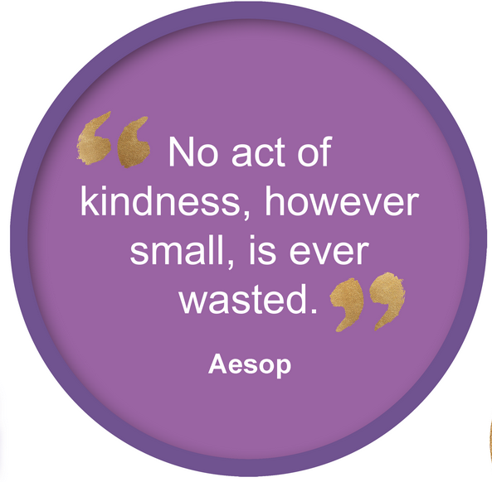
Monday 15th November
Watch: ‘One Kind Word’ (Anti-Bullying theme 2021, 1 min)
https://www.youtube.com/watch?v=4vqMM3fcJGE
God of Love,
We pray for those who sometimes bully others In school, online, or to and from school.
Give them the grace to understand the harm they are causing, To themselves as much as other people.
Give them the grace to break out of the cycle of bullying, To see things from the point of view of those they hurt, To have the courage to be reconciled, to say sorry.
God of peace,
We pray for those who are sometimes bullied by others In school, online or to and from school.
Give them the grace to break out of the cycle of bullying by telling someone they trust what is going on and to speak honestly about how they feel so those who bully will learn and grow.
Amen.

Slide 4
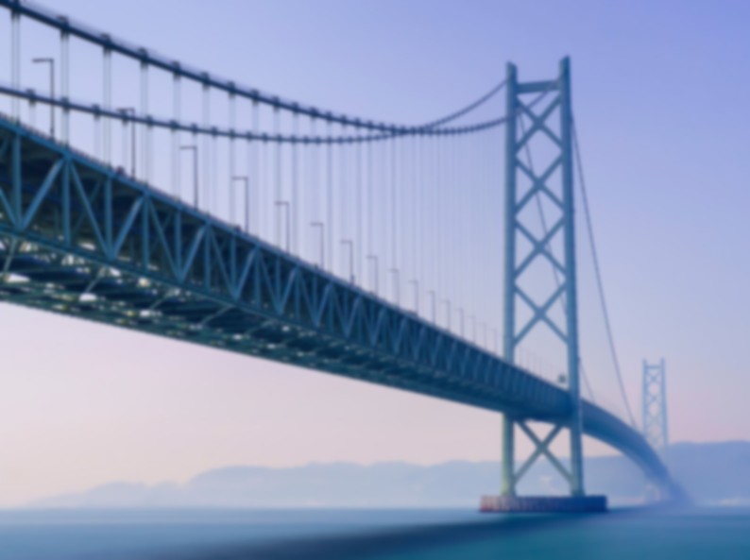
Tuesday 16th November
Loving God
We are all equal as human beings: sister and brother, employer and employee, teacher and student, equally loved before God.
Yet, our system discriminates based on education, abilities, race, luck, …
and many of God’s children are placed into a hierarchy of inequality and discomfort.
We are called to stretch out our arms between the tiny, exclusive tip and the broad, platform of the masses.
To form a bridge, to create a way for those made unequal to come together as one in equality, in human dignity.
Loving God, Creator of dignity and all that lives, help us be bridges.
Help us cry out for respect and value for all when society forgets that at in our most basic nature, we are all God’s children.
Amen.
(— By Jill Rauh, Education for Justice)

Slide 5
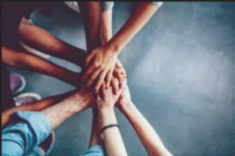
Tuesday 16th November
Dear God, Our Father,
We thank you for our lives.
We thank you for making each one of us a unique person.
We thank you for each other.
We thank you for the many gifts you have given us.
Help us to see the gifts of other people.
Help us to share our gifts with each other.
Help us to care for each other the way you care for us.
Amen.

Slide 6
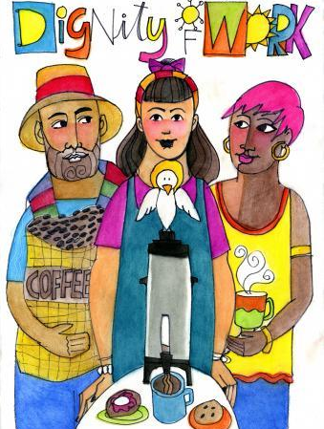
Wednesday 17th November
We pray for workers everywhere, that they will be able to take pride in the work they do, be treated with dignity and receive a fair wage in return for their labour.
Lord in your mercy, hear our prayer.
We pray for employers, that they will be motivated by compassion and a concern for the common good leading them to value people more than profit.
Lord in your mercy, hear our prayer.
We pray for decision makers and world leaders, that they will use the power they have for the good of all peoples.
Lord in your mercy, hear our prayer.
We pray for ourselves, that we may take time to reflect on our own talents and share our gifts to benefit our community and wider world.
Lord in your mercy, hear our prayer.
(— By Sophie Stanes, CAFOD)

Slide 7
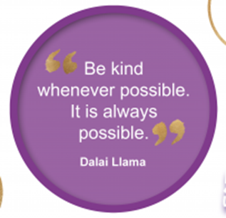
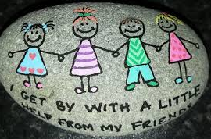
Wednesday 17th November
Dear Lord,
We ask that you would help us to make sure everyone belongs, in our thoughts, in our words and in our actions. We were all made in the image of You. You love us as we are your creation. May we always remember that you are in all of us. Teach us to accept and include everyone we meet, appreciate any differences; welcome all, no matter what they look like or where they live. We ask this through your Son, Jesus Christ, our friend and teacher, who receives all, loves all and embraces all.
Amen.

Slide 8
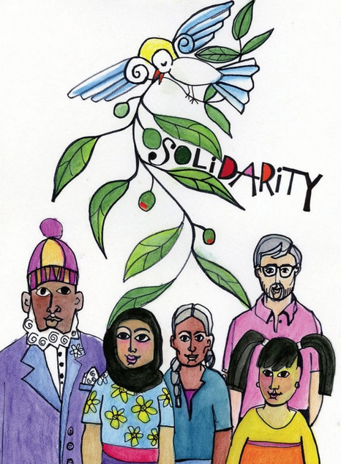
Thursday 18th November
God of faith, we believe in you.
God of hope, we place our trust in you.
God of love, we give you our hearts, our minds, our souls.
We are your people, members of your family.
We are brothers and sisters, living in every part of your world.
You ask us to believe in each other, as you believe in us.
You as us to trust in each other, as you trust in us.
Help us to build a world filled with your goodness and your care.
Help us to see the needs of all our brothers and sisters, and respond generously.
Help us to be a light for the world.
Amen.

Slide 9
Thursday 18th November
The FCJ values of Companionship, Dignity, Excellence, Justice, Gentleness and Hope are antidotes against bullying.
Lord,
The new day lies open before us; let us pray with one heart and mind. As we rejoice in the gift of this new day, may the light of your presence set our hearts on fire with love for you. Give us the gift of gentleness and kindness, and help us to treat everybody we meet today with love and respect.
We make this prayer through Christ our Lord.
Amen.

Slide 10
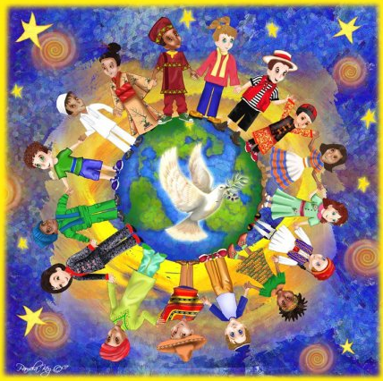
Friday 19th November
God made each person, so every life is important and should be protected.
I thank you, Lord, for the precious gift of my body. Whatever its strengths or limitations; help me always to see it as your gift.
As I marvel at the wonder of your creation, may the whole human family work together to protect creation and especially the precious gift of human life, from conception to death.
Enable us by your grace to promote the well-being and dignity of every person, serving you and the gospel of life in a spirit of generosity, faith and love, through Christ Jesus our Lord.
Amen.

Slide 11
Friday 19th November
Examen
Be silent and place yourself in God’s loving presence. Think about the good things that have happened and give thanks for who you are.​
Look back over your week. Where have you felt joy and what has been difficult and challenged you? In the quiet of your heart, tell God about your experiences.​
As you look ahead, with what spirit will you enter next week?
Ask God to help you.

