Slide 1
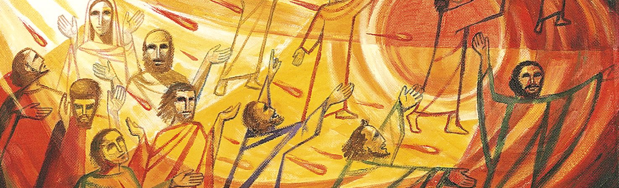
W/C 1st June 2020
This week’s theme is Pentecost. On Sunday 31st May, the Church celebrated the feast of Pentecost and this marks the end of the season of Easter.
Pentecost is a very joyful celebration as it celebrates the birthday of the Church, the day the disciples went out to tell everyone about the Good News of Jesus Christ, guided by the Holy Spirit

Slide 2
Monday 1st June
Acts of the Apostles 2:1-31
When Pentecost, the fiftieth day after Passover, came, all the believers were together in one place. Suddenly, a sound like a violently blowing wind came from the sky and filled the whole house where they were staying. Tongues that looked like fire appeared to them. The tongues arranged themselves so that one came to rest on each believer. All the believers were filled with the Holy Spirit and began to speak in other languages as the Spirit gave them the ability to speak.
Devout Jews from every nation were living in Jerusalem. They gathered when they heard the wind. Each person was startled to recognize their own dialect when the disciples spoke.
Stunned and amazed, the people in the crowd said, “All of these men who are speaking are Galileans. Why do we hear them speaking in our native dialects? We’re Parthians, Medes, and Elamites. We’re people from Mesopotamia, Judea, Cappadocia, Pontus, the province of Asia, Phrygia, Pamphylia, Egypt, and the country near Cyrene in Libya. We’re Jewish people, converts to Judaism, and visitors from Rome, Crete, and Arabia. We hear these men in our own languages as they tell about the miracles that God has done.”
All of these devout people were stunned and puzzled. They asked each other, “What can this mean?” Others said jokingly, “They’re drunk on sweet wine.”

Slide 3
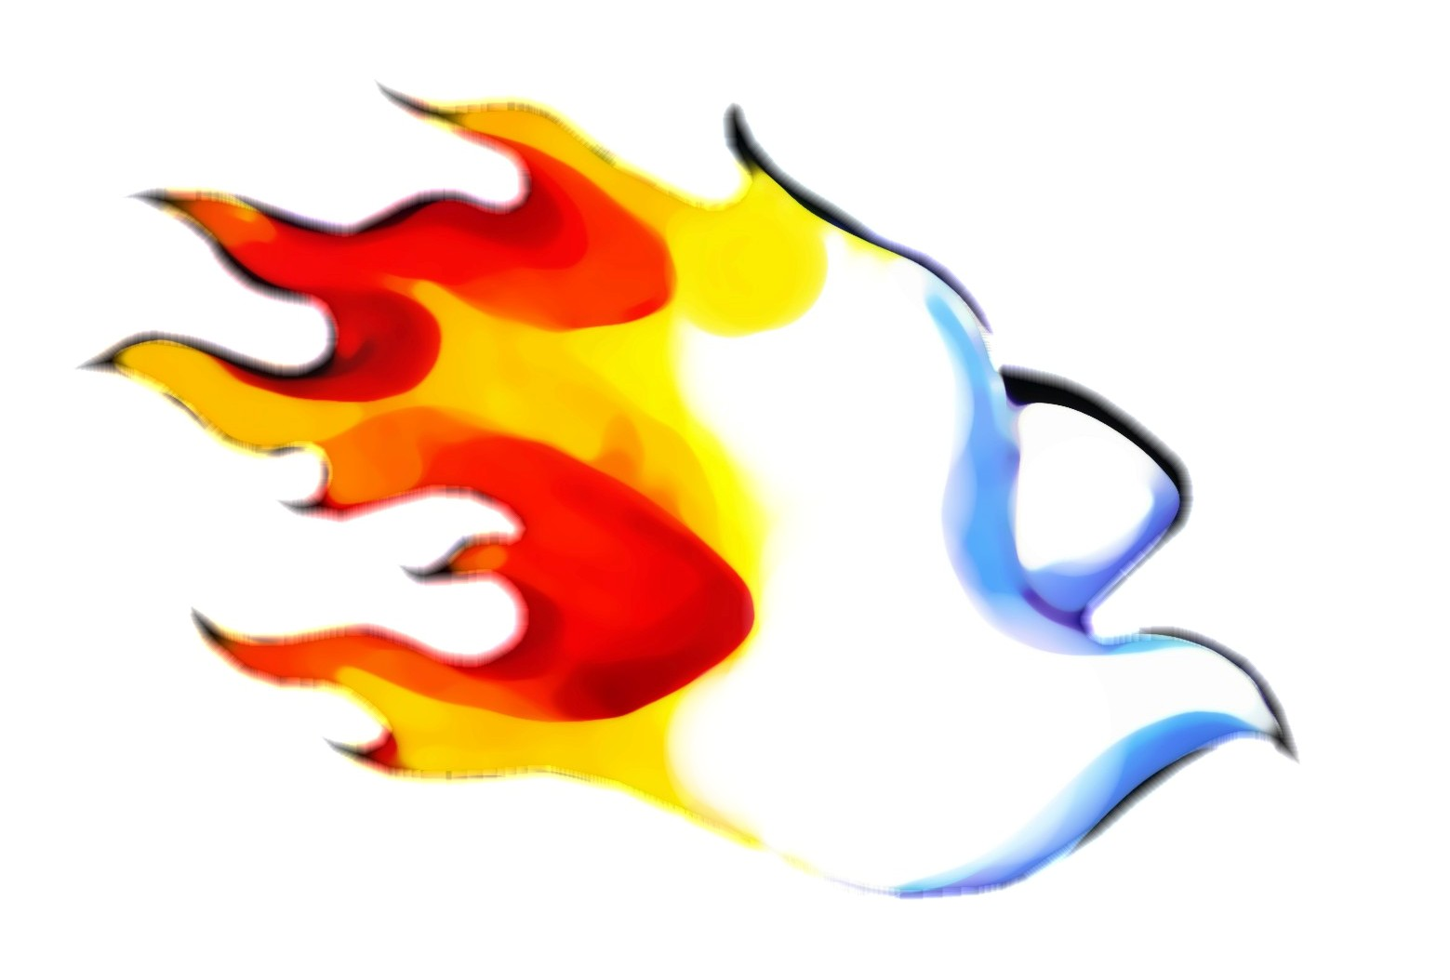
Prayer…
Lord, we thank you for our half term and our time of rest.
We pray as we start the end of our final term that your Holy Spirit will renew us and give us the energy and strength to face whatever comes our way.
Give us a fresh heart this term for you and those around us.
Amen
Come, Holy Spirit, fill the hearts of your faithful and enkindle in them the fire of your love.

Slide 4
Tuesday 2nd June
The coming of the Holy Spirit at Pentecost made a darkened world alive with the fullness of light and love, calling us to reap together the harvest of life
FCJ Faithfulness of God Prayer Book

Slide 5
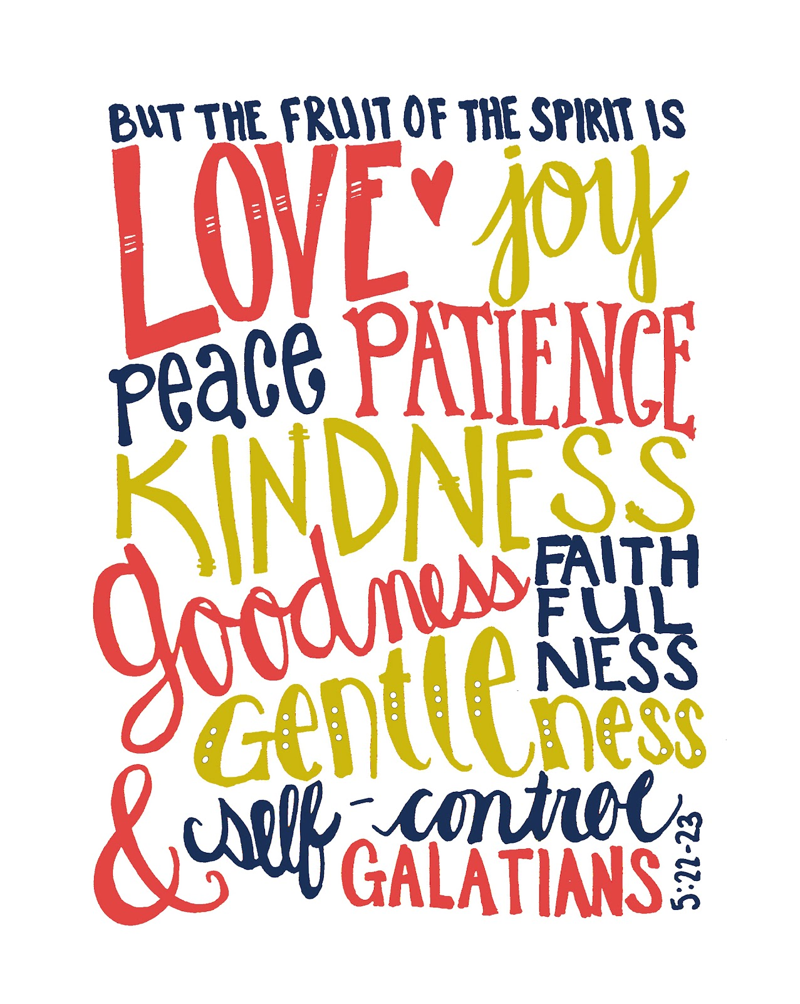
Wednesday 3rd June
We receive from the Holy Spirit, gifts and fruits.
What fruit do you need more of today? Ask God specifically to fill you afresh with this gift today.

Slide 6
Thursday 4th June
God of power, may the boldness of your Spirit transform us, may the gentleness of your Spirit lead us, may the gifts of your Spirit be our goal and our strength, now and always.
Amen
Come, Holy Spirit, fill the hearts of your faithful and enkindle in them the fire of your love.

Slide 7
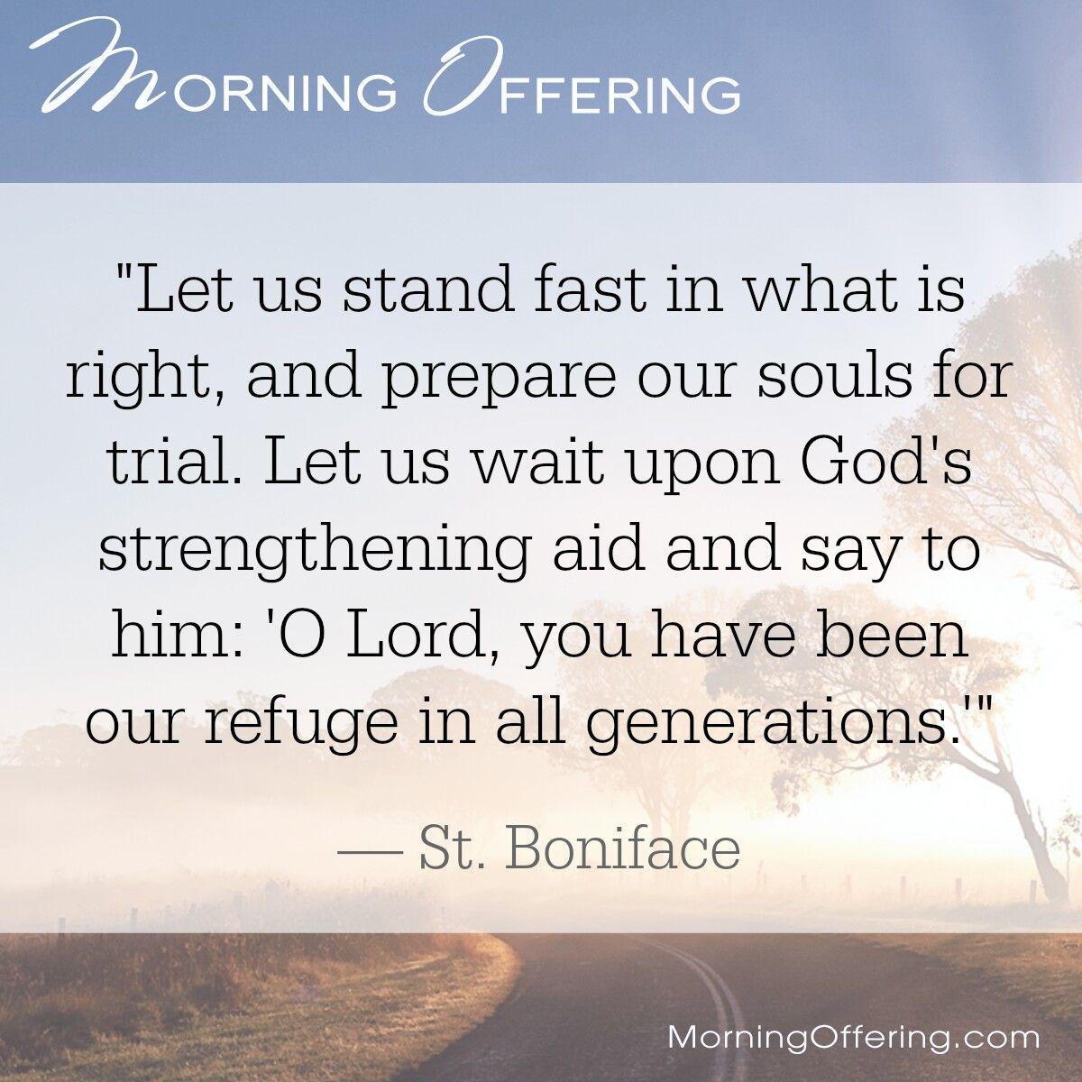
Friday 5th June
St Boniface was an English monk (672-754 AD) and is known as the Apostle of Germany because he organised the Church there in the 8th century

Slide 8
Friday 5th June: Examen
Be silent and place yourself in God’s loving presence. Think about the good things that have
happened this week and give thanks.​
Who have you left a good memory with this week?
Look back over your week. Where have you felt joy and what has been difficult and challenged
you? In the quiet of your heart, tell God about your experiences.​ Give thanks for who you are.
As you look ahead, with what spirit will you enter next week?
Ask God to help you.

Slide 9
Thought for the Weekend:
On Trinity Sunday in 1817 Marie Madeline made her vow of chastity. She said ‘Quite suddenly and unexpectedly it was made known to me that God wished me to make the vow of chastity there and then, in his presence. What was asked of me appeared so clear and positive, that in spite of the strong natural aversion I had felt up till then, I no longer had the slightest objection... I readily and joyfully made the vow.’
What beautiful words… how will you be inspired by God today? What promise is God asking you to make him today, it could be small or big, but no matter what, say your yes readily and joyfully!

