Slide 1
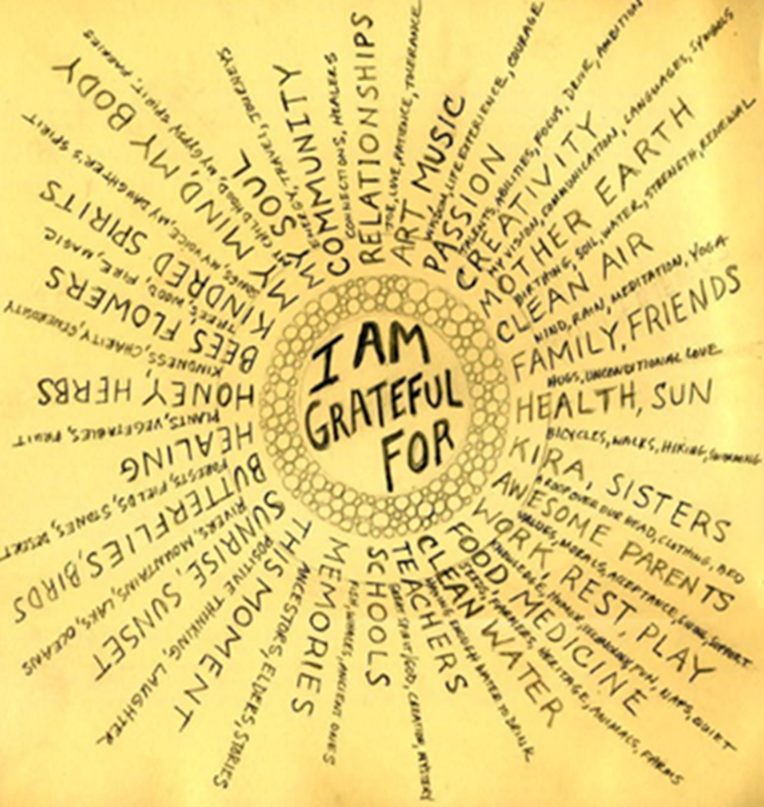
GRATITUDE
This week we give thanks for all the good we have received
If the only prayer you ever say in your entire life is Thank You that will be enough.
Meister Eckhart (13th Century)
Week commencing 4th July 2022

Slide 2
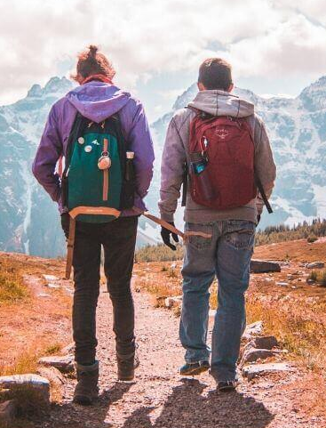
Monday 4th July
SUNDAY READING: Luke 10, 1-9
After this the Lord appointed seventy-two others and sent them out ahead of him in pairs, to all the towns and places he himself would be visiting. And he said to them, 'The harvest is rich but the labourers are few, so ask the Lord of the harvest to send labourers to do his harvesting. Start off now, but look, I am sending you out like lambs among wolves. Take no purse with you, no haversack, no sandals. Salute no one on the road. Whatever house you enter, let your first words be, "Peace to this house!" And if a man of peace lives there, your peace will go and rest on him; if not, it will come back to you. Stay in the same house, taking what food and drink they have to offer, for the labourer deserves his wages; do not move from house to house. Whenever you go into a town where they make you welcome, eat what is put before you. Cure those in it who are sick, and say, "The kingdom of God is very near to you."
Pause for thought: do you think it’s foolish to take few things and trust in God’s providence and the kindness of strangers or would you be willing to take such a risk?

Slide 3
Monday 4th July
Loving Lord,
As I express my gratitude to you in prayer, may it be a pleasing, joyful sound to you.
Thank you, Lord, for your love. It brings me acceptance and significance.
Thank you, Lord, for your truth. It brings me guidance and direction.
Thank you, Lord, for your mercy. It brings me help and comfort.
Thank you, Lord, for your faithfulness. It brings me stability and strength.
Thank you, Lord, for your beauty displayed in the earth. It brings me joy and delight.
Thank you, Lord, for your way of redemption - the cross. Amen.
By Beth McLendon of Inspirational-prayers.com

Slide 4
Tuesday 5th July
For the expanding grandeur of creation, worlds known and unknown, galaxies beyond galaxies, filling us with awe and challenging our imaginations: We give thanks this day. For this fragile planet earth, its times and tides, its sunsets and seasons: We give thanks this day. For the joy of human life, its wonders and surprises, its hopes and achievements: We give thanks this day. For our human community, our common past and future hope, our oneness transcending all separation, our capacity to work for peace and justice in the midst of hostility and oppression: We give thanks this day. For high hopes and noble causes, for faith without fanaticism, for understanding of views not shared: We give thanks this day. For all who have laboured and suffered for a fairer world, who have lived so that others might live in dignity and freedom: We give thanks this day. For human liberty and sacred rites; for opportunities to change and grow, to affirm and choose: We give thanks this day. We pray that we may live not by our fears but by our hopes, not by our words but by our deeds. We give thanks this day.
- O. Eugene Pickett

Slide 5
Tuesday 5th July
Remembering Others
O God, when I have food, help me to remember the hungry; When I have work, help me to remember the jobless; When I have a home, help me to remember those who have no home at all; When I am without pain, help me to remember those who suffer, And remembering, help me to destroy my complacency;
Stir my compassion, and be concerned enough to help; By word and deed, those who cry out for what we take for granted.
Amen.

Slide 6
Wednesday 6th July
Listen to this Taize song: In the Lord I’ll be ever thankful (3 mins)
https://www.youtube.com/watch?v=m4-dnOrdJrs
In the Lord I'll be ever thankful, In the Lord I'll rejoice. Look to God, do not be afraid, Lift up your voices, the Lord is near; Lift up your voices the Lord is near.
What are some of the things you are grateful for?

Slide 7
Wednesday 6th July
Loving Creator, We asked for strength, and you gave us difficulties to make us strong. We asked for wisdom, and you gave us problems to solve. We asked for prosperity, and you gave us purpose and brains to use. We asked for courage, and you gave us fears to overcome. We asked for patience, and you gave us situations where we were forced to wait. We asked for love, and you gave us troubled people to help. We asked for justice, and you called us to be just
and to lead with integrity. Lord, we have received nothing that we asked for or wanted. And yet, we received everything that we needed. For this, we give thanks.
Amen.

Slide 8
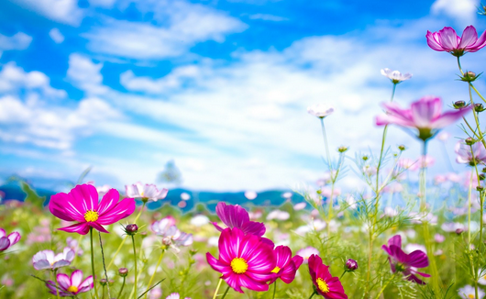
Thursday 7th July
‘The natural world is not a possession to be seized but a gift to be received with gratitude and reverence’
(FCJ The Faithfulness Of God Book)
Think about creation for a moment,
What’s your favourite thing?
Thank God for this today.

Slide 9
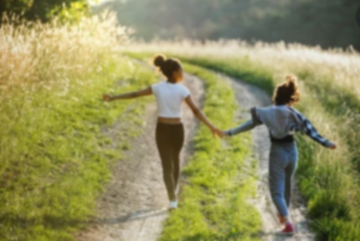
Thursday 7th July
A Prayer to Begin Summer
For more light in the day, we thank you,
For gentle mornings, we thank you,
For night time conversations, we thank you,
For friends and family, we thank you,
For gardens and all manner of creatures, we thank you.
Help us, Creator and lover of our souls.
Help us love this earth.
Help us to live in the present moment.
Help us pray as we walk, work, play, rest, and create.
Amen.

Slide 10
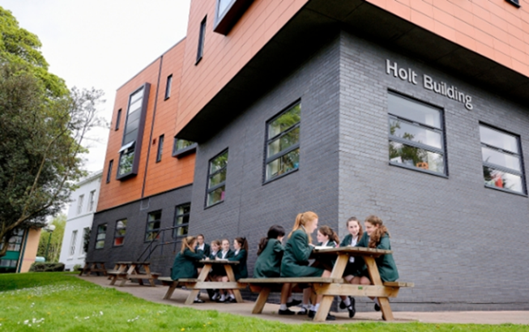
Friday 8th July
Dear God,
We thank you for all that we have enjoyed at Upton this year. The lessons, our teachers, the clubs and the excursions, the food in the dining room, the beautiful environment, the support we received during lockdown and the joy of friendship.
We thank you that we have been given the chance to make a difference in the world by fundraising and donating to many good and worthwhile causes. May we never stop trying to find ways to make the world a better place.
Help us never to take for granted the many gifts we have been given and the richness of the lives that we live.
We make this prayer through Christ our Lord.
Amen.

Slide 11
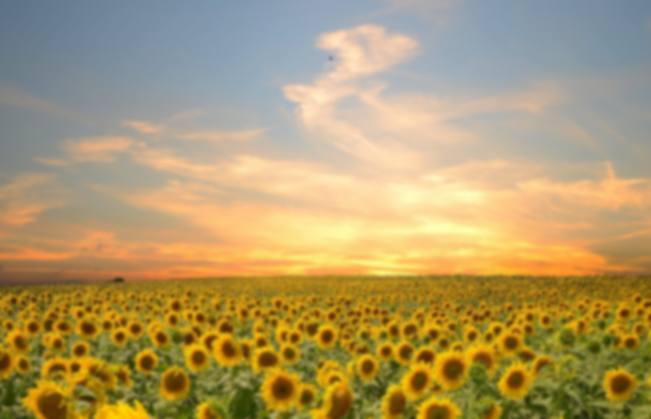
Friday 8th July:
Be silent and place yourself in God’s loving presence. Think about the good things that have
happened this week and give thanks.​
Who have you left a good memory with this week?
Look back over your week. What were the joys, what were the challenges
As you look ahead, with what spirit will you enter next week?
Ask God to help you.

