Slide 1
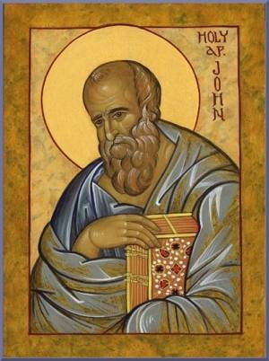


Prayers for the week
12 - 16 March 2018
The Sunday Gospel this week is taken from the writings of St John. In Chapter 3 of the Gospel, these words, spoken by Jesus, are quoted:
The man who lives by truth comes out into the light,
so that it may be plainly seen that what he does
is done in God.
Since these words were written 2000 years ago many men and women have lived by this truth. Our prayers this week are inspired by five people who have come to exemplify this way of living in the light of God. They provide both an example and a challenge to us in 2018. One of them is our foundress, another
a former pupil of Upton Hall.
It is the fundraising week for Year 10

Slide 2

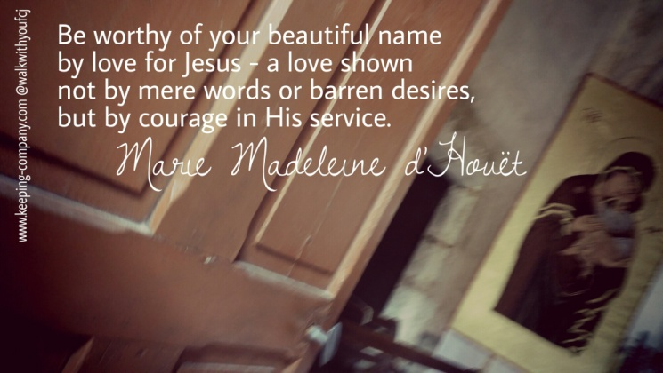

Monday 12 March
Marie Madeleine D’Houet (1781 – 1858) was the foundress of the FCJ Society and of our school. Marie Madeleine was a French widow and single mother who, later in her life, was inspired by zeal and love for God and guided by Ignatian spirituality to found a religious society known as the Faithful Companions of Jesus. The mission of the sisters is to work to help and to educate the poor and needy of society. The FCJ sisters live and work in the UK and Ireland and in countries around the world. They run schools and support social service operations. Our local community of FCJ sisters live in St Joseph’s parish in Birkenhead.
God our creator, Jesus our companion, Holy Spirit source of wisdom
Marie Madeleine believed in your power, hoped in your promises and lived for your glory and service. We ask her to pray with us for all members of our school community. Through her prayer may your presence be shown and your name be glorified.
We make this prayer through Christ our Lord
Amen

Slide 3
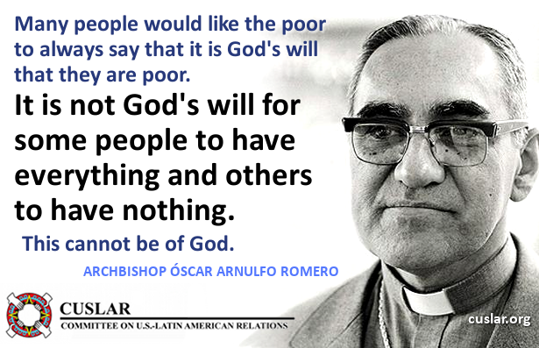
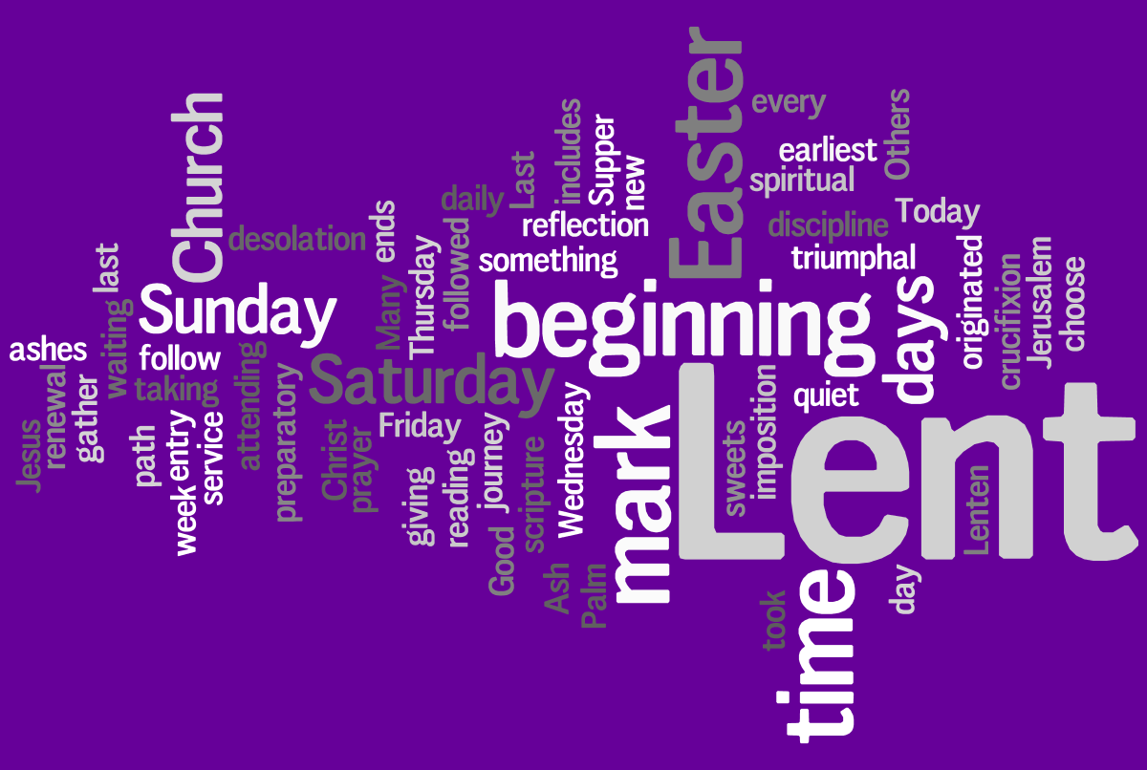
Tuesday 13 March
Óscar Romero (1917 – 1980) was a priest of the Catholic Church in El Salvador, who served as the fourth Archbishop of San Salvador. He spoke out against poverty, social injustice, murder, and torture. In 1980, Romero was assassinated while offering Mass in the chapel of the Hospital of Divine Providence. No one was ever convicted of his murder. Romero actively denounced violations of the human rights of the most vulnerable people and defended the principles of protecting lives, promoting human dignity and opposing all forms of violence. Just last week, Pope Francis recognised that Óscar Romero should be made a saint of the Catholic Church.
Archbishop Oscar Romero
Lord Jesus,
We give thanks for the life of Blessed Óscar Romero
who spread your message and fought against injustice in El Salvador.
Like you, he was a shepherd, a pastor and a teacher. We ask that throughout our lives we will be blessed and guided by wise and caring teachers.
Spirit of hope, work within us, just as you worked in Blessed Óscar Romero.
May we too strive for justice and spread the Good News,
by living out the Gospel, in solidarity with those living in poverty.
Amen.

Slide 4
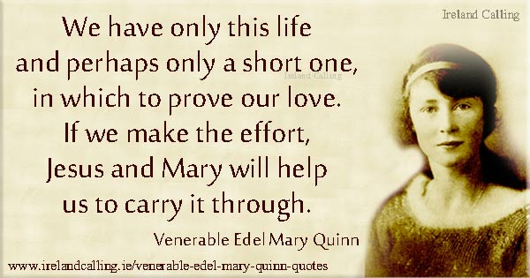

Wednesday 14 March
Venerable Edel Quinn
Born in Ireland in 1907, Edel Quinn felt a call to religious life at a young age. When she was 20 she joined the Legion of Mary in Dublin. She gave herself completely to its work in the form of helping the poor in the slums of Dublin. In 1936, aged 29 and seriously ill with tuberculosis, Edel became a Legion of Mary Envoy and a very active missionary in Kenya. Edel settled in Nairobi and in seven and a half years in Africa she established hundreds of Legion branches and councils in Tanzania, Kenya, Uganda, Malawi, and Mauritius.
Throughout this time her health was never good and in May 1944 she died in Kenya. She is buried in the capital Nairobi in the Missionaries' Cemetery. The cause for her beatification was introduced in 1956. She was declared venerable by Pope John Paul II in 1994, since when the campaign for her beatification has continued. Edel Quinn is a former pupil of Upton Hall School FCJ. The local nursing home that backs onto our school grounds is named after her.
Eternal Father,
We thank you for the grace you gave to our fellow pupil, Edel Quinn, of striving to live always in the joy of your presence and for devoting her life to working for the benefit of others. Grant us that same generous spirit and loving heart, so that in our own way we may become missionaries of your word. When the span of our life is complete, may we rest like Edel, confident in the knowledge that the world is a better place because we lived in it and lived our lives to the full.
We make this prayer through Christ our Lord
Amen

Slide 5
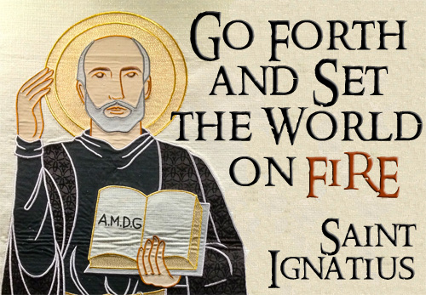
Thursday 15 March
Saint Ignatius of Loyola (1491-1556) was a Spanish Basque priest and theologian, who founded the religious order called the Society of Jesus (Jesuits) and became its first Superior General. The Jesuit order served the Pope as missionaries, they were bound by a vow of special obedience to the Pope in regard to the missions. Ignatius is remembered as a talented spiritual director. He recorded his method in a celebrated treatise called the Spiritual Exercises, a simple set of meditations, prayers, and other spiritual exercises designed to bring people closer to God, first published in 1548. The spirit of St Ignatius was the inspiration for Marie Madeleine. The FCJ society was founded by her based on the guidance and the principles of Ignatian spirituality.
Suscipe (from the Latin word “receive”) is a short but powerful prayer written by St. Ignatius Loyola. It can be found towards the end of his Spiritual Exercises.
Take, O Lord, and receive my entire liberty, my memory, my understanding and my whole will. All that I am and all that I possess, You have given me: I surrender it all to You to be disposed of according to Your will. Give me only Your love and Your grace; with these I will be rich enough and will desire nothing more.
Amen.

Slide 6
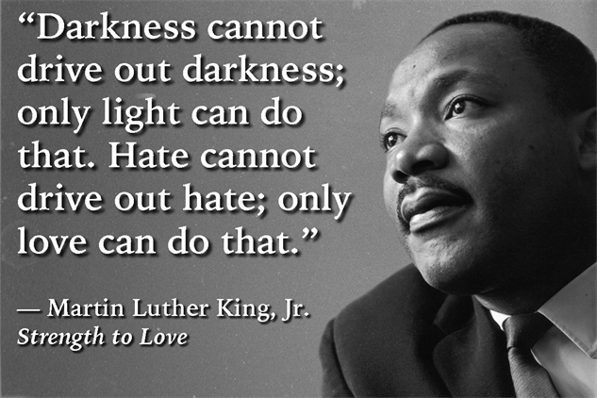
Friday 16 March
Martin Luther King (1929 – 1968) was an American Baptist minister and activist who became the most visible spokesperson and leader in the civil rights movement from 1954 to 1968. He is best known for his role in the advancement of civil rights using the tactics of non-violence and civil disobedience based on his Christian beliefs and inspired by the non-violent activism of Mahatma Gandhi. King became a civil rights activist early in his career. He led the 1955 Montgomery bus boycott and he also helped to organize the 1963 March on Washington, where he delivered his celebrated "I Have a Dream" speech. In 1964, King received the Nobel Peace Prize for combating racial inequality through non-violent resistance. In 1968, King was planning a national occupation of Washington, D.C., to be called the Poor People's Campaign, when he was murdered by a gunman in Memphis, Tennessee. This morning we pray using Martin Luther King’s own words:
Lord
We thank you for your church, founded upon your Word, that challenges us to do more than sing and pray, but go out and work as though the very answer to our prayers depended on us and not upon you. Help us to realise that humanity was created to shine like the stars and live on through all eternity. Keep us, we pray, in perfect peace. Help us to walk together, pray together, sing together and live together until that day when all God’s children - Black, White, Red, Brown and Yellow - will rejoice in one common band of humanity in the reign of our Lord and of our God.
Amen

Slide 7
Afternoon Prayer and Reflection
Lord
Thank you for the morning, for watching over me and walking with me. May I find joy and understanding this afternoon, in all I do. Grant me the zest and the strength I need to work for you until nightfall. Amen
Let us pause for a few moments in silence and remember those family members and friends who need our prayers and support today…………
Let us say together a prayer inspired by Marie Madeleine, but first, the prayer that Jesus taught his disciples:
Our Father who art in heaven, hallowed be thy name. Thy kingdom come. Thy will be done, on earth as it is in heaven. Give us this day our daily bread, and forgive us our trespasses, as we forgive those who trespass against us, and lead us not into temptation but deliver us from evil. Amen
Loving Father, life-giving spirit – Marie Madeleine believed in your power, hoped in your promises and lived for your glory. We ask her to pray for us and be with us as we carry the FCJ spirit into the 21st century. Protect and guide the pupils and staff at Upton and at all FCJ schools in this country and around the world. Amen
May the Lord bless us and keep us from all evil and bring us to everlasting life. Amen

