Slide 1
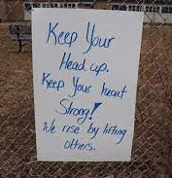
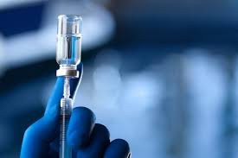
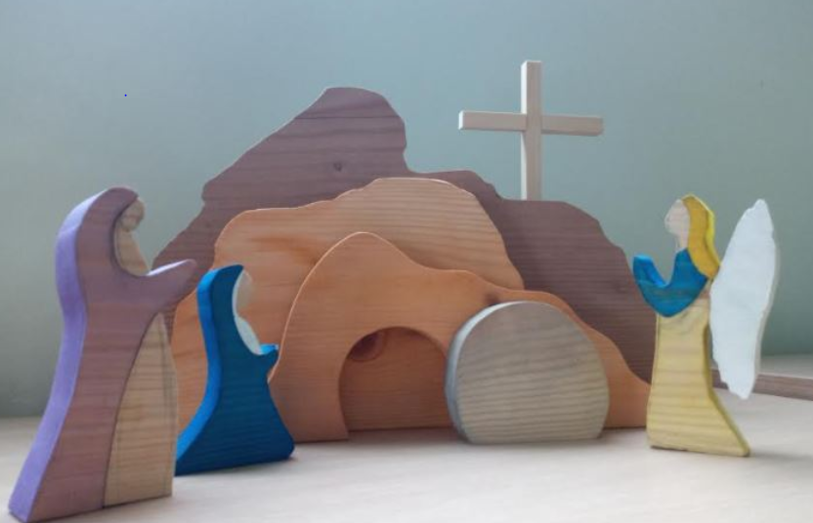
Daily Prayers for FCJ Schools Week beginning Monday April 19th 2021
Prayer Theme for This Week
Signs of hope
&
New life in springtime
Prayers prepared by Gumley FCJ & Upton Hall FCJ
Made by yr 12 Product Design

Slide 2
Sunday’s Gospel: Luke 24:35-48
Monday 19th
The disciples told their story of what had happened on the road and how they had recognised Jesus at the breaking of bread. They were still talking about all this when Jesus himself stood among them and said to them, ‘Peace be with you!’ In a state of alarm and fright, they thought they were seeing a ghost. But he said, ‘Why are you so agitated, and why are these doubts rising in your hearts? Look at my hands and feet; yes, it is I indeed. Touch me and see for yourselves; a ghost has no flesh and bones as you can see I have.’ And as he said this he showed them his hands and feet. Their joy was so great that they still could not believe it, and they stood there dumbfounded; so he said to them, ‘Have you anything here to eat?’ And they offered him a piece of grilled fish, which he took and ate before their eyes. Then he told them, ‘This is what I meant when I said, while I was still with you, that everything written about me in the Law of Moses, in the Prophets and in the Psalms has to be fulfilled.’ He then opened their minds to understand the scriptures, and he said to them, ‘So you see how it is written that the Christ would suffer and on the third day rise from the dead, and that, in his name, repentance for the forgiveness of sins would be preached to all the nations, beginning from Jerusalem. You are witnesses to this.’
Risen Jesus,
When you met your disciples you said “Peace be with you”.
In these days, Lord, we pray especially for the gift of your peace and healing for ourselves and for the whole world.
Sometimes, we cannot find the words for the prayers we want to make,
but we know that you understand what we want to say anyway.
Calm us if feel anxious, support us if we feel confused, comfort us if we feel sad, and help us all to be people of great hope, trusting in your faithful love. We make this prayer in your name, risen Jesus. Amen.

Slide 3
Monday 19th
Dear Lord,
don’t let me miss any opportunities today:
Any opportunity to learn something new.
Any opportunity to help
someone in difficulty.
Any opportunity to show those who
love me that I love them too.
Don’t let me miss any opportunity
to make myself a little better and a
little wiser than I was yesterday.
Amen!
Let’s keep in our prayers as well the pupils of year 11 and 13 as they start this time of assessments.

Slide 4
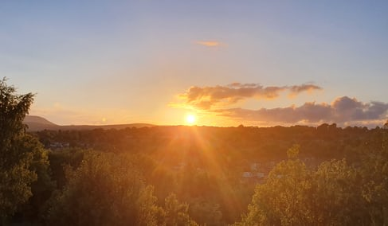
Life can seem very difficult at the moment but even in these difficult times, there are signs of hope all around us.
Can you think of any signs of hope which you have seen
over the last couple of weeks?
You might like to think of these as signs of hope:
Tuesday 20th
Those signs of hope can be for us, signs that God is with us. How might you be a sign of hope for someone you are living with today?
Loving God,
help us to be people of faith, hope and love. Strengthen us if things are difficult and, above all, help us to remember that you are with us always. Amen.

Slide 5
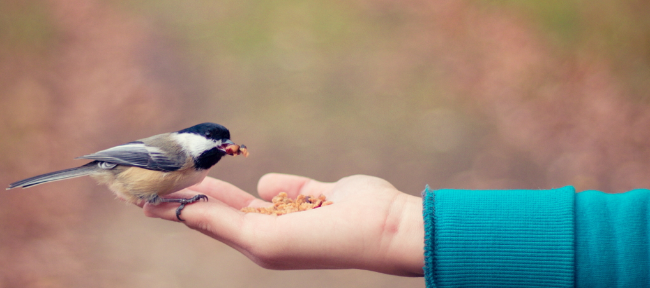
Live a little, enjoy life,
take time to have fun.
God has given us life to live,
to grow in ourselves and with others.
Go out and give yourself to the world
and make the world yours…
The city , the country, the school and the town.
Do not measure the giving of others,
or the way they live their lives.
Leave them in the hands of your God.
Lord teach us to trust your will in our lives,
just as the little birds do…
Amen
Tuesday 20th
“Look at the birds, they
do not plant seeds or gather
a harvest. Yet your Father in
heaven takes care of them”.
Matthew 6:26

Slide 6
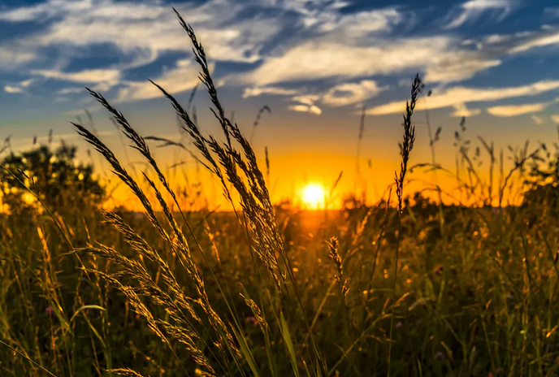
Wednesday 21st April
Loving God,
We thank you for the resurrection of Jesus, and we thank you for the signs of hope and resurrection which we see in the world around us today.
In these days, we pray for all those who are unwell and those who are caring for them.
We think especially of anyone we know ourselves. We pray for healing, peace and hope.
We pray too for all those who have died recently; that they may have eternal life,
and for all those who miss them; that they may be comforted.
Give all of us courage and strength, and help us to be people of hope for one another and our families.
We make these and all our prayers in Jesus’ name. Amen.

Slide 7
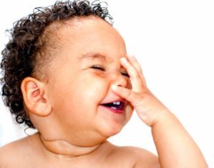
Wednesday 21st
O God
help me to believe
the truth about myself…
no matter how beautiful
it may be!
Amen

Slide 8
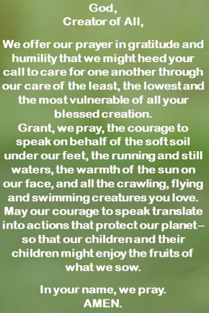
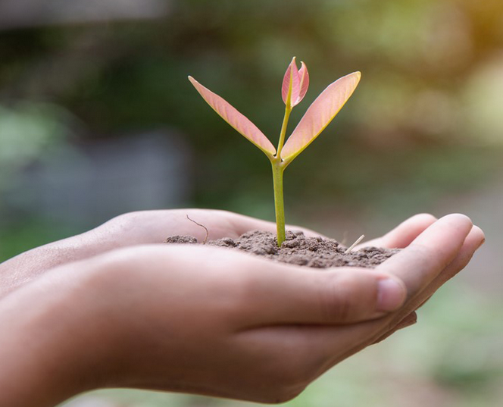
EARTH DAY
Thursday 22nd
Watch this reflection video (1:27 mins)
https://www.youtube.com/watch?v=km2uAj11q0Y&t=3s
Pause for thought:
How much do you care about our earth?
Is this reflected in your everyday living?
What more could you do?
Make a resolution.

Slide 9
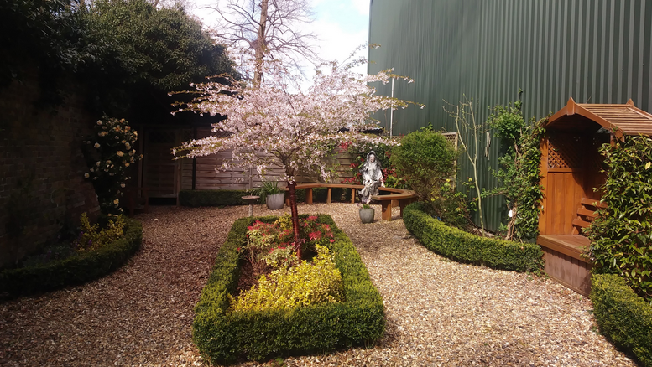
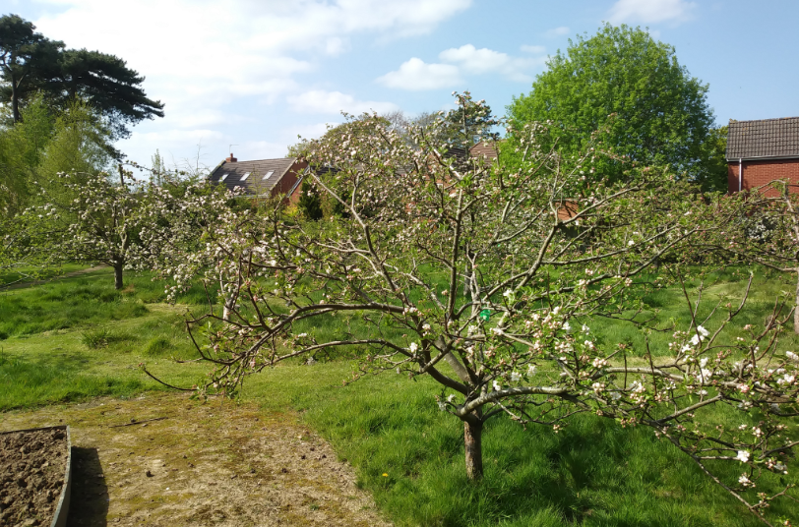
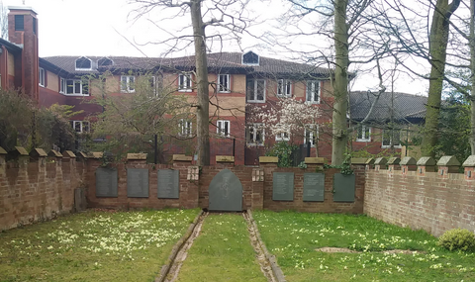
Thursday 22nd
EARTH DAY
God, thank you for Spring and the hope of warmer, longer, brighter days. Thank you for the coming of growth and life and birth. Thank you that things are coming awake in the world. This is what our calendar says, and we do see some signs that it is real. But we also still struggle with the layover of winter. Now we ask that you bring into reality all that belongs in this season.
Your word says that we will have provision, and hope, and joy, and health and loving relationships here and now in this life. We ask that what belongs in this season would become actual in our practical lives. We hope in you and in your promises. We hope in your gift of Spring.
Amen.

Slide 10
Friday 23rd - Today is the Feast of St. George, Patron of England, Georgia, Beirut, Ethiopia, Palestinian Christians, skin disease sufferers and the Scouts.
A reflection inspired by St. George
St George is often associated with killing
a dragon, which may
represent fighting
against injustice.
What are the bad
things that you can
conquer in your life?
Do you have courage
to stand up when you see something unjust happen?
Who will speak out if you don’t?
Some actions to complete today
Stand up for doing right today!
Pray for those who are facing hardships
as a result of speaking out against those in power.
_________________________________________________
PRAYER
My God, for today, let me just be faithful, just and courageous like St. George was.
Let me just be available so that you can do your mighty works with my help.
We are old friends, who have walked together for my whole life.
You have taught me, led me,
shown your face to me.
Today let me walk by your side, as you walk by mine, gently and in great confidence.
Amen.

Slide 11
Friday 23rd April
The Examen
Let us take some time to look back over our week…
This week, what signs of hope have you seen?
How have you brought hope to others?
What are you grateful for this week?
Take a moment to thank God for it.
What has been challenging? Ask God to help you with this.
As you look ahead to the weekend with hope,
what would you like to ask of God?

Slide 12
Thought for the Weekend:
“Life is change.
Growth is optional.
Choose wisely.”
Karen Kaiser Clark

