Slide 1
Excellence
W/c 18th May
Excellence is one of the FCJ values. We set the highest standards in supporting each other as we always try to do our best, pursuing our dreams.

Slide 2
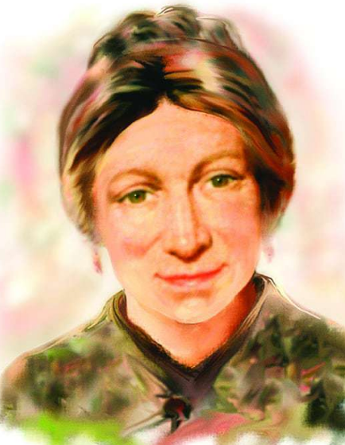
Monday 18th May
Our school motto tells us: “Whatever you do, do it well”.
We’ve never experienced school closures and distance learning at this level, but our school motto encourages us to strive do to well, academically, but also in our relationships.
How are you living out our school motto in this time?
Lord, just as Marie Madeleine lived out excellence in giving glory to you, let us be inspired by her life, striving to give glory to you in our school work, our friendships, our hobbies, our dreams and in everything we do. Amen.

Slide 3
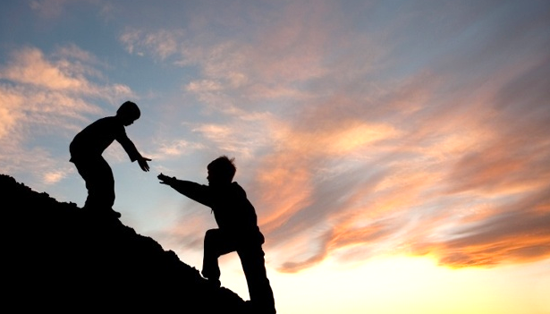
Tuesday19th May
Excellence is supporting each other to become our best selves’
FCJ Zest for life document
Today think of one way you could encourage or support a friend or family member.
You might tell someone how much they mean to you, encourage them to not give up (in person or via social media), or just offer a friendly smile.

Slide 4
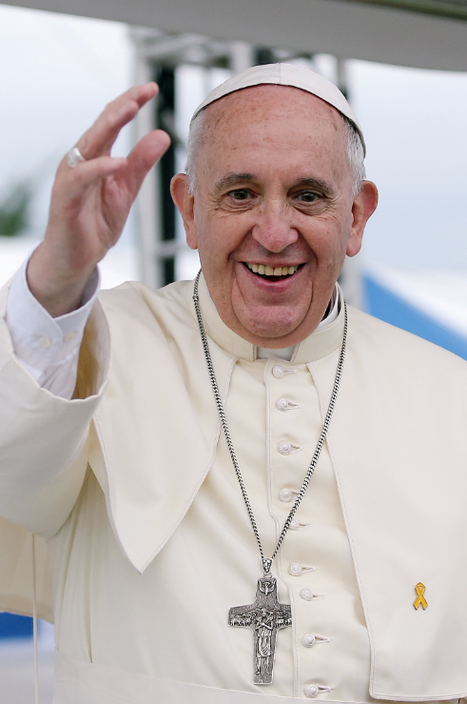
Wednesday 20th May
Message from Pope Francis
Dear young people, do not bury your talents, the gifts that God has given you! Do not be afraid to dream of great things!
God, we pray that we risk more than others think is safe, care more than others think is wise, dream more than others think is practical, expect more than others think is possible. We ask this through Jesus Christ who is our example. Amen.
(Claude Bisell)

Slide 5
Thursday 21st May
FEAST OF THE ASCENSION
A reading from the Acts of the Apostles (Acts 1: 6-11)
When they had gathered together they asked him, “Lord, are you at this time going to restore the kingdom to Israel?” He answered them, “It is not for you to know the times or seasons that the Father has established by his own authority.
But you will receive power when the Holy Spirit comes upon you, and you will be my witnesses in Jerusalem, throughout Judea and Samaria, and to the ends of the earth.”
When he had said this, as they were looking on, he was lifted up, and a cloud took him from their sight.
While they were looking intently at the sky as he was going, suddenly two men dressed in white garments stood beside them.
They said, “People of Galilee, why are you standing there looking at the sky?
This Jesus who has been taken up from you into heaven will return in the same way as you have seen him going into heaven.”
Dear Lord Jesus Christ, right before your Ascension into heaven you told your apostles to be His witnesses to the ends of the earth upon receiving the Holy Spirit. May I be similarly inspired to spread your Gospel message in word and deed, according to your will for me. And may I do so joyfully, with your help, your guidance, and your grace! And remembering this glorious event, help me to seek what is above, Heaven, where you are seated at the right hand of God the Father. Amen.

Slide 6
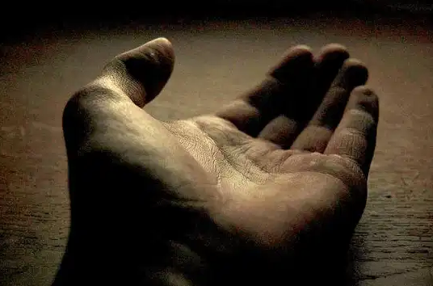
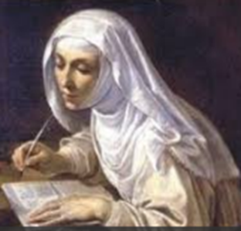
Friday 22nd May
Be who are meant you to be and you will set the world on fire!
(Saint Catherine of Siena, 13th century)
Dear God,
Help me to grow to be the best I can be.
Help me to shine, to radiate joy, to trust.
Hold my hand as I take the next step and strive to practise excellence in the daily
things I do.
Guide my thoughts to see the beauty, the wonder and the majesty of people
I meet.
Hold me in your divine hand as I do try to achieve the best that I truly am.
Amen.

Slide 7
Prayer for the afternoon May: the month of Mary
Let us pause for a few moments in silence and remember those family members and friends who need our prayers and support today. Let us pray to Mary to intercede for us:
Hail Mary, full of grace.
The Lord is with thee.
Blessed art thou amongst women,
and blessed is the fruit of thy womb, Jesus.
Holy Mary, Mother of God,
pray for us sinners,
now and at the hour of our death.
Amen.
May the Lord bless us and keep us from all evil and bring us to everlasting life. Amen.

Slide 8
Friday afternoon: Examen
Be silent and place yourself in God’s loving presence. Think about the good things that have happened this week and give thanks.​
Who have you left a good memory with this week?
Look back over your week. Where have you felt joy and what has been difficult and challenged you? In the quiet of your heart, tell God about your experiences.​ Give thanks for who you are.
As you look ahead, with what spirit will you enter next week?
Ask God to help you.

Slide 9
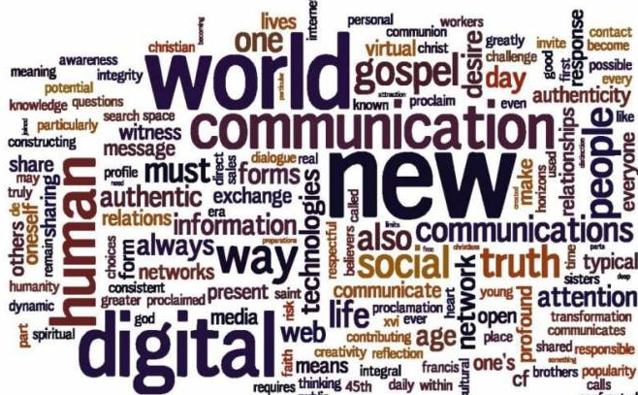
Thought for the weekend
Sunday 24th May is World Communications Day
Let us pray for those who work in media
Reflect on your media usage,
how can you use media
for the better?

