Slide 1
PRAYER THEMES
FCJ BI-CENTENARY YEAR

Slide 2

W/C 16th September 2019

Slide 3

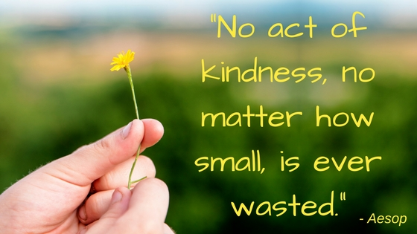
Monday 16th September 2019: morning
The Science of Kindness
https://www.randomactsofkindness.org/the-science-of-kindness
St Paul wrote: “You are the people of God; he loved you and chose you for his own. So then, you must clothe yourselves with compassion, kindness, humility, gentleness, and patience.” Colossians 3:12
Think about a time when someone has been kind to you

Slide 4
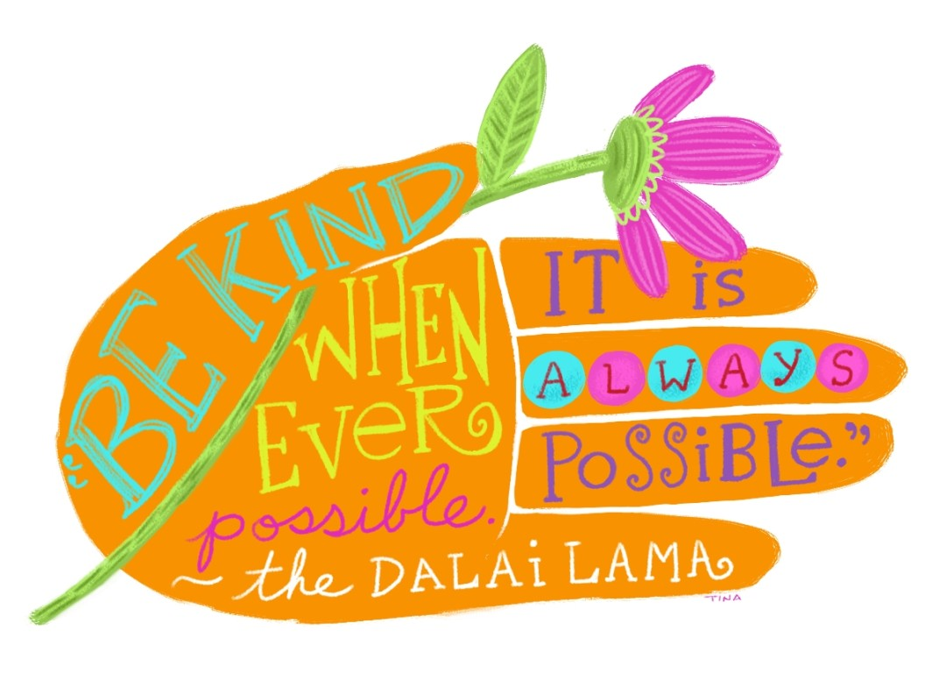

Monday 16th September 2019
Dear God, sometimes we find kindness
In the most surprising places
And at the most surprising times.
Help us see those blessed moments
When your love shines through
The kindness of a neighbour, the concern of a teacher,
The compassion of a classmate – all moments of love.
Help us to be agents of your love.
Fill us with the gifts to let your love shine through us.
We ask this through Jesus,
Who loved everyone he met. Amen
Adapted from Prayers Before the Bell by Betty Manion

Slide 5


Tuesday 17th September 2019
The definition of kindness: the quality of being friendly, generous, and considerate.
https://www.youtube.com/watch?v=cZGghmwUcbQ#
On Friday we will celebrate the FCJ Global Day of Kindness – what will you do to take part?

Slide 6

Tuesday 17th September 2019
Dear God, If I can not be brilliant, let me be kind. If I can not change the world, let me inspire just one other to do so. If I can not give away riches, let me be loving. Let me be known for kindness, for it is the greatest glory.
Amen.

Slide 7
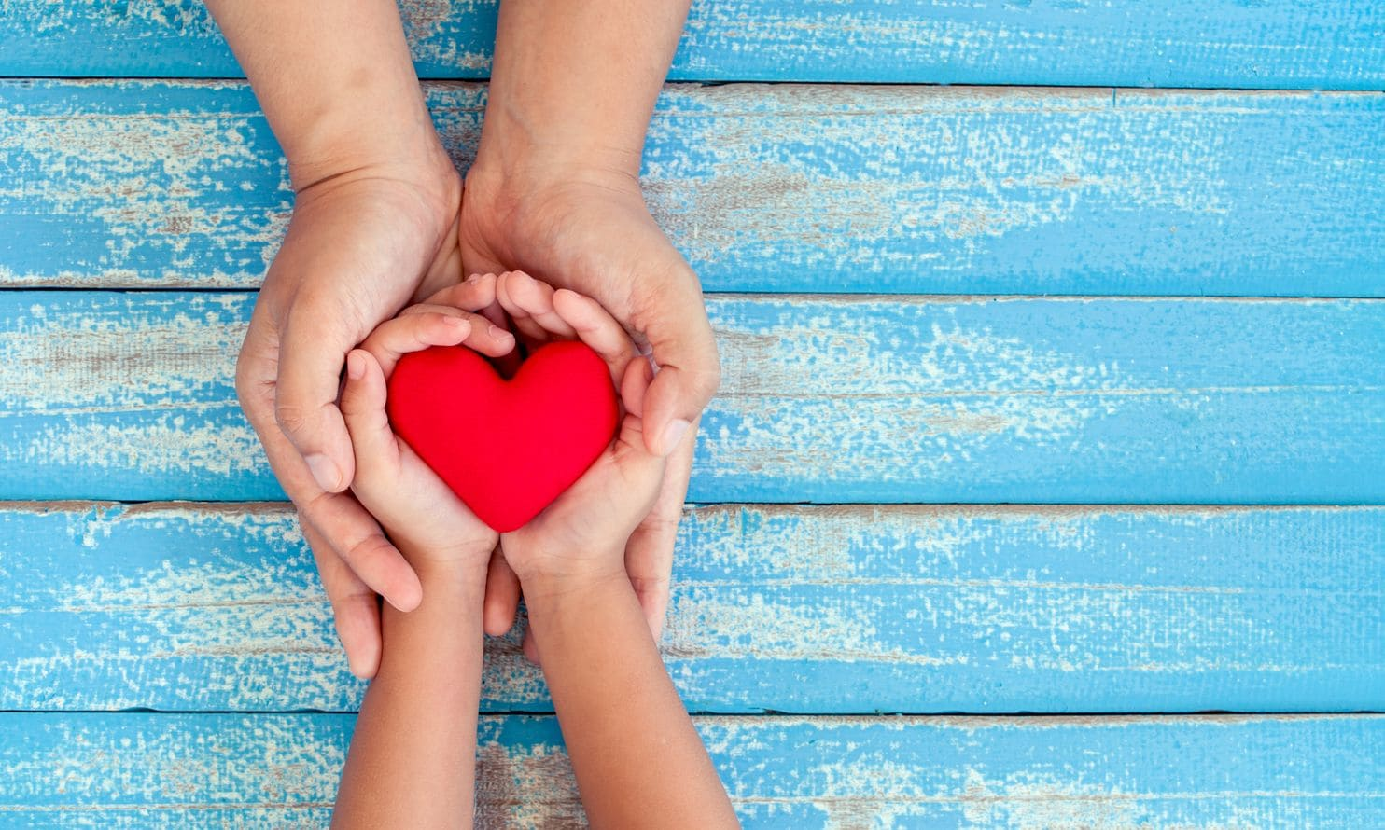
Wednesday 18th September 2019
It’s really important that we are kind to ourselves! Spend time in silence or listening to relaxing music and think about these questions:
At what times in the week have I needed kindness?
How have I been kind to myself this week?
What can I do in the next few days to be kind to myself
At the end of your time together, pray together the Our Father….

Slide 8

Our Father,
who art in heaven,
hallowed be thy name;
thy kingdom come;
thy will be done
on earth as it is in heaven.
Give us this day our daily bread;
and forgive us our trespasses
as we forgive those who trespass against us;
and lead us not into temptation,
but deliver us from evil.
Amen.

Slide 9
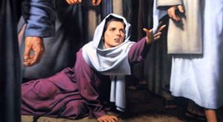
Thursday 19th September
A time Jesus showed kindness from the Gospel of Mark
Now there was a woman who had been suffering from haemorrhages for twelve years. She had endured much under many doctors, and had spent all that she had; and she was no better, but rather grew worse. She had heard about Jesus, and came up behind him in the crowd and touched his cloak, for she said, ‘If I but touch his clothes, I will be made well.’ Immediately her haemorrhage stopped; and she felt in her body that she was healed of her disease. Immediately aware that power had gone forth from him, Jesus turned about in the crowd and said, ‘Who touched my clothes?’ And his disciples said to him, ‘You see the crowd pressing in on you; how can you say, “Who touched me?” ’ He looked all round to see who had done it. But the woman, knowing what had happened to her, came in fear and trembling, fell down before him, and told him the whole truth. He said to her, ‘Daughter, your faith has made you well; go in peace, and be healed of your disease.’
How did Jesus show kindness to the woman in this account?

Slide 10


Thursday 19th September
We pray that this example of the kindness Jesus showed, will help us to be kind today.
When people ask for our help, may we respond immediately,
When people need our kindness, may we give it freely
We pray today that there will be kindness in our thoughts, our words and our actions.
Amen.

Slide 11


Friday 20th September 2019
Today is our FCJ
Global Day of Kindness
#fcj200

Slide 12
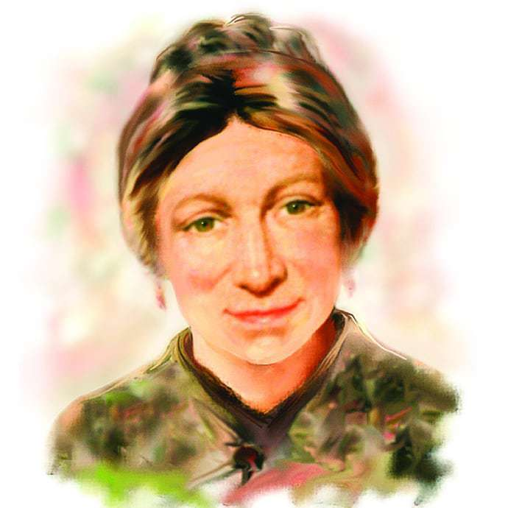
Today marks the start of the Bi-Centenary Celebrations. Today we give thanks for the life and example of Marie Madeleine and we celebrate the birth of the FCJ Society
Lord, inspire us to live in such a way that our choices each day and our commitment to live in a positive way may transform the negative into something positive, and the ordinariness of daily life into something extraordinary. Amen.

Slide 13
Friday 20th September
Examen
Be silent and place yourself in God’s loving presence. Think about the good things that have happened this week and give thanks.​
Who have you left a good memory with this week?
Look back over your week. Where have you felt joy and what has been difficult and challenged you? Have you been kind to yourself and to others? Have you received kindness from others?
Tell God about your experiences.​ Give thanks for who you are.
As you look ahead, with what spirit will you enter next week?
Ask God to help you.

