Slide 1
PRAYER THEMES
FCJ BI-CENTENARY YEAR

Slide 2
New Beginnings
W/C 2nd September 2019

Slide 3

Prayer theme: New Beginnings
On Holy Thursday 1820 Marie Madeleine founded the FCJ Society in Amiens, France
“In the disused building provided by the town authorities, she set up a school for undernourished, exhausted children, many of them suffering from acute neglect. Each day, 250 children crowded in…”
This year marks 200 years since the Faithful Companions of Jesus was founded. The FCJ schools continue to share the vision Marie Madeleine had for education. As we begin this school year we pray for all the FCJ Schools around the world.
The FCJ schools of The United Kingdom and Ireland have worked collaboratively to produce daily prayers and reflections for this special year.

Slide 4


Wednesday 4th September
Loving God,
Another term begins and we come back to school
Refreshed and restored by the break,
Grateful for those we share our lives with,
For the memories of the past few weeks,
For the opportunities we have, which are denied
To so many in our world today….
We come back to school pleased to see our friends,
Determined to make the most of our talents,
To grow in understanding of the kind of person we are called to be,
To turn over a new leaf, perhaps,
To make up for the times we were less than our best self.
(continues on the next slide)

Slide 5

We come back to school and our grateful
For the energy and enthusiasm a new term brings,
For the optimism and good humour in the air
Bless our school, keep us safe and well
Keep us on the right path.
Bless our teachers and support staff
Who look after us and help us grow in knowledge and skills.
Bless the new pupils and staff
As they begin their journey with us,
May they quickly feel at home.
Bless all our efforts to build up the Kingdom of God,
To make the world more just and compassionate
Beginning here, in this school of ours,
Our home from home.
From Prayers for Schools by Raymond Friel

Slide 6

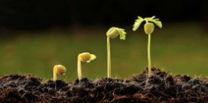
Wednesday 4th September 2019
Dear Jesus, bless our school, our teachers,
Our classrooms, and the students
So our school will be a place of learning and love.
Help our teachers do their best
And guide us to be the best students possible.
May our classrooms be places of hospitality,
Compassion, excitement, blessings, and joy.
May our minds and our hearts be filled with knowledge
Of you, our world, and all that will
Help us grow in faith with you.
We ask this trough your Son,
The greatest teacher and student of all.
Amen
From Prayers Before the Bell by Betty Mannion

Slide 7

Thursday 5th September
Today’s Gospel Reading (Luke 5:1-11)
One day Jesus was standing on the shore of Lake Gennesaret while the people pushed their way up to him to listen to the word of God. He saw two boats pulled up on the beach; the fishermen had left them and were washing the nets. Jesus got into one of the boats—it belonged to Simon—and asked him to push off a little from the shore. Jesus sat in the boat and taught the crowd.
When he finished speaking, he said to Simon, “Push the boat out further to the deep water, and you and your partners let down your nets for a catch.”
“Master,” Simon answered, “we worked hard all night long and caught nothing. But if you say so, I will let down the nets.” They let them down and caught such a large number of fish that the nets were about to break. So they motioned to their partners in the other boat to come and help them. They came and filled both boats so full of fish that the boats were about to sink. When Simon Peter saw what had happened, he fell on his knees before Jesus and said, “Go away from me, Lord! I am a sinful man!”
He and the others with him were all amazed at the large number of fish they had caught. The same was true of Simon's partners, James and John, the sons of Zebedee. Jesus said to Simon, “Don't be afraid; from now on you will be catching people.”
They pulled the boats up on the beach, left everything, and followed Jesus.
(Continue on the next slide)

Slide 8
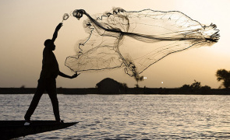
Thursday 5th September
Luke 5: 1-11
This narrative marks a new beginning for the men working on the lake fishing that day. Peter, James and John left everything to follow Jesus.
Where do you find Jesus in everyday life?
What are you willing to give up to start a new beginning?

Slide 9
Thursday 5th September 2019
We pray that this year we will do our best, to show excellence using the skills and talents that God has given to us, to be the best person we can be for the Glory of God.
Lord in your Goodness All: Hear our Prayer
We pray that we will work for justice and peace in our communities and our world just as Marie Madeleine did.
Lord in your Goodness All: Hear our Prayer
We pray for the gift of gentleness, that we may be gentle with others, but also with ourselves.
Lord in your Goodness All: Hear our Prayer

Slide 10
We pray that we will treat each person in our community with dignity, that when we talk to people in person or on social media, we remember that they are a human being created and loved by God as we are.
Lord in your Goodness All: Hear Our Prayer
We pray that in our community we will demonstrate companionship, that we will be companions that listen to each other and walk together on this life’s journey
Lord in your Goodness All: Hear Our Prayer
May we start this year with Hope, that it will be a year that we all grow in knowledge and love, that there will be many moments of joy as we celebrate our bi-centenary.
Lord in your Goodness All: Hear Our Prayer

Slide 11
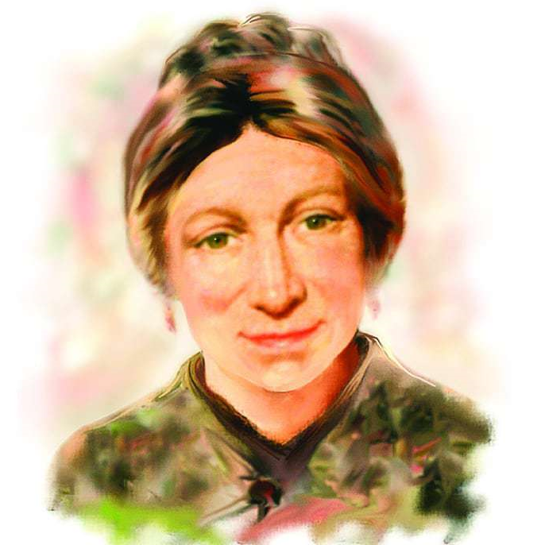
Friday 6th September 2019
“I desire nothing but the accomplishment of God’s Will”, Marie Madeleine
The call is clear;
It is imperative that we listen.
God waits expectantly for our ‘fiat’
God will use our desires,
Our efforts, our words
and our actions;
In the power of the Spirit
We must be the love, the peace,
The mercy and the justice
In the world. FCJ General Chapter 1983
Look back over your week and ask yourself: ‘Where did I hear, see, sense the presence of God…?
From “Celebrating Marie Madeleine-Reflections”

Slide 12
Friday 6th September 2019
Examen
Be silent and place yourself in God’s loving presence. Think about the good things that have happened this week and give thanks.​
Who have you left a good memory with this week?
Look back over your week. Where have you felt joy and what has been difficult and challenged you? In the quiet of your heart, tell God about your experiences.​ Give thanks for who you are.
As you look ahead, with what spirit will you enter next week?
Ask God to help you.

