Slide 1
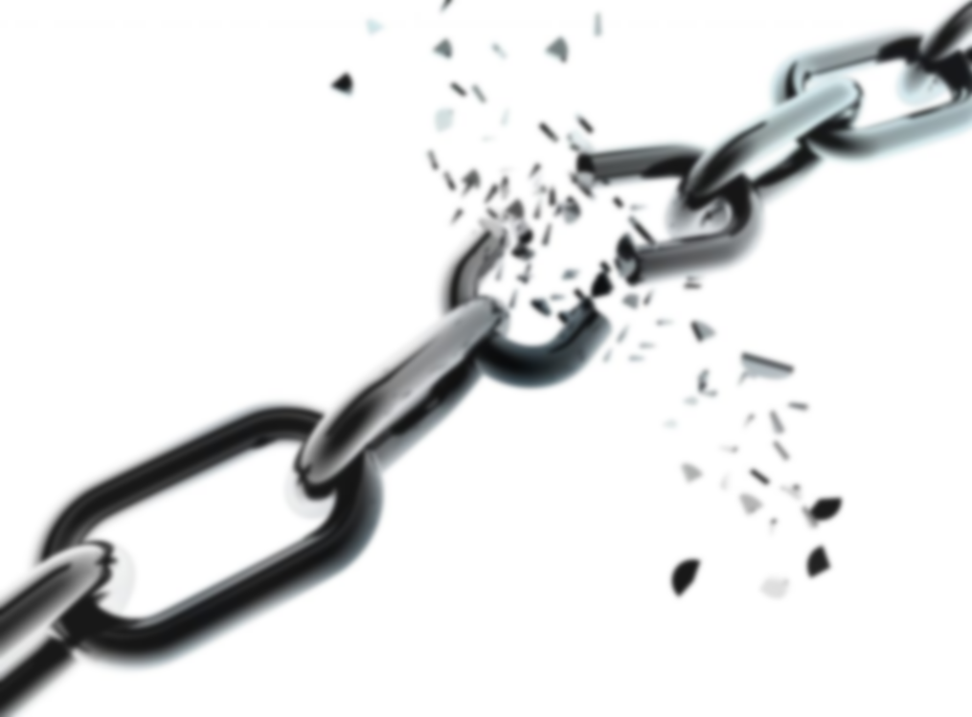
Prayers for those who are oppressed and persecuted ~ Feast of St Peter and St Paul
Week commencing 27th June
Democracy is in crisis. The values it embodies—particularly the right to choose leaders in free and fair elections, freedom of the press, freedom to choose one’s religion
are under assault and in retreat globally.
St Peter and St Paul were two of the first leaders of the early Church. In those days Christianity was prohibited by the Roman Empire so many of the early Christians were oppressed and persecuted.

Slide 2
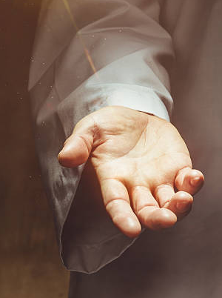
Monday 27th June
Sunday Gospel: Luke 9:51-62
As the time drew near for him to be taken up to heaven, Jesus resolutely took the road for Jerusalem and sent messengers ahead of him. These set out, and they went into a Samaritan village to make preparations for him, but the people would not receive him because he was making for Jerusalem. Seeing this, the disciples James and John said, ‘Lord, do you want us to call down fire from heaven to burn them up?’ But he turned and rebuked them, and they went off to another village.
As they travelled along they met a man on the road who said to him, ‘I will follow you wherever you go.’ Jesus answered, ‘Foxes have holes and the birds of the air have nests, but the Son of Man has nowhere to lay his head.’
Another to whom he said, ‘Follow me’, replied, ‘Let me go and bury my father first.’ But he answered, ‘Leave the dead to bury their dead; your duty is to go and spread the news of the kingdom of God.’
Another said, ‘I will follow you, sir, but first let me go and say goodbye to my people at home.’ Jesus said to him, ‘Once the hand is laid on the plough, no one who looks back is fit for the kingdom of God.’
Pause for thought: What holds you back?

Slide 3
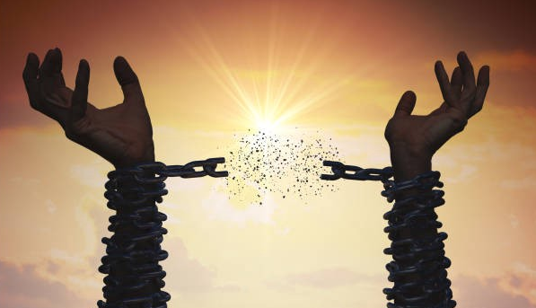
Monday 27th June
10 of the most oppressed and sometimes persecuted groups in the world
1. Women and girls in much of Africa, the Middle-East and Asia
2. Palestinians in Israel
3. Kurds in Turkey and historically Syria and Iraq
4. Muslims in China
5. Indians and Pakistanis in Africa
6. People with disabilities
7. LGBTQ+ around the world
8. Native Americans in the USA
9. Albinos in Sub-Saharan Africa
10. Jewish and Christian people in some Muslim countries
Judge eternal, bringer of justice, hear the cry of those who suffer under the lash of heartless political oppression; those who languish in prisons and labour camps, untried or falsely condemned; those whose bodies are shattered, or whose minds are unhinged by torture or deprivation. Meet them in their anguish and despair, and kindle in them the light of hope, that they may find rest in your love, healing in your compassion and faith in your mercy. In the name of him who suffered, Jesus Christ our Lord. Amen.

Slide 4
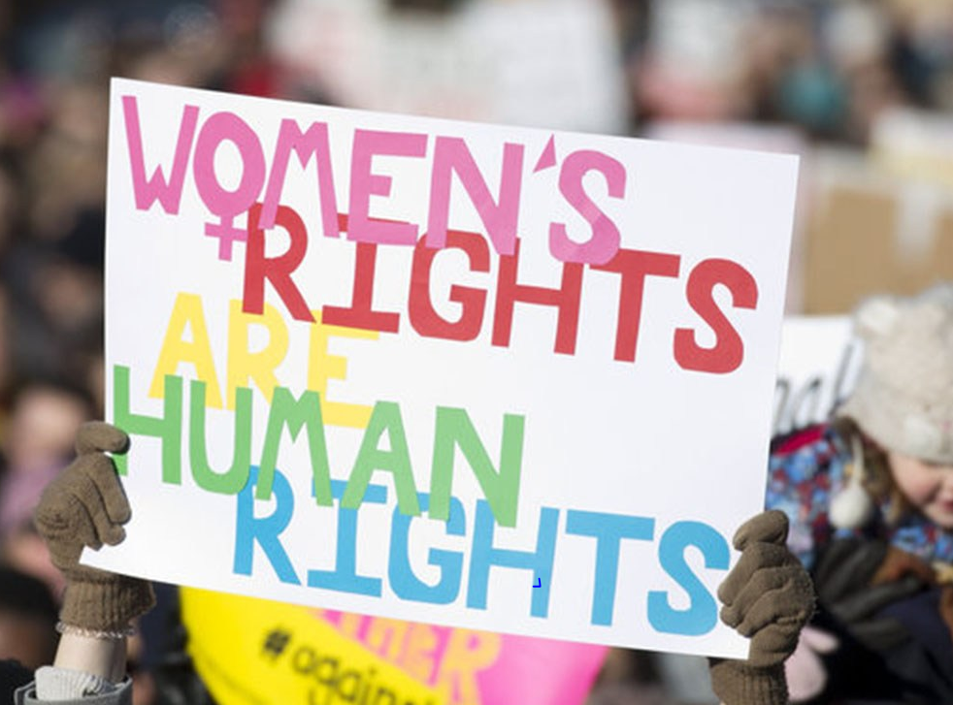
Tuesday 28th June
Grant, O God,
that all may recognize women
as equal partners in creation and prophesy. By the grace of the Holy Spirit,
empower women at home, at work, in government,
and in the hierarchies of churches, temples, mosques, synagogues, and all other places of worship. Provide safety and protection, O Gracious God, and inspire just laws against all forms of violence against women.
We ask this through Jesus Christ, Amen.

Slide 5
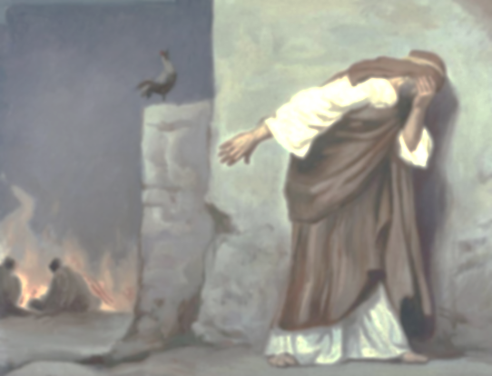
Tuesday 28th June
Peter
Impulsive master of misunderstanding
You comfort me with all your big mistakes;
Jumping the ship before you make the landing,
Placing the bet before you know the stakes.
I love the way you step out without knowing,
The way you sometimes speak before you think,
The way your broken faith is always growing,
The way he holds you even when you sink.
Born to a world that always tried to shame you,
Your shaky ego vulnerable to shame,
I love the way that Jesus chose to name you,
Before you knew how to deserve that name.
And in the end your Saviour let you prove
That each denial is undone by love.
St. Peter was originally named Simon but after he became a disciple, Jesus gave him the name Peter (which translates as ‘Rock’).
Peter was chosen despite his many flaws and didn’t always live up to his name, yet after Jesus ascended to heaven Peter became the first pope (leader of the Church).
In Rome, you can visit St Peter’s Basilica where Peter is buried.

Slide 6
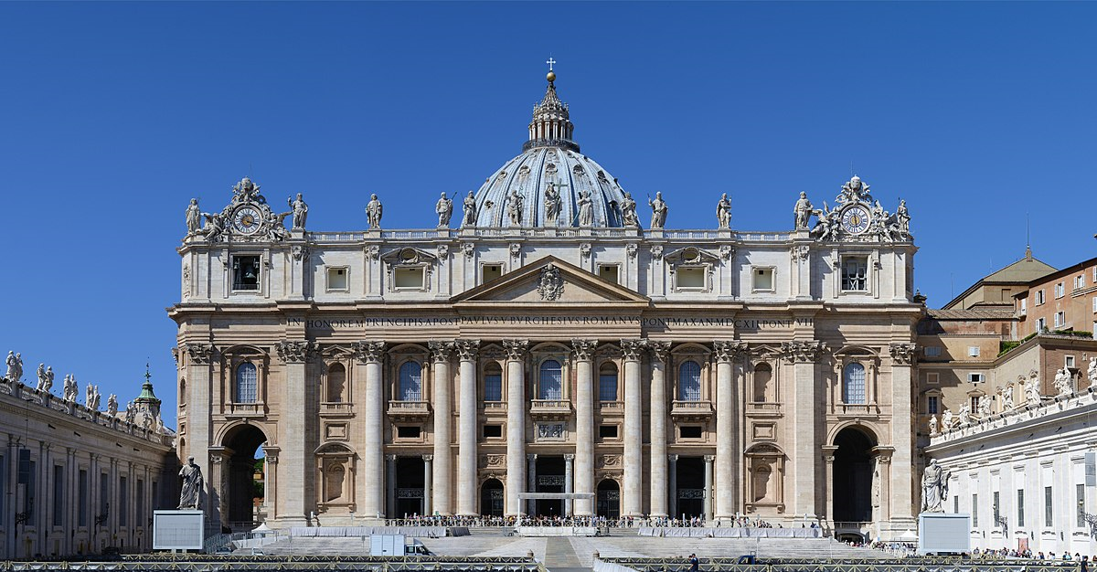
Wednesday 29th June
Today is the feast day of St Peter and Paul, it is a Holy Day. We pray using the Gospel that will be read in Mass (Matthew 16: 13-19)
When Jesus went into the region of Caesarea Philippi, he asked his disciples, “Who do people say that the Son of Man is?” They replied, “Some say John the Baptist, others Elijah, still others Jeremiah or one of the prophets.” He said to them, “But who do you say that I am?” Simon Peter said in reply, “You are the Christ, the Son of the living God.” Jesus said to him in reply, “Blessed are you, Simon. For flesh and blood has not revealed this to you, but my heavenly Father. And so I say to you, you are Peter, and upon this rock I will build my Church, and the gates of the netherworld shall not prevail against it. I will give you the keys to the Kingdom of heaven. Whatever you bind on earth shall be bound in heaven; and whatever you loose on earth shall be loosed in heaven.”
Dear God,
We pray for the church, the pope, priests and those in Christian leadership.
May they be strong in their faith and filled with joy. May we too be inspired to be like Peter, serving others both here and around the world and speaking up for what we believe. Amen.

Slide 7
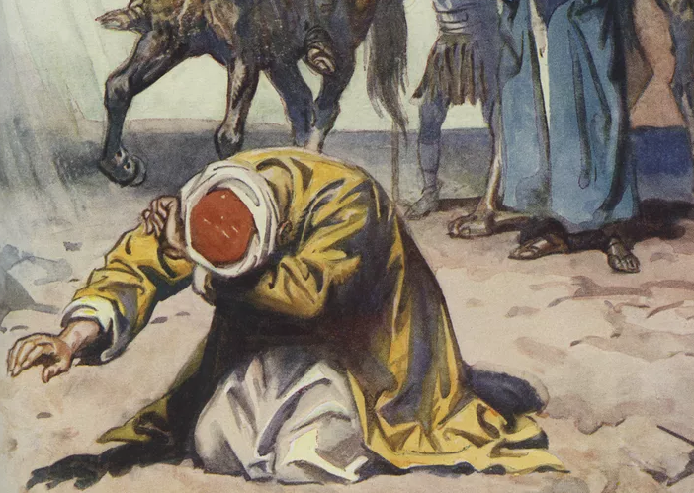
Wednesday 29th June
St Paul was originally called Saul and he persecuted the early Christians. While Saul was travelling to Damascus he had a religious experience. He was knocked of his horse, saw a blinding light and God spoke to him. He then converted to Christianity and took the name Paul.
Paul travelled around the Mediterranean teaching and supporting the early Christian communities. He visited Turkey and Cyprus on his travels. St Paul’s Letters to these communities can be found in the New Testament.
Dear God,
When we look at the life of St Paul we are inspired to know that our past doesn’t define us. Our mistakes provide us with opportunities to grow and to rely on God.
Today let us focus on the people we want to become, rather than our past and fix our eyes on Jesus.
Amen.

Slide 8
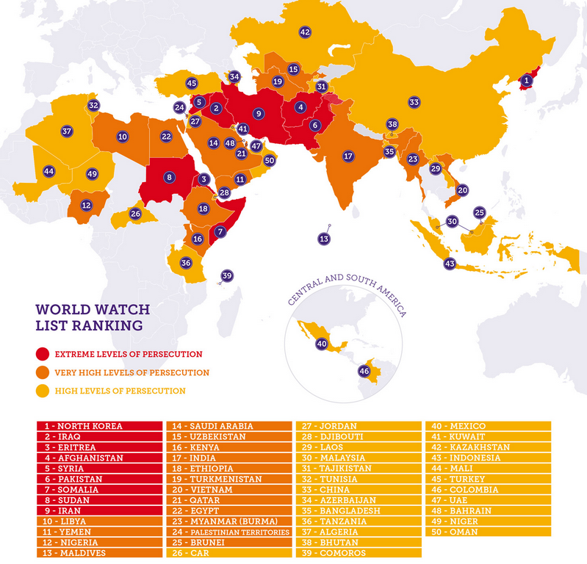
Thursday 30th June
Worldwide Christians face the most persecution because of their faith, especially in Asia and Africa. In 202. 309 million Christians (1 in 8) were living in countries where they might suffer very high or extreme levels of persecution. Every day, 13 Christians worldwide are killed because of their faith, 12 churches or Christian buildings are attacked and 12 Christians are unjustly arrested or imprisoned, while another 5 are abducted.
Loving God,
We unite ourselves with people around the country today in praying for Christians, and all people of faith, who are persecuted because of their beliefs.
Help everyone in the world to come to understand the beliefs of others so that we can build a world where everyone is respected and able to live their faith without fear.
Amen.

Slide 9
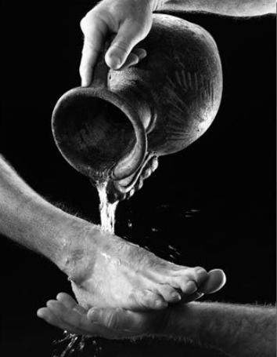
Thursday 30th June
A Leader's Prayer
Leadership is hard to define. Lord, let us be the ones to define it with justice. Leadership is like a handful of water. Lord, let us be the people to share it with those who thirst. Leadership is not about watching and correcting. Lord, let us remember it is about listening and connecting. Leadership is not about telling people what to do. Lord, let us find out what people want. Leadership is less about the love of power, and more about the power of love.
Lord, as we continue to undertake the role of leader let us be affirmed by the servant leadership we witness in your son Jesus. Let us walk in the path He has set and let those who will, follow.
Let our greatest passion be compassion. Our greatest strength love. Our greatest victory the reward of peace.
In leading let us never fail to follow. In loving let us never fail. Amen.

Slide 10
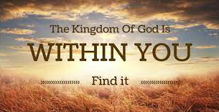
Friday 1st July
Almighty God, Ruler of all the peoples of the earth, forgive our shortcomings as a nation, purify our hearts to see and love the truth,
give wisdom to our leaders, and steadfastness to our people, and bring us at last to that fair city of peace
whose foundations are mercy,justice, and goodwill, of which you are the designer and builder; through your Son, Jesus Christ our Lord.
(By Woodrow Wilson)

Slide 11
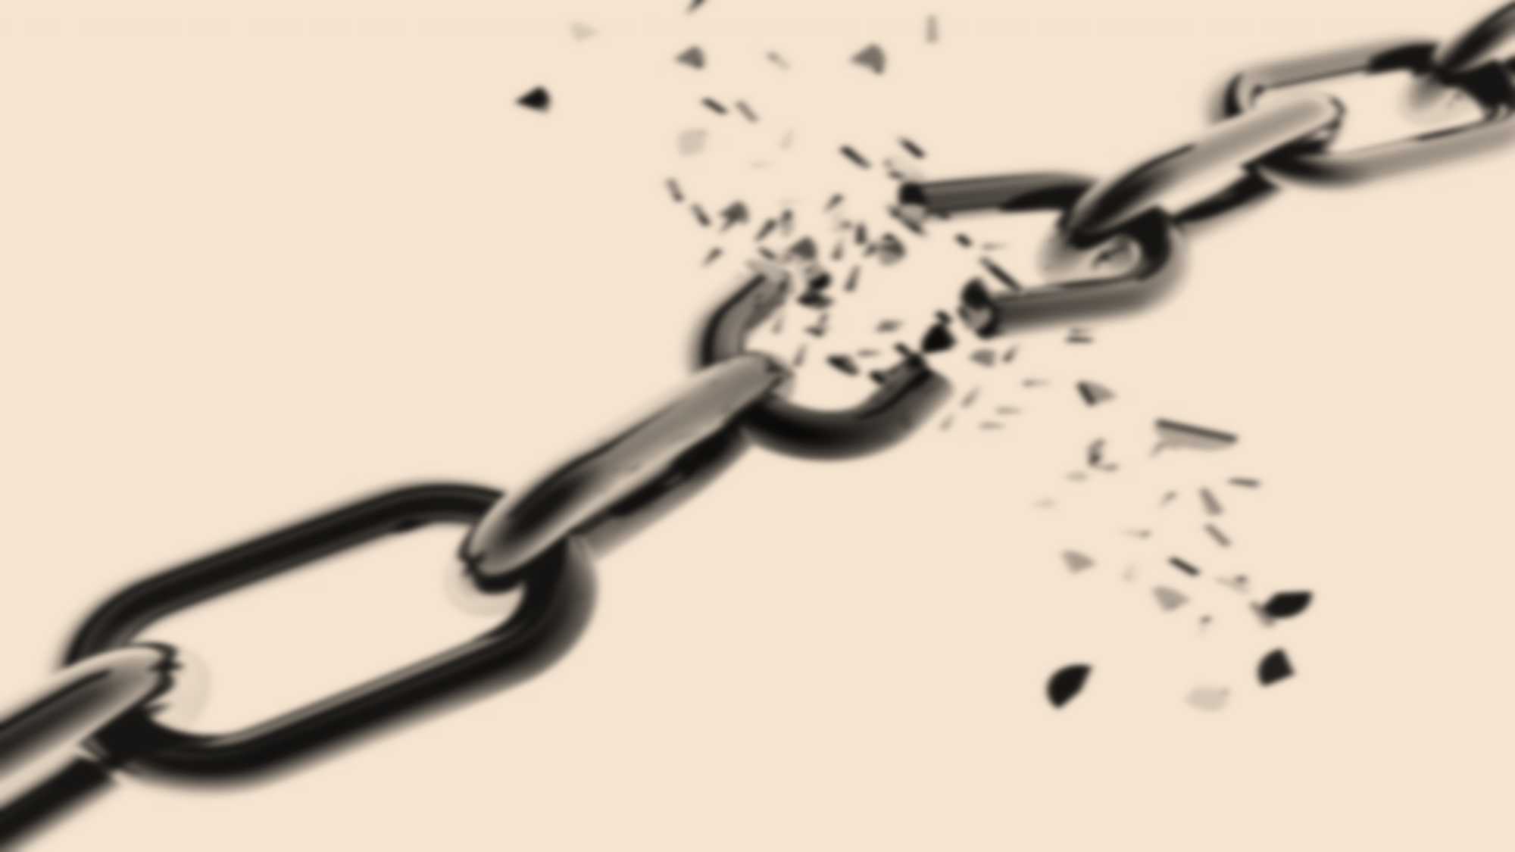
Friday 1st July
Examen
What are you grateful for this week? Take a moment to thank God for it.
What is the injustice you are most aware of? Is there anything you can do about it?
Ask God to help you with this.
As you look ahead to the weekend, what would you like to ask of God?

