Slide 1
Prayers for the week 7 – 10 May
Prayer theme: May: the Month of Mary

Slide 2
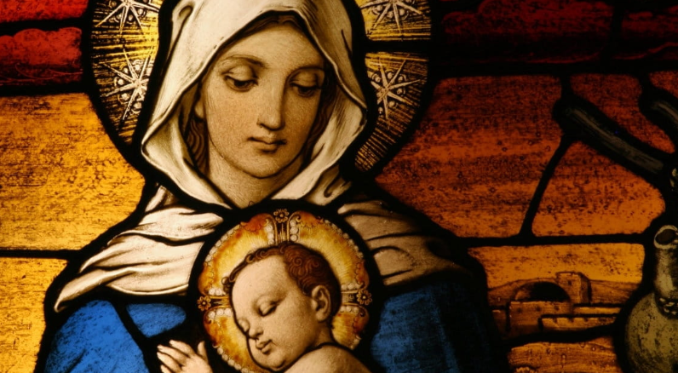
Tuesday 7 May
Mary in two minutes
https://www.youtube.com/watch?v=j7AQGyqtoK0

Slide 3
Wednesday 8 May
Dear Jesus,
How blessed we are to have two mothers!
You’ve given us mothers who care for us here on earth and your mother in heaven, who cares for us just as she cared for you.
Thank you for the gift of selfless love gives us a glimpse at how you must love us. Care for our mothers. Protect them and keep them safe. Prepare a special place for them in heaven next to your mum.
Amen.

Slide 4
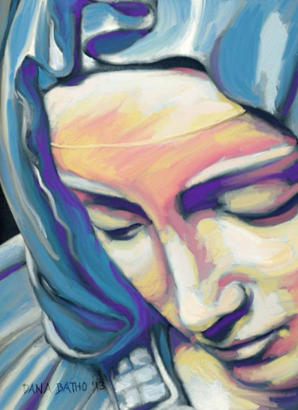
Thursday 9 May
Dear Mary,
You were so strong as you stood at the foot of the cross and watched your only son die. When we need you to be strong for us, please be there for us. When we’re sad or weak or hurting and turn to you for strength, help us be strong. Ask Jesus to help us be strong. With you and your Son on our side, we’ll never fail. Amen.
The women at the foot of the cross are very important to the FCJ sisters: they stood by Jesus until the very end.

Slide 5
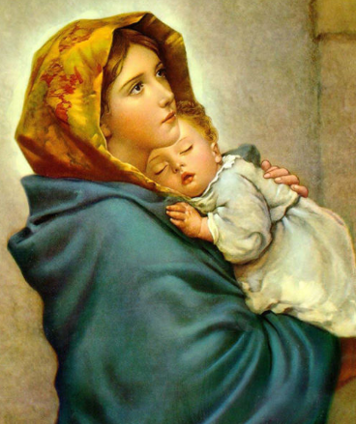
Friday 10 May
Hail Mary (CJM music)
https://www.youtube.com/watch?v=3kBicrhrcf8

Slide 6
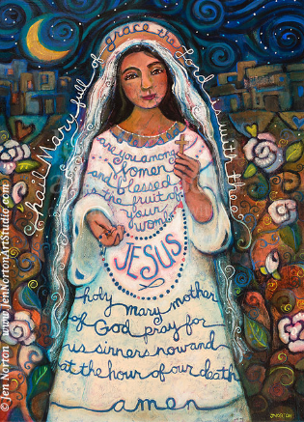
Afternoon prayer:
Let us pause for a few moments in silence and remember those family members and friends who need our prayers and support today…………
Let us pray to Mary to intercede for us:
Hail Mary, full of grace.
The Lord is with thee.
Blessed art thou amongst women,
and blessed is the fruit of thy womb, Jesus.
Holy Mary, Mother of God,
pray for us sinners,
now and at the hour of our death.
Amen.
May the Lord bless us and keep us from all evil and bring us to everlasting life. Amen

Slide 7
Friday afternoon 10 May
Examen
Be silent and place yourself in God’s loving presence. Think about the good things that have happened this week and give thanks.​
Who have you left a good memory with this week?
Look back over your week. Where have you felt joy and what has been difficult and challenged you? In the quiet of your heart, tell God about your experiences.​ Give thanks for who you are.
As you look ahead, with what spirit will you enter next week?
Ask God to help you.

