Slide 1
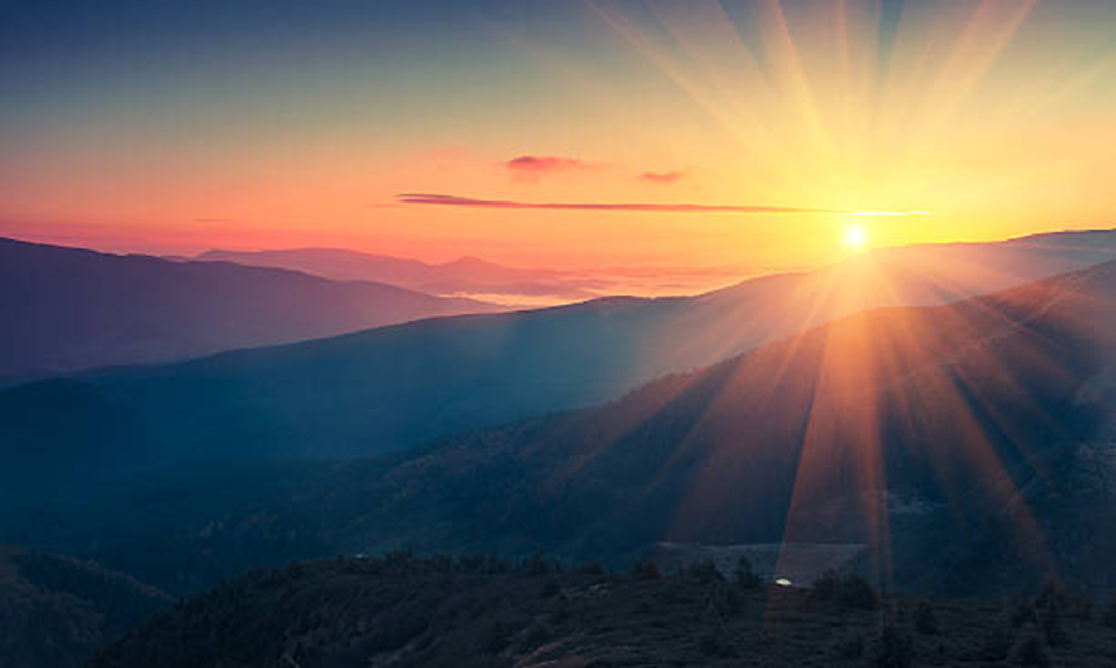
New Beginnings
Tuesday 5th September – Friday 8th September 2022
Season of Creation 1st September – 4th October

Slide 2
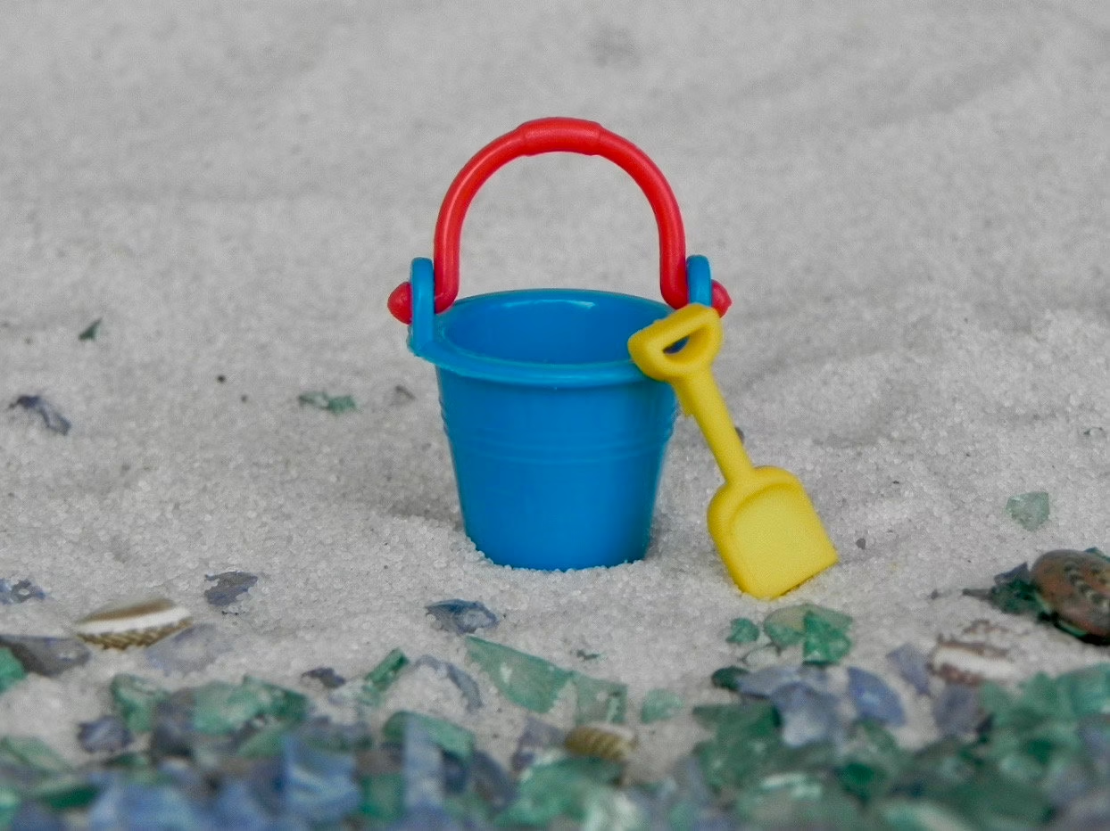
Tuesday 5th September 2023 Prayer
Loving God,
Another term begins and we come back to school
Refreshed and restored by the break,
Grateful for those we share our lives with,
For the memories of the past few weeks,
For the opportunities we have, which are denied
To so many in our world today….

Slide 3
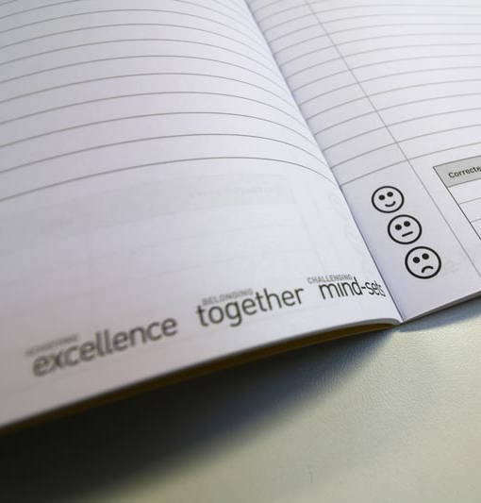
We come back to school pleased to see our friends,
Determined to make the most of our talents,
To grow in understanding of the kind of person we are called to be,
To turn over a new leaf, perhaps,
To make up for the times we were less than our best self.
We come back to school and our grateful
For the energy and enthusiasm a new term brings,
For the optimism and good humour in the air…….

Slide 4
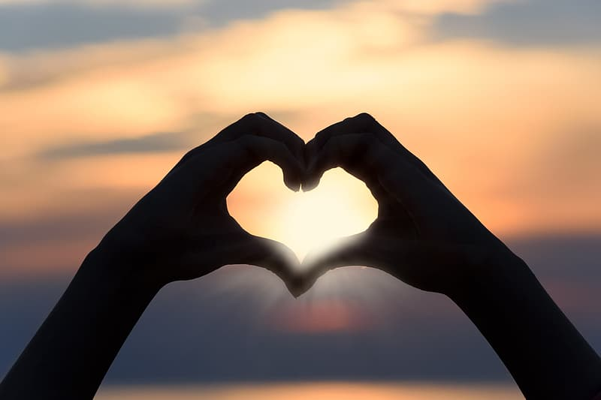
Bless our school, keep us safe and well
Keep us on the right path.
Bless our teachers and support staff
Who look after us and help us grow in
knowledge and skills.
Bless the new pupils and staff
As they begin their journey with us,
May they quickly feel at home.
Bless all our efforts to build up the Kingdom of God,
To make the world more just and compassionate
Beginning here, in this school of ours,
Our home from home
From Prayers for Schools by Raymond Friel

Slide 5
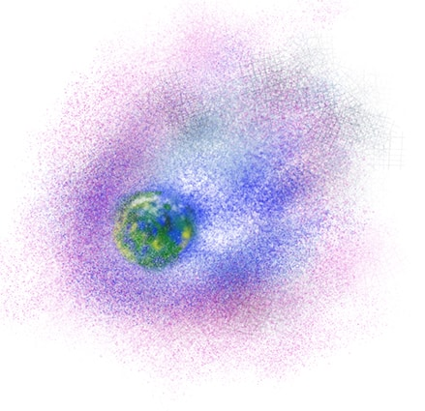
FCJ Prayer for Creation
Creator God, we give thanks for the wonderful gift of creation
and your presence in every part of it.
As we seek to widen our circle of love,
help us to rediscover the value, unity
and sacredness of all that exists.
We seek forgiveness for the ways in which our actions
and our choices have damaged the earth,
affecting the climate, destroying diversity,
and impacting the lives of the poorest of our sisters and brothers.
In your love, lead us into solidarity and companionship,
inspire our leaders to courageous decisions,
and grant each of us the wisdom and commitment to act.
May we treasure earth’s resources,
work to reduce our impact on the climate
and be open to a conversion of heart and lifestyle.
Amen

Slide 6
Wednesday 6th September
We pray that this year we will do our best, to show excellence using the skills and talents that God has given to us, to be the best person we can be for the Glory of God.
Lord in your Goodness All: Hear our Prayer
We pray that we will work for justice and peace in our communities and our world just as Marie Madeleine did.
Lord in your Goodness All: Hear our Prayer
We pray for the gift of gentleness, that we may be gentle with others, but also with ourselves.
Lord in your Goodness All: Hear our Prayer

Slide 7
We pray that we will treat each person in our community with dignity, that when we talk to people in person or on social media, we remember that they are a human being created and loved by God as we are.
Lord in your Goodness All: Hear Our Prayer
We pray that in our community we will demonstrate companionship, that we will be companions that listen to each other and walk together on this life’s journey
Lord in your Goodness All: Hear Our Prayer
May we start this year with Hope, that it will be a year that we all grow in knowledge and love, that there will be many moments of joy as we celebrate our bi-centenary.
Lord in your Goodness All: Hear Our Prayer

Slide 8
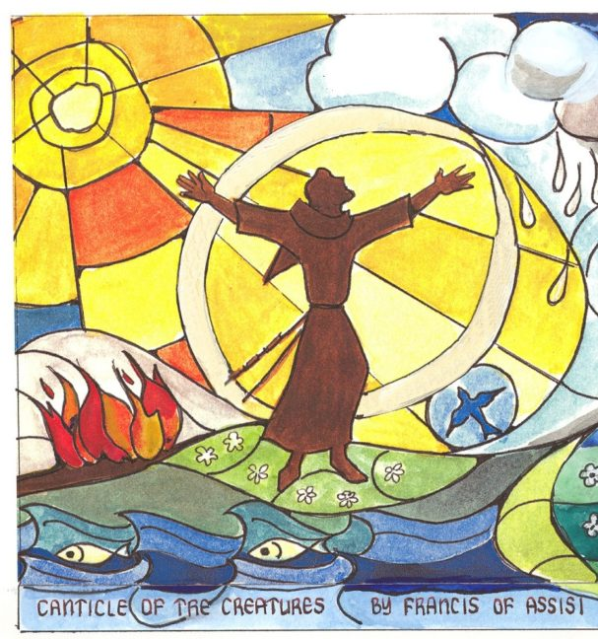
Living God,
have mercy on us,
for the times we forget
that we belong to each other.
You call us to be still,
to hear the whisper of our Sister Wind,
to feel the radiance of our Brother Sun,
and to be nourished by our Mother Earth.
Renew us in your healing love.
Inspire us to water the earth,
and nurture one another,
so all may flourish.
Together, as one family,
may we always sing your praise.
Through Christ our Lord,
Amen.
Rachel McCarthy/CAFOD

Slide 9
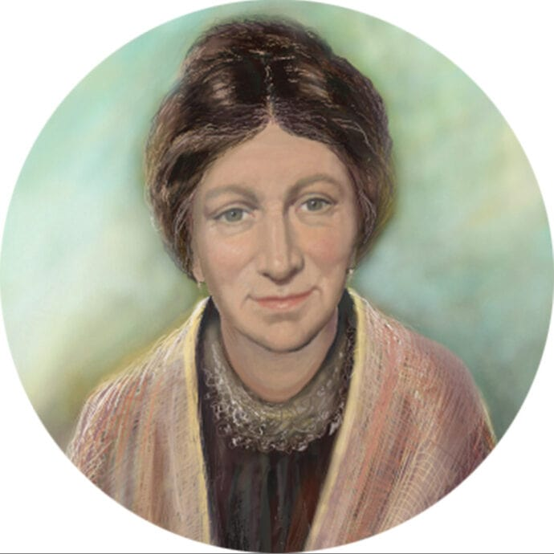
Thursday 7th September
Dear Jesus, bless our school, our teachers,
Our classrooms, and the students
So our school will be a place of learning and love.
Help our teachers do their best
And guide us to be the best students possible.
May our classrooms be places of hospitality,
Compassion, excitement, blessings, and joy.
May our minds and our hearts be filled with knowledge
Of you, our world, and all that will
Help us grow in faith with you.
We ask this through your Son,
The greatest teacher and student of all.
Amen
From Prayers Before the Bell by Betty Mannion

Slide 10
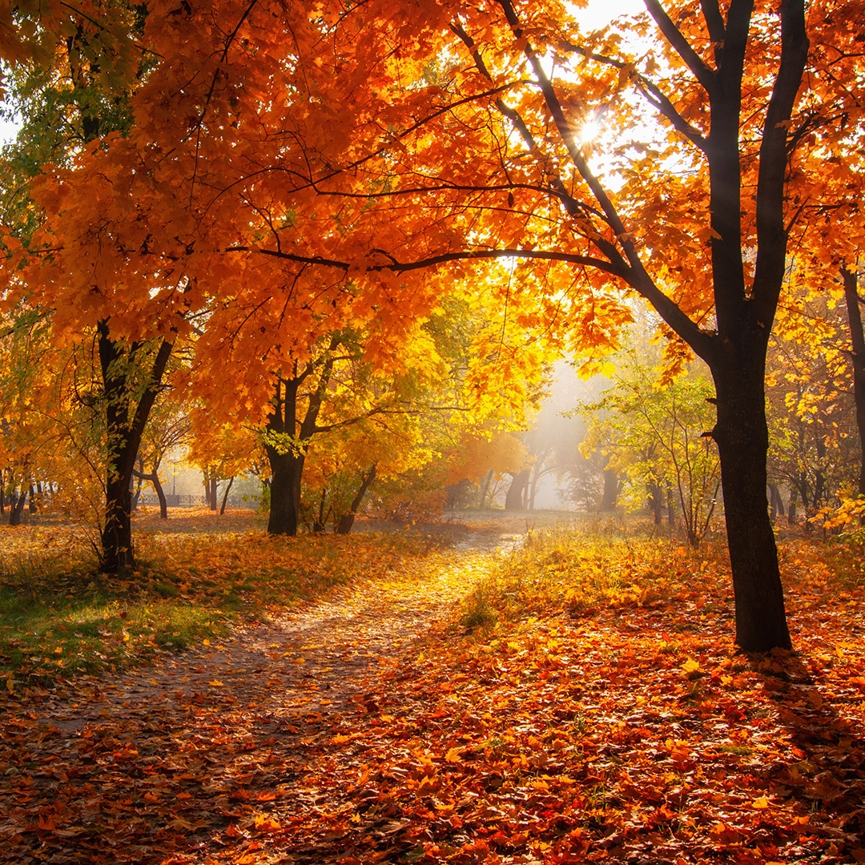
Creator God, You show us what love is through the beauty of the earth and the gift of your Son.
For the love of… animal and plant mountain and forest sea and city woman and man friend and family those who live far from us and those yet to be born.
Move us to live more simply, to protect the earth and to speak up for those in need. Amen.
Sarah Hagger-Holt/CAFOD

Slide 11
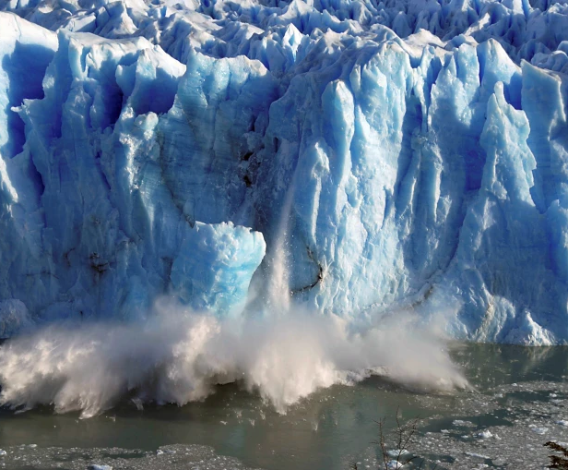
O Lord, we pray for courage as the oceans rise and people suffer. Let us care for one another, and protect our precious home.
O Lord, we pray for strength as the glaciers thaw and our Earth is in pain. Give us the spirit to do more. We must all act together, and protect our fragile home.
O Lord, we pray for hope as the temperatures soar. To the tears of your Creation we will not close our eyes. We will all work together to preserve our common home.
We ask this through Christ Our Lord,
Amen.
Prayer: Catherine Wignall/CAFOD

Slide 12
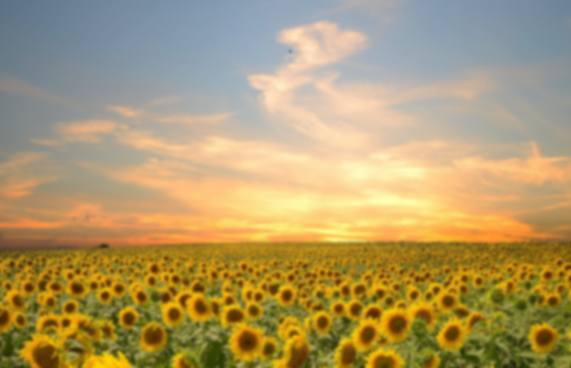
Friday 8th September
Be silent and place yourself in God’s loving presence. Think about the good things that have happened this week and give thanks.​
Who have you left a good memory with this week?
Look back over your week. What were the joys, what were the challenges
As you look ahead, with what spirit will you enter next week?
Ask God to help you.

