Slide 1


Prayers for the week
4 – 8 March 2019
Prayer theme: Feast, then fast
The season of Lent begins this week on Ash Wednesday. This is the period of 40 days of preparation as we approach the great Christian feast of Easter. The focus of this preparation falls into three distinct areas. They are prayer, fasting and alms-giving (fundraising for charity). At Upton Hall during Lent, the charity that we support is known as Caritas, sometimes called The Good Shepherd. This charity is run by the diocese of Shrewsbury and it supports families in need and vulnerable young people across the north-west including here on the Wirral.

Slide 2


Monday 4 March
We start fundraising today for the Good Shepherd Appeal. We pray for a blessing on all our form’s fundraising efforts.
A Prayer for Fundraisers
Good and gracious God,
we recognize all life is a gift and a blessing.
We thank you for your most generous love.
Encourage us to be persons of honesty and integrity,
In this ministry of fundraising.
Give us joyful spirits, and an eagerness to engage others.
Give us hopeful imagination and creative vision,
recognizing generosity in even the smallest gift.
Give us strong, steadfast hearts in times of discouragement.
Remind us always that what we do for the least of our sisters and brothers, we do for you.
We ask this in Jesus’ name and in unity of the Holy Spirit.
Amen.

Slide 3
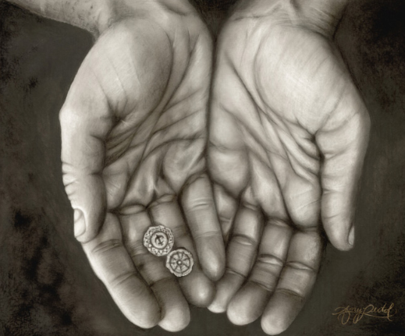
Monday 4 March
A reading from the Gospel of Luke
Just then he looked up and saw the rich people dropping offerings in the collection plate. Then he saw a poor widow put in two pennies. He said, “The plain truth is that this widow has given by far the largest offering today. All these others made offerings that they’ll never miss; she gave extravagantly what she couldn’t afford—she gave her all!”
What would be hard for you to give up in Lent, but would benefit you and or others?

Slide 4

Tuesday 5 March
Blessed are you, Lord God of all creation, for it is from your goodness that we have this day to celebrate on the threshold of the Season of Lent.
Tomorrow we will fast and abstain from meat. Today we feast.
We thank you for the abundance of gifts you shower upon us.
We thank you especially for one another.
As we give you thanks, we are mindful of those who have so much less than we do.
As our feasting fills us with gratitude
so may our fasting help us
to be more attentive to hear the cry of the poor.
May our fasting turn our hearts to you
and give us a new freedom for
generous service to others.
Be with us in our Lenten journey. Amen.

Slide 5

Tuesday 5 March
Prayer for Shrove Tuesday
God of feasting,
we give you thanks
for the richness of life.
Bless us as we celebrate the joy
of being your people.
Send your Spirit to dance
and sing with us.
As we enter the Season of Lent,
may it, too, be a celebration of life:
of an inward journey of contemplation and wondering,
of learning and exploring.
And in all of this,
may we grow closer to Jesus,
to one another, and to you.
We pray in Jesus' name. Amen.
Shrove Tuesday is also called Fat Tuesday because on that day a thrifty housewife uses up the fats that she has kept around for cooking, but that she will not be using during Lent. Since pancakes are a standard way of using up fat.

Slide 6

Wednesday 6 March
https://www.youtube.com/watch?v=Xo1mjuy1NA0
What are your hopes for Lent?

Slide 7

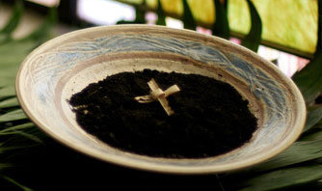
Wednesday 6 March
Today, ashes are thumbed onto our forehead as a sign that we are human, fragile, and will sometimes get it wrong.
They are also an invitation to turn away from sin and believe in the Gospel, the Good News of Jesus Christ who loved us to the end.
Ash Wednesday begins the season of Lent, forty days of reflection and action: prayer, fasting from what’s not good for us and almsgiving.
The colour is violet. The volume is turned down, the Alleluia is put away, the Gloria is unplugged. Time to go deeper.
We pray and fast and give alms to the needy so that we can come closer to God and our neighbour, to the presence of love that is never far from us.
Dear Lord, may we be open this Lent to your love, so that we ay know we are reconciled to you, that we are friends.

Slide 8
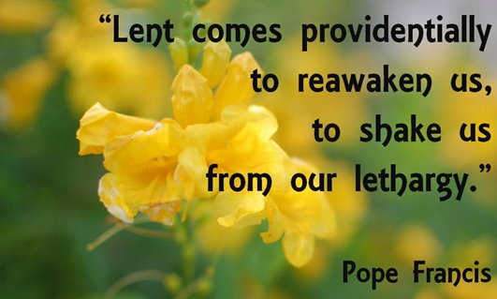

Thursday 7 March
Lord God
As we begin this season of Lent, teach us to use the time wisely. Let us be reawakened to new possibilities in our lives. Help our prayer life to grow in depth and meaning. May we be generous with our fund-raising efforts on behalf of young people and families in our community who need our support. Let us find a way to improve ourselves during Lent so that we may truly live out our FCJ values.
We make this prayer through Christ our Lord.
Amen.
Idea: No TV or screens today (except for homework)

Slide 9

Thursday 7 March
Loving God,
We thank you for all the good books that we enjoy. Thank you for the people who make them, the people who read them to us, and the people who help us to learn to read. We thank you especially for the Bible: the good book that you gave us, where we can learn more about Jesus. Amen.

Slide 10

Friday 8 March
We ask you God to walk with us through this season of Lent.
As we find ourselves challenged,
remind us of our inner strength and give us hope.
As we struggle to engage in acts of charity,
remind us to think of the dignity of others and to act justly.
When we know we have moved away from your companionship
remind us that you are waiting to welcome us back.
Inspire us to be generous;
encourage us to be gentle;
and strengthen us on our journey.
Amen.
Idea: Don’t eat meat today

Slide 11

Friday 8 March
Examen
Be silent and place yourself in God’s loving presence. Think about the good things that have happened this week and give thanks.​
Who have you left a good memory with this week?
Look back over your week. Where have you felt joy and what has been difficult and challenged you? In the quiet of your heart, tell God about your experiences.​ Give thanks for who you are.
As you look ahead, with what spirit will you enter next week?
Ask God to help you.

Slide 12
Afternoon Prayer and Reflection
Lord
Thank you for the morning, for watching over me and walking with me. May I find joy and understanding this afternoon, in all I do. Grant me the zest and the strength I need to work for you until nightfall. Amen
Let us pause for a few moments in silence and remember those family members and friends who need our prayers and support today…………
Let us ask Mary, our Mother, to join us in our prayers as we say:
Hail Mary, full of grace, the Lord is with thee. Blessed art thou amongst women and blessed is the fruit of thy womb, Jesus. Holy Mary, Mother of God, pray for us sinners now and at the hour of our death. Amen
We end our reflection with a prayer inspired by our foundress followed by the school prayer:
Loving Father, life-giving spirit – Marie Madeleine believed in your power, hoped in your promises and lived for your glory. We ask her to pray for us and be with us as we carry the FCJ spirit into the 21st century. Protect and guide the pupils and staff at Upton and at all FCJ schools in this country and around the world. Amen
May the Lord bless us and keep us from all evil and bring us to everlasting life. Amen

