Slide 1
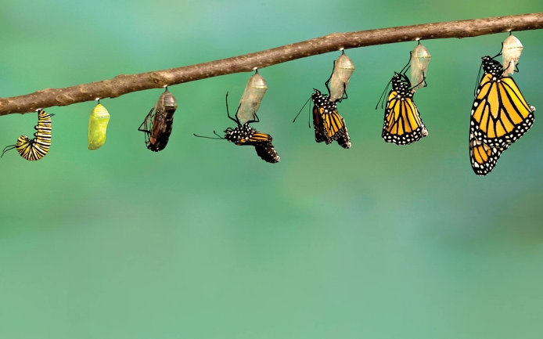
Change
What needs to change to make the World a more equal and loving place?
And what’s my role in it?
8th – 11th June
Prayers prepared by Maria Fidelis FCJ and Upton Hall FCJ

Slide 2
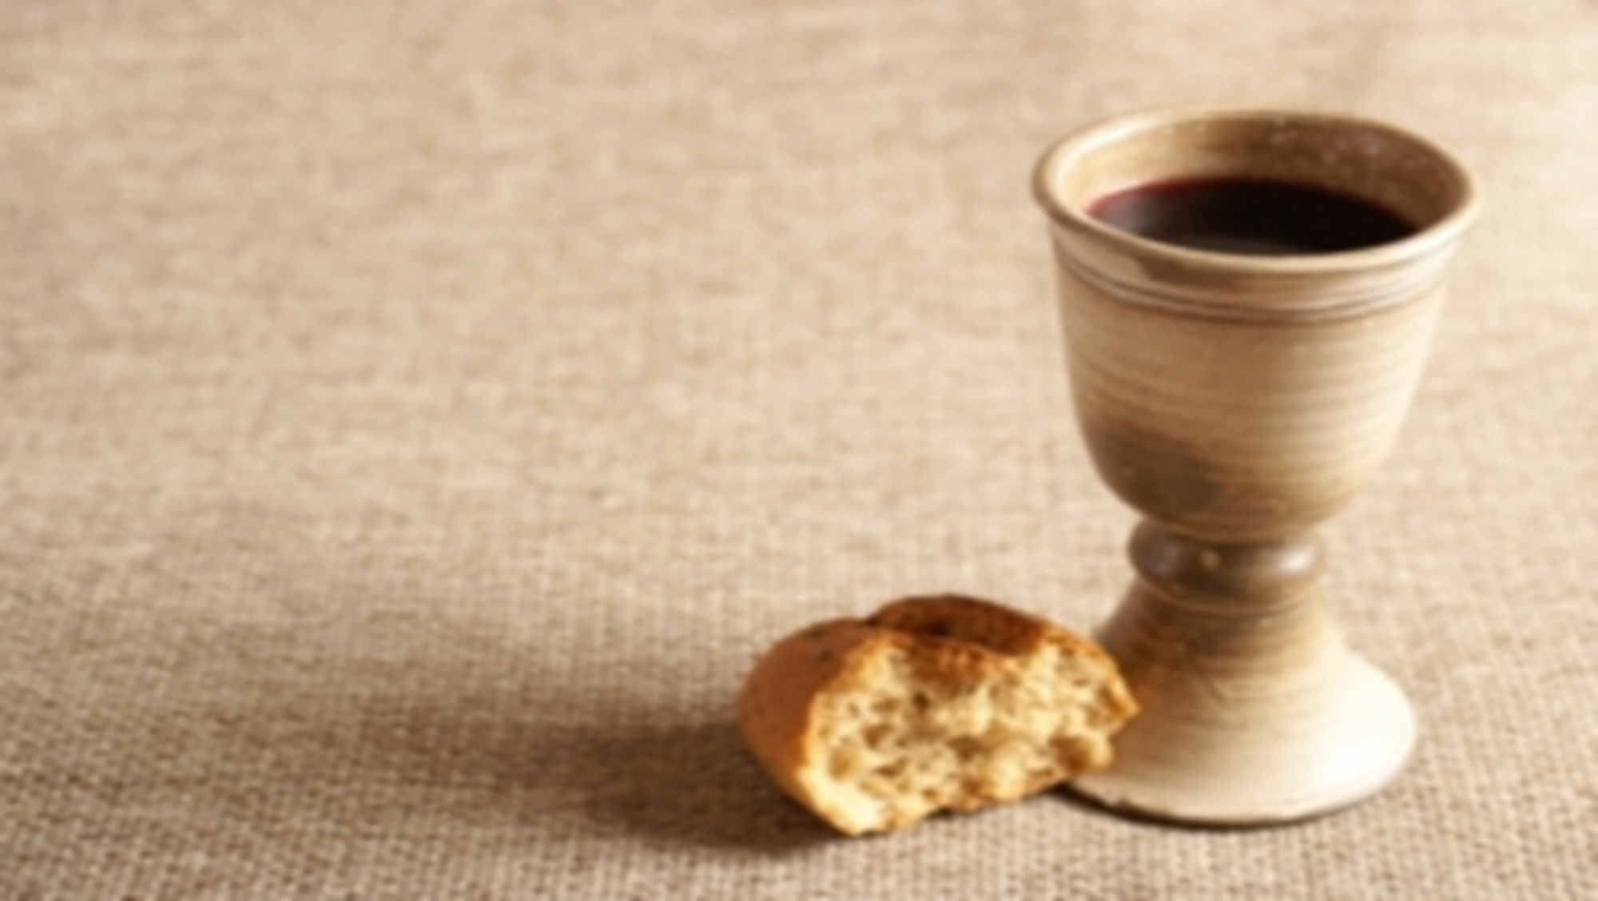
Feast of the Body and Blood of Christ
Tuesday 8th June
Sunday was the feast of the Body and Blood of Christ.
Jesus, I believe that You are present in the Most Holy Sacrament. I love You above all things, and I desire to receive You into my soul.
Since I cannot at this moment receive You sacramentally, come at least spiritually into my heart. I embrace You as if You were already there and unite myself wholly to You. Never permit me to be separated from You. Amen.
(Prayer of St Alphonsus)
Holy Communion is the shortest and safest way to Heaven. (- Pope Saint Pius X )

Slide 3
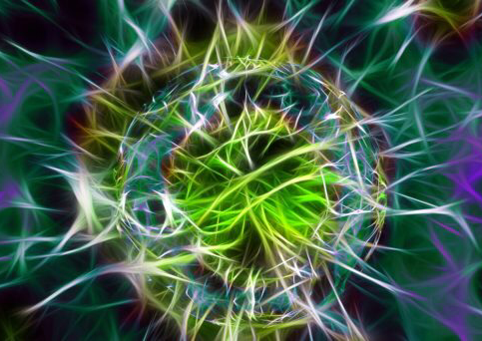
Can I change just one thing about myself so I can grow into my best self?
Tuesday 8th June
Recognising you have the ability to change is like realising you have a superpower. Whether it be social skills, studying abilities, waking up on time or any other traits, these can all be developed and improved – you’re never truly as stuck as you might think you are… teenagers who are able to recognise their ability to change can use that as a powerful coping skill to handle stress, insecurity and other anxieties or pressures.
- Jay Martin, Life Teen
Continue on the next slide

Slide 4
Let us pray…
Lord, I do not know where I am going or what you would have me do next, but I trust that you have a purpose for everything you do and that you are leading me to where you would like me to be. I ask that you would give me the strength to follow you and the grace to trust you even though I do not know the way or what the future holds. Send your Holy Spirit to guide and accompany me on the journey that you would have me follow so that my life may give greater glory to you always. Amen.
Rebecca Ruiz
https://www.ignatianspirituality.com/when-the-winds-of-change-blow/

Slide 5
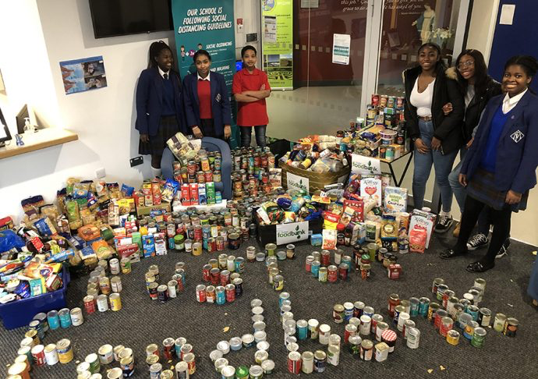
Can I choose to work with others to bring about positive change where I live?
Wednesday 9th June
Fighting for justice will never be an easy battle. We have learned that from Christ, to the disciples, to Abraham Lincoln, to Martin Luther King, to many Catholic saints. Yet people like you and I keep trying to fight for it.
…why?
Because like all those who fought with everything they had before us, you and I are called to more than what this world may want us to settle for. So don’t give up fighting for justice. We are the Body of Christ after all; when one of us hurts, the whole body does too…
- Juan Aznaran, Life Teen
Song: Christ has no body now but yours (2:30 mins)
https://www.youtube.com/watch?v=2SQtXzjC2pg

Slide 6
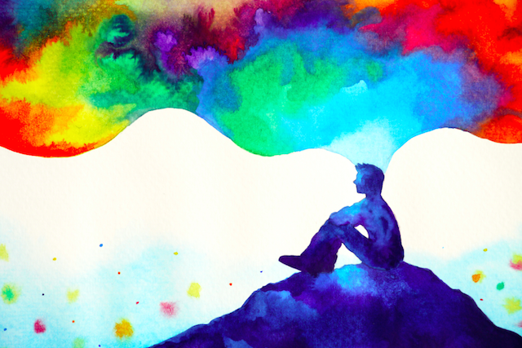
Can I change my thoughts about God and God’s Creation?
Wednesday 9th June
God invites us to join in the great adventure begun with creation, to cooperate with God in bringing about the kingdom of God in which human beings live in harmony with God, with one another, and with the whole created world. The kingdom of God is not about some heavenly realm outside this world; it’s about this world in which we live. How we live, here and now, has enormous consequences for all of creation and for God.
- Fr. William Barry, SJ

Slide 7
Let us pray…
Lord, I do not know where I am going or what you would have me do next, but I trust that you have a purpose for everything you do and that you are leading me to where you would like me to be. I ask that you would give me the strength to follow you and the grace to trust you even though I do not know the way or what the future holds. Send your Holy Spirit to guide and accompany me on the journey that you would have me follow so that my life may give greater glory to you always. Amen.
Rebecca Ruiz
https://www.ignatianspirituality.com/when-the-winds-of-change-blow/

Slide 8
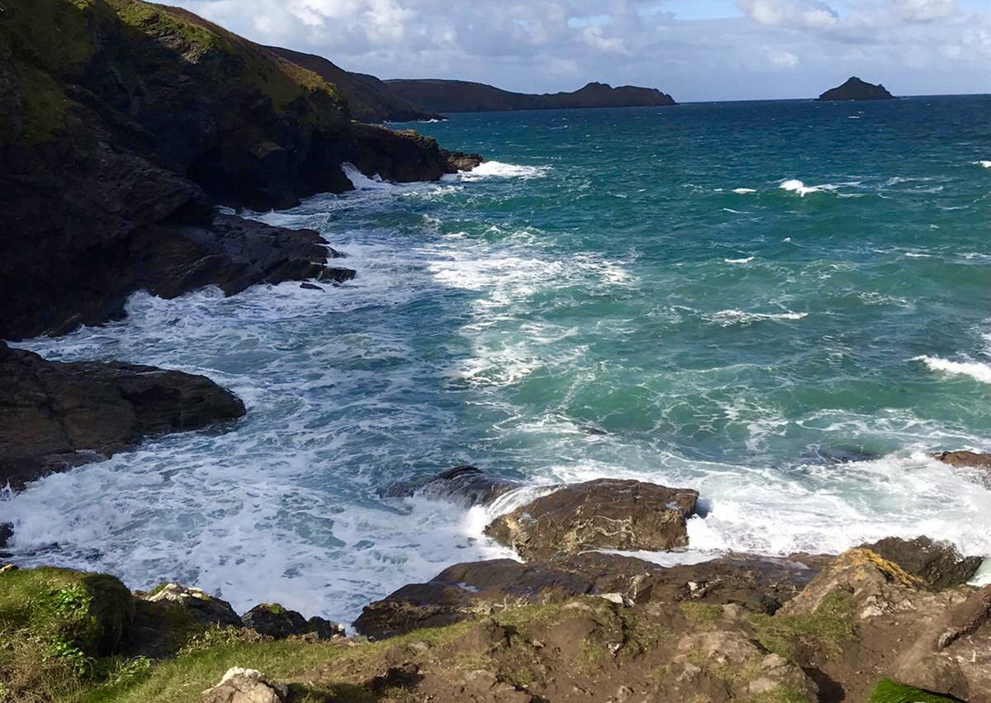
What difference can I make?
Thursday 10th June
Often times as a teen (and as an adult too), I felt like what I was doing was never making an impact on the larger world. While I volunteered when I could, it can feel like everything we do is minuscule compared to all the issues the world has. As frustrating as this might be, we must not lose hope in our ability to make a difference or the effects that these types of movements can have.
Mother Teresa said, “We ourselves feel that what we are doing is just a drop in the ocean. But the ocean would be less because of that missing drop.”
Dillon Duke, Life Teen
Continue on the next slide

Slide 9
Let us pray…
Lord, I do not know where I am going or what you would have me do next, but I trust that you have a purpose for everything you do and that you are leading me to where you would like me to be. I ask that you would give me the strength to follow you and the grace to trust you even though I do not know the way or what the future holds. Send your Holy Spirit to guide and accompany me on the journey that you would have me follow so that my life may give greater glory to you always. Amen.
Rebecca Ruiz
https://www.ignatianspirituality.com/when-the-winds-of-change-blow/

Slide 10
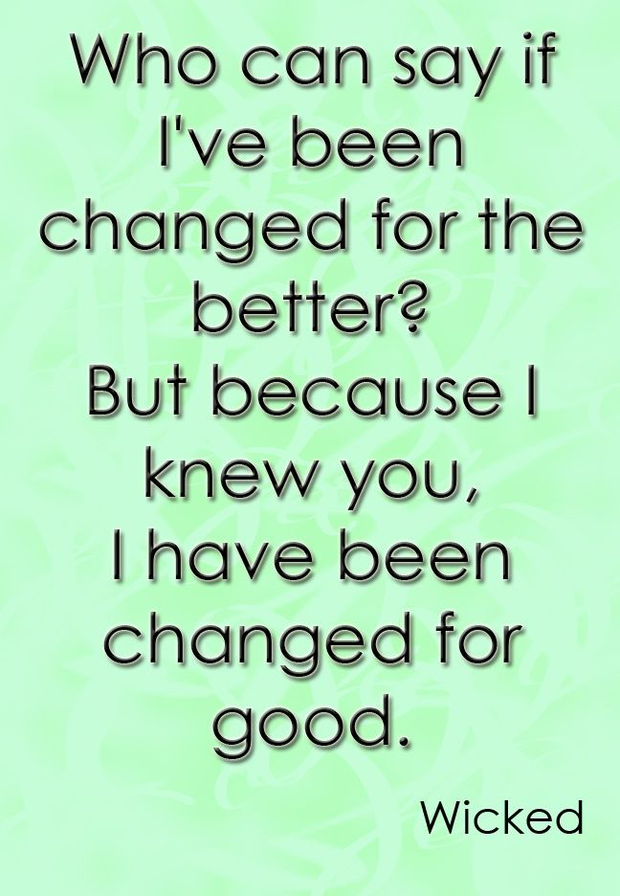
Can I invite others to help me change for the better, knowing I will be changed for good? Can I let my friends help me to become a better person? And can I help them do the same? Let’s see what this song might teach us…
Thursday 10th June
https://youtu.be/AuMBSnU5Doc(4:20 mins)

Slide 11
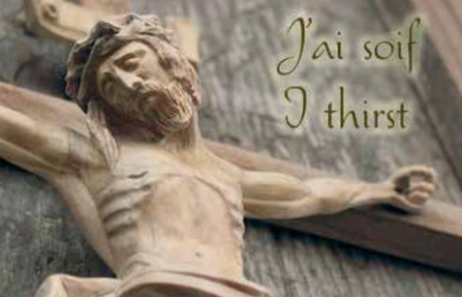
Friday 11th June
Feast of the Sacred Heart of Jesus
Today’s feast is celebration of the love of God, the God who loves us forever. It is a sign of the open heartedness of Jesus.
On the Feast of the Sacred Heart 1816, Marie Madeleine (FCJ Foundress) was praying before the crucifix when she heard the words of Jesus on the cross as though spoken directly to her. ‘I Thirst’. She understood that Jesus’ thirst and love for all people was to become her own.
Loving God,
In our own time it is not difficult to recognise some of the ways in which Jesus is thirsting in our world. There are countless news items that draw our hearts and lead us to compassion. Help us to listen and to respond to what God is asking of each of us.
Amen.

Slide 12
The Examen
Friday 11th June
Be silent and place yourself in God’s loving presence. Think about the good things that have happened this week and give thanks.​
Who have you left a good memory with this week?
Look back over your week. Where have you felt joy and what has been difficult and
challenged you? How have you been able to make a difference? In the quiet of your heart, tell God about your experiences.​
As you look ahead, with what spirit will you enter next week?
Ask God to help you.

