Slide 1
Prayers for the week 1 – 5 October 2018
Prayer theme: Gratitude
This week we give thanks for all the good we have received, for all those who love us and care for us and we pray especially for these people who are a blessing for us.

Slide 2
Monday 1 October
From the letter of St. Paul to the Philippians:
Don’t be anxious about anything; rather bring up all your requests to God in your prayers, along with giving thanks. Then the peace of God that is beyond understanding will keep your hears and minds safe in Christ Jesus.
God of all good things sometimes I complain about having a hard time when things aren’t going well, but help me to remember what I have to be grateful for, beginning with this morning –
I woke up in a warm bed, my eyes opened and I could see. I got out of bed unaided and put on clean clothes.
I had a choice for breakfast, and clean water to brush my teeth.
I had school books to put in my bag, someone to wave my off for the day, a safe journey to school I have teachers, I have friends.
For all that and more

Slide 3
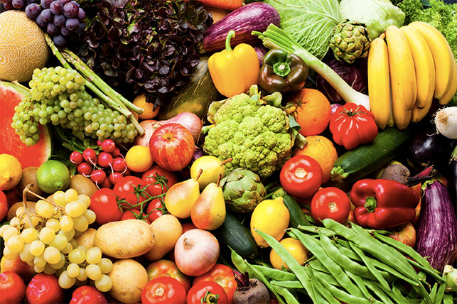
Tuesday 2 October
Harvest
Lord of the Harvest, we thank you for your creation, for its beauty and fruitfulness, we thank you for blessing us with our daily bread
Lord of Mercy, we pray that we will become wise stewards of this world.
We are sorry for the times when we are selfish and not sharing the earth’s bounty fairly.
Lord of Justice, we pray for those living in poverty and cry out for an end to inequality. We pray that you help us to help others, tat all might live a life of plenty.
Amen.

Slide 4
Wednesday 3 October
Sunday 7th October is Grandparents Day
Dear God, please bless my grandparents. Thank you for the life they gave my parents and for the life they give to me. For the ways they helped me, I give thanks. For the ways they love me no matter what, I rejoice.
Let them grow in wisdom and joy in life. Bless them always.
We also pray for all those grandparents who have passed away, giving thanks for all they have done and what they have meant to us. May they rest in peace. Amen.

Slide 5
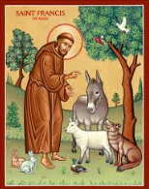
Thursday 4 October
Feast of Saint Francis
Saint Francis lived in the 12th-13th century. He was born in a wealthy family and initially lived the typical life of a rich young man. After having had a vision he changed his lifestyle drastically choosing to live in poverty, trusting that God would give him all he needed, he founded the Franciscans. Because of his love and care for all animals he became the patron saint of animals.
We give thanks for God’s creation and for all life.
Good St. Francis, you loved all of God’s creatures. To you they were your brothers and sisters. Help us to follow your example of treating every living thing with kindness.
St. Francis, Patron Saint of animals, watch over my pet and keep my companion safe and healthy. Amen.

Slide 6
Friday 5 October
Giver of all wisdom and greatest of all teachers,
Look upon our teachers with love, grant them the resolve to nurture our eager minds and to never give up on us who fall behind.
Bless their hearts for they rejoice when we succeed and encourage us when we need help.
Bless them with gentle patience for the path of learning is never easy.
Kindle a passion in them because it is that flame that ignites the love of learning in us.
Help them see the potential in each of us. Their belief in us means much more than the grade we make.
Instil in them a commitment to keep on learning. It shows us to not fear new knowledge and experiences.
Inspire them to touch the future. They influence how big we dream for ourselves.
Bless our teachers from before for their work endures.
Let the light of your example shine upon all teachers to build up with their words, to love with their mind, to share with their heart. Amen.

Slide 7
Afternoon Prayer and Reflection
Lord
Thank you for the morning, for watching over me and walking with me. May I find joy and understanding this afternoon, in all I do. Grant me the zest and the strength I need to work for you until nightfall. Amen
Let us pause for a few moments in silence and remember those family members and friends who need our prayers and support today…………
Let us ask Mary, our Mother, to join us in our prayers as we say:
Hail Mary, full of grace, the Lord is with thee. Blessed art thou amongst women and blessed is the fruit of thy womb, Jesus. Holy Mary, Mother of God, pray for us sinners now and at the hour of our death. Amen
We end our reflection with a prayer inspired by our foundress followed by the school prayer:
Loving Father, life-giving spirit – Marie Madeleine believed in your power, hoped in your promises and lived for your glory. We ask her to pray for us and be with us as we carry the FCJ spirit into the 21st century. Protect and guide the pupils and staff at Upton and at all FCJ schools in this country and around the world. Amen
May the Lord bless us and keep us from all evil and bring us to everlasting life. Amen

Slide 8
Friday afternoon
Examen
Be silent and place yourself in God’s loving presence. Think about the good things that have happened this week and give thanks.​
Who have you left a good memory with this week?
Look back over your week. Where have you felt joy and what has been difficult and challenged you? In the quiet of your heart, tell God about your experiences.​ Give thanks for who you are.
As you look ahead, with what spirit will you enter next week?
Ask God to help you.

