Slide 1

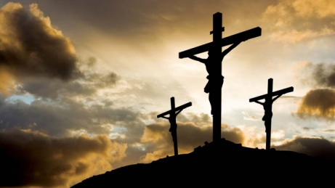
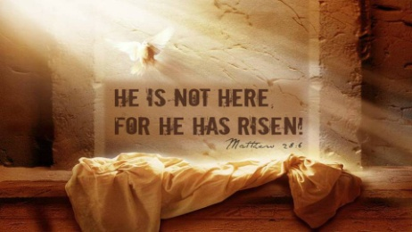


Prayers for the week
26 - 29 March 2018
Easter and Holy Week
The Easter Triduum or the Three Days of Easter, is the period that begins with the liturgy on the evening of Maundy Thursday (Holy Thursday). It continues with the service on Good Friday and ends with the celebration of the Resurrection of Jesus on Easter Sunday. It recalls the passion, death, burial, and resurrection of Jesus, as portrayed in the Gospels. As we journey into the holy mystery of the Easter Triduum, may we acknowledge each other, not as this person or that, but as an equal member of the Body of Christ, as one part to a unified whole.
The prayers this week are taken from the iBelieve community website, the author is Rachel Marie Stone
It is the fundraising week for Year 11

Slide 2
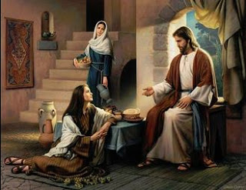

Monday 26 March
Lord God,
Six days before his death, your son sat with Lazarus,
Whom he had raised from the dead, and ate dinner with his friends.
Once again, the gospel tells us, Martha served,
And Mary knelt at Jesus’ feet to anoint them with costly perfume.
The disciple who was about to betray Jesus said that it was a waste.
He didn’t care about the poor, he just wanted to fill his own pockets
And make Mary feel ashamed.
Lord God, often we cannot discern what is best:
When to pour out costly perfume for your sake,
Even if the world thinks it a waste. When to be busy serving,
Or when to rest at your Son’s feet and learn.
Give us ears to hear you and eyes to see.
For the sake of your Son, Jesus Christ.
Amen.

Slide 3
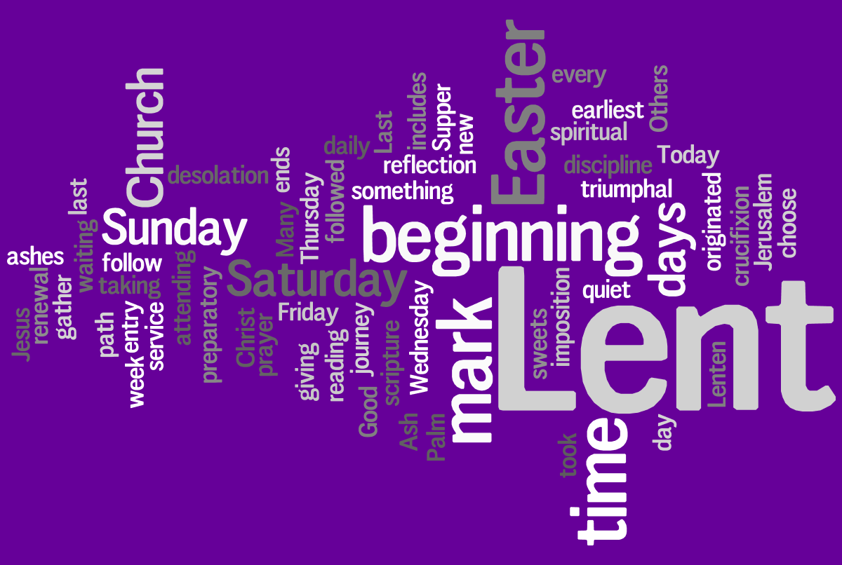
Tuesday 27 March
Lord God,
The message of the cross is difficult to take.
How can death give way to life? How can weakness be strength?
Yet your word says that Jesus, being God,
Took on human flesh and suffered the worst kind of death.
How can this be?
This message is indeed difficult to take.
But your foolishness is wiser than our wisdom.
Your weakness is greater than our strength.
In his name, we ask you to help our unbelief:
That we may love you, and walk in the way Jesus taught us.
In his name, through Christ our Lord
Amen.

Slide 4


Wednesday 28 March
Lord God,
It is hard to think
That it was one of Jesus’ own friends who betrayed him.
One who sat by him, who broke bread with him.
Give us strength, we pray, to walk faithfully with Jesus,
Even when the road we walk is rocky,
Even when the message of the cross seems like foolishness
And even when we feel betrayed.
You, Lord, are always faithful.
We stumble, we become lost,
But you are steady and sure.
Give us the grace to endure our troubles,
And reveal to us the glory of your kingdom,
Through your son, Jesus Christ,
who lives and reigns with you
and the Holy Spirit, one God for ever and ever.
Amen.

Slide 5

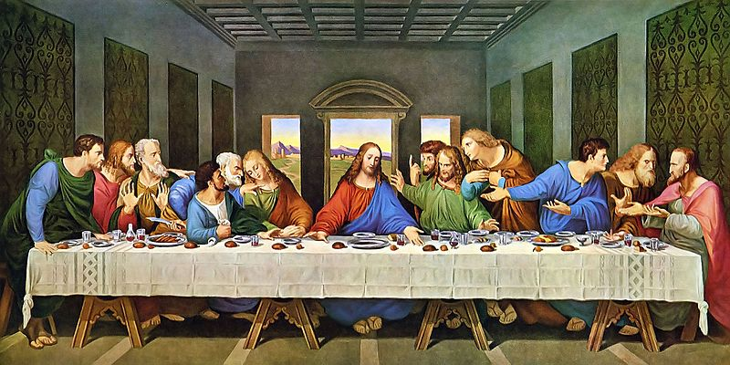
Thursday 29 March
Maunday Thursday
Lord God,
You sent your Son into the world,
And before his hour had come, he washed his disciples’ feet.
You had given all things into his hands.
He had come from you, and was going to you,
And what did he do? He knelt down on the floor,
And washed his friends’ feet.
He was their teacher and their Lord, yet he became their servant.
Lord God, help us learn from his example;
Help us to do as he has done for us.
The world will know we are his disciples if we love one another.
Strengthen our hands and our wills for love and for service.
Keep before our eyes the image of your Son,
Who, being God, became a Servant for our sake.
All glory be to him who lives and reigns with you
and the Holy Spirit, one God, now and forever.
Amen.

Slide 6
Afternoon Prayer and Reflection
Lord
Thank you for the morning, for watching over me and walking with me. May I find joy and understanding this afternoon, in all I do. Grant me the zest and the strength I need to work for you until nightfall. Amen
Let us pause for a few moments in silence and remember those family members and friends who need our prayers and support today…………
Let us say together the prayer that Jesus taught his disciples and then a prayer inspired by Marie Madeleine:
Our Father who art in heaven, hallowed be thy name. Thy kingdom come. Thy will be done, on earth as it is in heaven. Give us this day our daily bread, and forgive us our trespasses, as we forgive those who trespass against us, and lead us not into temptation but deliver us from evil. Amen
Loving Father, life-giving spirit – Marie Madeleine believed in your power, hoped in your promises and lived for your glory. We ask her to pray for us and be with us as we carry the FCJ spirit into the 21st century. Protect and guide the pupils and staff at Upton and at all FCJ schools in this country and around the world. Amen
May the Lord bless us and keep us from all evil and bring us to everlasting life. Amen

