Slide 1
Daily Prayers for FCJ Schools Week beginning Monday April 26th 2021
Vocation: what are you called to do, who are you called to be?
The 4th Sunday of Easter is also known as Vocation Sunday
Prayers prepared by Gumley FCJ and Upton Hall FCJ

Slide 2
Sunday’s gospel (John 10: 11-18)
Monday 26th April
Jesus said: ‘I am the good shepherd: the good shepherd is one who lays down his life for his sheep. The hired man, since he is not the shepherd and the sheep do not belong to him, abandons the sheep and runs away as soon as he sees a wolf coming, and then the wolf attacks and scatters the sheep; this is because he is only a hired man and has no concern for the sheep. ‘I am the good shepherd; I know my own and my own know me, just as the Father knows me and I know the Father; and I lay down my life for my sheep. And there are other sheep I have that are not of this fold, and these I have to lead as well. They too will listen to my voice, and there will be only one flock, and one shepherd. ‘The Father loves me, because I lay down my life in order to take it up again. No one takes it from me; I lay it down of my own free will, and as it is in my power to lay it down, so it is in my power to take it up again; and this is the command I have been given by my Father.’
Loving God, At times there can be a lot of noise, distracting us from hearing your voice. Help us to be still sometimes to listen and connect with you, who know what we need most of all. Amen.

Slide 3
Our collective vocation
Who is the Christ we are called to reflect?
Christ who
opened his heart to the unwanted
experienced solitude as a source of strength
allowed compassion to move through all his glances and actions
encouraged simplicity
acknowledged and praised the goodness of others
was a presence that encouraged
extended forgiveness to all
struggled to do the Father’s will
Monday 26th April
Lord,
may your will
be done
in me.
Amen.

Slide 4
Tuesday 27th April
The Church today acknowledges the broadness of vocation. One can have a vocation to priesthood or religious life, but also to marriage or single life.
Each one of us has a vocation and it simply means that God loves us for who we are and that we are called to be the best version of ourselves.
Loving Father,
you call us to help you build a better world.
As we journey through life listening to the voice of the Risen Lord,
make our hearts burn within us, as we hear your Word in scripture, and share in the Holy Eucharist.
Pour out on us your Holy Spirit,
that we might have wisdom and understanding.
Guide us in the footsteps of holy men and women of every age so that we may be transformed into the living
image of Jesus your Son, who lived at the service of all.
We ask this, through Christ our Lord, Amen.

Slide 5
Tuesday 27th April
“Come to the edge,” he said.
“We’re comfortable back here” they said.
“Come to the edge,” he said.
“We’re too busy,” they said.
“Come to the edge,” he said.
“It’s too high,” they said.
“Come to the edge,” he said.
“We're afraid,” they said.
“Come to the edge,” he said. “We’ll fall,” they said.
“Come to the edge,” he said. And they did. And he pushed them. And they flew.
Christopher Logue
Lord, give us the courage we need to fly.
Amen

Slide 6
Wednesday 28th April
LORD of the Harvest,
BLESS young people with the gift of courage to respond to your call.
Open their hearts to great ideals, to great things.
INSPIRE all of your disciples to mutual love and giving—
for vocations blossom in the
good soil of faithful people.
INSTILL those in religious life, parish
ministries, and families with the confidence
and grace to invite others to embrace
the bold and noble path of a life
consecrated to you.
UNITE us to Jesus through prayer,
so that we may cooperate
with you in building your reign of mercy
and truth, of justice and peace. Amen.
(adapted from pope Francis)

Slide 7
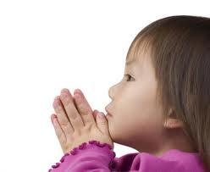
May we be aware of the needs of others;
spend some time in quiet prayer;
be of service to those who need our help;
And a guide to all
who ask for our care.
We make this prayer through Christ our Lord and guide.
Amen

Slide 8
Listen to the song ‘The Summons’ (4 mins) https://www.youtube.com/watch?v=GiXnbOORTAU

Slide 9
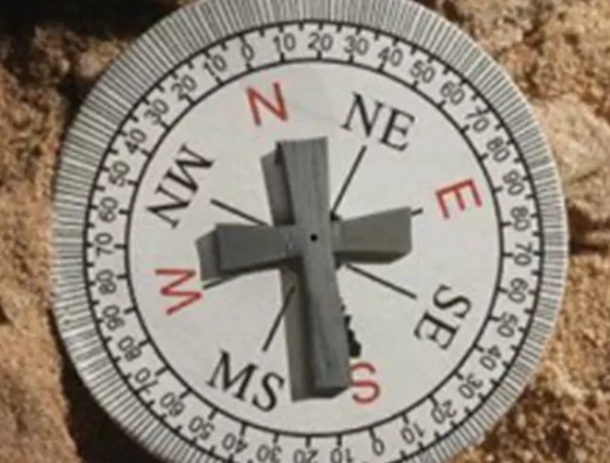
Thursday 29th April
Dear God,
As I adventure with you today be the compass that guides me, the light that shines on my path, the only one I follow.
As I adventure with you today be the word that encourages, the hand that reaches out, each time I stumble
As I adventure with you today let me glimpse our destination, and appreciate the places through which you lead me.
As I adventure with you today, be the strength I need to follow, and as the day draws to a close let me rest in your embrace.
Amen.

Slide 10
Thursday 29th April
We have a call! To be loved and to love. To be shown mercy and to show mercy. To be forgiven and to forgive. To receive hope and to offer hope . To know joy and share joy. To feel peace and bring peace. To be made whole and offer wholeness. We have a call Listen... Listen... Do you hear?

Slide 11
Friday 30th April
When does an ordinary life become extraordinary?
When does a mundane day become revolutionary?
When does a moment in time change history?
When God enters in, forgives sin and allows us to begin again.
Lord, thanks for your love. Amen
Lord I place my prayers into your
loving hands this day. Amen.

Slide 12
Try this EXAMEN this week.
It is from The Jesuit Institute, South Africa
https://www.youtube.com/watch?v=pDQgjzJINdk

Slide 13
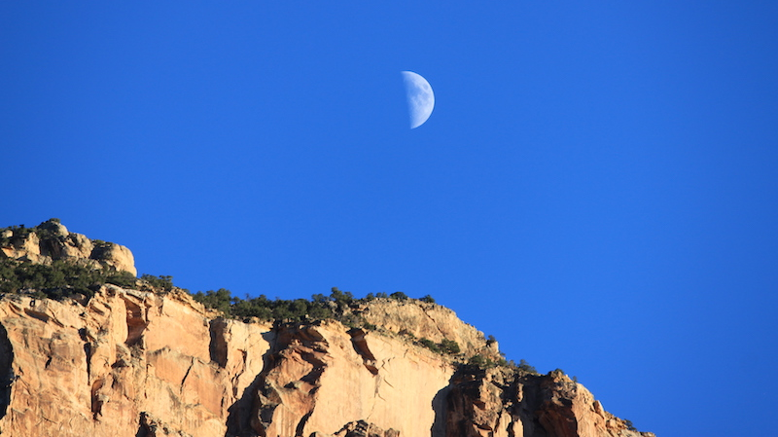
Thought for the Weekend:
How Good
God
Is!

