Slide 1
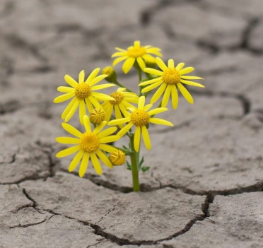
Prayers for the week 29 April – 3 May
Prayer theme: Hope and New Life
On Easter God does what people thought to be the impossible: he raises Jesus fro the death. This is the basis for our Christian hope and the reason why it is one of the FCJ values.
Our hope and expectation is that,
through God’s grace working in us all,
each young person grows into their best self,
with zest for life and the generosity
and confidence to use their talents and gifts
in the service of others.
Hope inspires and enables us to persevere
in the face of difficulties and empowers us
to fulfil our aspirations.

Slide 2
Monday 29 April
The Gift of Easter
https://www.youtube.com/watch?v=mr1WD7NwbrQ

Slide 3
Monday 29 April
Loving God,
After Easter the news spread quickly, Jesus is alive, he is risen! At first the disciples doubted. But their doubts turned to joy and to praise as they met the risen saviour.
We can still hear the words of the first Easter Jesus is alive, he is risen! And we give thanks Father, You hold out to us an eternal hope, If you can do this, then you can do anything. We ask that you guide all of us in the months ahead with what we have to face.
Thank you for the hope we have in our lives, A hope we can scarcely put into words: Jesus is alive, he is risen, And we are saved! Thank you God. Amen

Slide 4
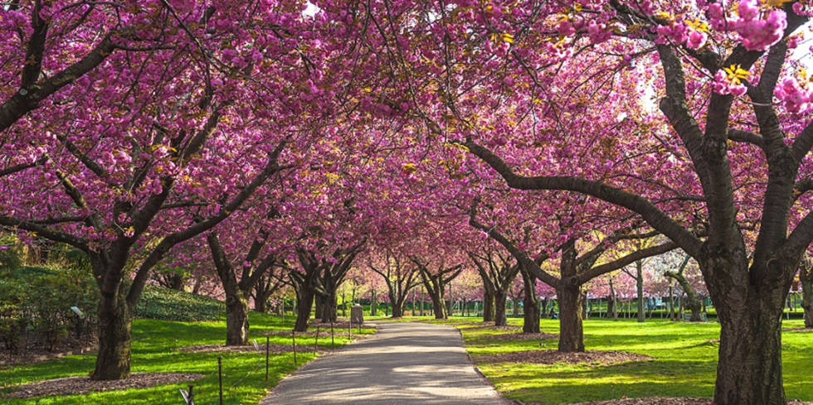
Tuesday 30 April
God, thank you for Spring and the hope of warmer, longer, brighter days.
Thank you for the coming of growth and life and birth.
Thank you that things are coming awake in the world.
This is what our calendar says, and we do see some signs that it is real.
Now we ask that you bring into reality all that belongs in this season. Your word says that we will have provision, and hope, and joy, and health and loving relationships here and now in this life.
We ask that what belongs in this season would become actual in our practical lives.
We hope in you and in your promises. We hope in your gift of Spring.

Slide 5
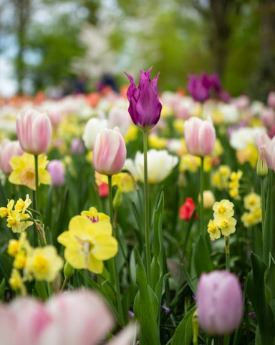
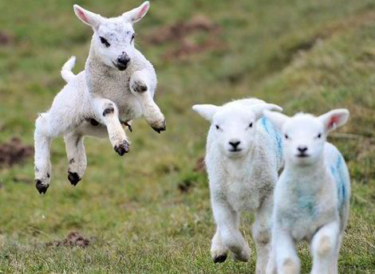
Tuesday 30 April
Loving God,
Thank you for New Life , for Spring flowers, baby chicks, new born lambs for Spring sunshine and rain showers, Which helps the plants to grow. Thank you for the dried bulbs and seeds which look so dead They are springing into new life, soon they will be beautiful.
Most of all Lord, We thank you for your Son, Jesus, Who suffered and died for us, on the cross. Now we celebrate, that He rose from the dead. HE IS RISEN! ALLELUIA Amen.

Slide 6
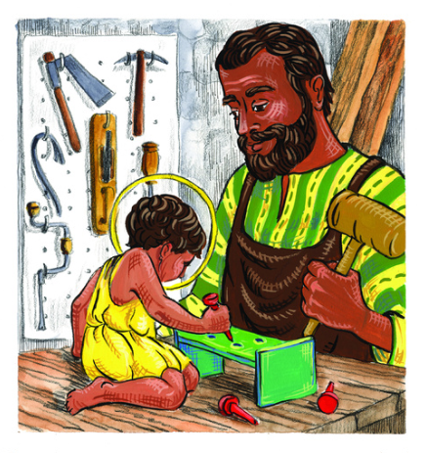
Wednesday 1 May
Feast of St. Joseph the Worker
Worker in wood and stone, skilled with hammer and chisel,
Man of courage who protected Mary fro the demands of the law that someone in her position should be stoned. You made a home for her and her unborn Son of God.
Joseph the worker, husband, father –
Pray for the workers,
that they may have dignity,
Pray for the husbands,
that they ay be loving,
Pray for the fathers,
that they may be patient and wise.
Amen.

Slide 7
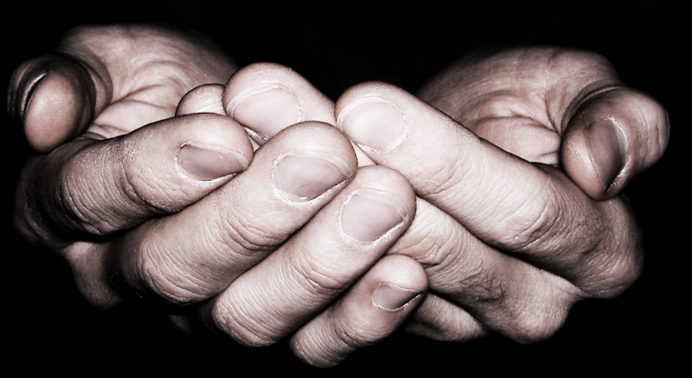
Wednesday 1 May
Bless the hands
God of created things, your Son worked with his hands, apprenticed to his human father Joseph-
He learned to work in wood and stone, shaping and measuring, sawing and chiselling, getting the line just right, the fit snug.
Bless the hands we take for granted, the hands that help us on our way, that provide for us, that pick us up when we stumble.
Bless the hands that combed and brushed our hair when we were younger, the hands that held ours when we could not be trusted on the road.
Bless the hands that serve our food, the hands that planted and raised the crops that made it al the way to our plate. Bless the hands that stitched and sewed our clothes, that pinned and packed our shirts and tops, sometimes for less than we call a living wage.
Bless the hands that fix our bodies when they’re broken, sew up wounds, take our temperature, tell us when to slow down.
Bless the hands that mark our books, that help us grow in skill and understanding, that point us on the way to truth.
Bless the hands that bless us, no matter what we’ve done, the hands that bless us anyway.
Amen.

Slide 8
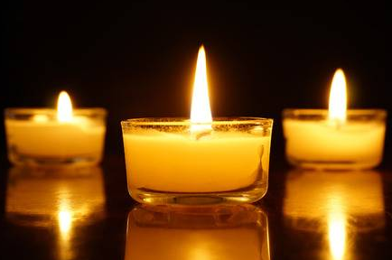
Thursday 2 May
We pray for all those who have recently died and for those who are mourning. Help us to see death and dying in the light of the resurrection.
In your hands, O Lord, we humbly entrust our loved brothers and sisters.
Welcome them into paradise,
where there will be no sorrow,
no weeping or pain,
but fullness of peace and joy
with your Son and the Holy Spirit
forever and ever. Amen.

Slide 9
Thursday 2 May

Slide 10
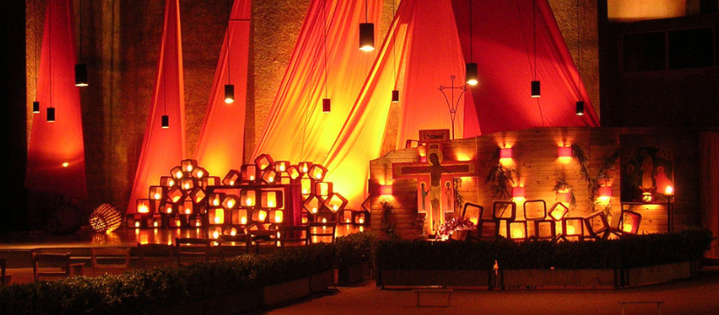
Friday 3 May
A Latin song from the community in Taize (in France) https://www.youtube.com/watch?v=_47gKnCMVNQ
In resurrectione tua, Christe, coeli et terra laetentur
In your resurrection, O Christ, let heaven and earth rejoice!”﻿

Slide 11
Friday 3 May
Examen
Be silent and place yourself in God’s loving presence. Think about the good things that have happened this week and give thanks.​
Who have you left a good memory with this week?
Look back over your week. Where have you felt joy and what has been difficult and challenged you? In the quiet of your heart, tell God about your experiences.​ Give thanks for who you are.
As you look ahead, with what spirit will you enter next week?
Ask God to help you.

Slide 12
Afternoon Prayer and Reflection
Lord
Thank you for the morning, for watching over me and walking with me. May I find joy and understanding this afternoon, in all I do. Grant me the zest and the strength I need to work for you until nightfall. Amen
Let us pause for a few moments in silence and remember those family members and friends who need our prayers and support today…………
Let us say together the prayer that Jesus taught his disciples:
Our Father who art in heaven, hallowed be thy name. Thy kingdom come. Thy will be done, on earth as it is in heaven. Give us this day our daily bread, and forgive us our trespasses, as we forgive those who trespass against us, and lead us not into temptation but deliver us from evil. Amen
May the Lord bless us and keep us from all evil and bring us to everlasting life. Amen

