Slide 1


Prayers for the week
March 2019
Prayer theme:
Lent: Pray, Fast, Give
We pray for the students and staff who are fundraising and for the work of the charities we support such as Caritas Shrewsbury, CAFOD and Hospice Africa.
It is the fundraising week for year 9.

Slide 2

Monday 11 March
About CAFOD
https://www.youtube.com/watch?v=kzDPkRbTIxY
Loving God,
Open our ears to hear the cries of our sisters and brothers and of the earth, our common home.
Open our eyes to the scandal of poverty and injustice in the world.
Open our hearts to feel the pain, the hurt, the hunger of one another.
Open our mouths to speak of the dignity of each person, precious in your sight.
Open our arms wide to reach out with compassion.
Open our hearts to share your love and our hope of
a world where no one is beyond reach.
We ask this through Christ Our Lord, Amen.

Slide 3
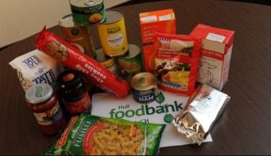
Monday 11 March
In every country in the world there are people who don’t have their human needs met, who struggle to find their daily bread or who don’t have a roof over their heads.
Dear God, it is difficult to see children suffer, especially from hunger. We ask You to give them daily bread today and end their persistent hunger. Provide the food they need to grow and thrive. Pour out Your grace on hungry families. Amen.
Idea: Donate food to your local foodbank.

Slide 4

Tuesday 12 March
A prayer for a better world
Generous God
We thank you: For the gifts you have given us, the abundance of your Creation, and the beauty that surrounds us.
For the people whose lives have touched ours, for the love they show, the burdens they lift and the hopes we share.
Compassionate God, we ask you: to fill us with your love, to place in our hearts a spirit of courage, to move us to reach out to others in need.
Lead us to play our part, so that now and for generations to come all of your children may share in our hope for a better world.
We ask this through Christ our Lord,
Amen.
Idea: Look out for opportunities to share.

Slide 5
Tuesday 11 March
Give up harsh words: use generous ones.
Give up unhappiness: take up gratitude.
Give up anger: take up gentleness and patience.
Give up pessimism: take up hope and optimism.
Give up worrying: take up trust in God.
Give up complaining: value what you have.
Give up stress: take up prayer.
Give up judging others: discover Jesus within them.
Give up sorrow and bitterness: fill your heart with joy.
Give up selfishness: take up compassion for others.
Give up being unforgiving: learn reconciliation.
Give up words: fill yourself with silence, and listen to others.

Slide 6
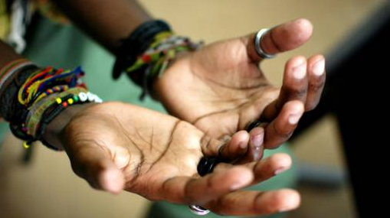
Wednesday 13 March
https://www.youtube.com/watch?v=hZDh05Vjmes

Slide 7


Wednesday 13 March
Lord Jesus,
teach me to be generous;
teach me to serve you as you deserve,
to give and not to count the cost,
to labour and not to seek reward,
except that of knowing that I do your will.
Amen.
(after St. Ignatius Loyola)
Idea: Support year 9 as they fundraise.
Have a Spring clean in your wardrobe and donate clothes you don’t want anymore.

Slide 8
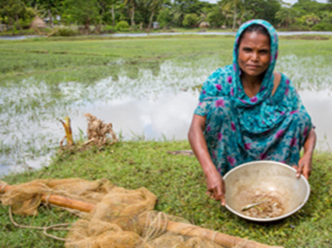
Thursday 14 March
Mahinur live in rural Bangladesh and relies on the river beside her house to feed her family. It is normally full of fish to eat and to sell.
But last year, a drought dried up the river. The fish died. Rains have refilled the river bed but there are hardly any fish and all are tiny. Sometimes the family only has water for dinner.
Loving God, you are a God who wants justice and dignity for all.
We pray for all those who hunger:
through the grace of God may they know
that they are not forgotten.
May they find the strength and support
that they need to lift themselves out of
poverty. Amen.

Slide 9
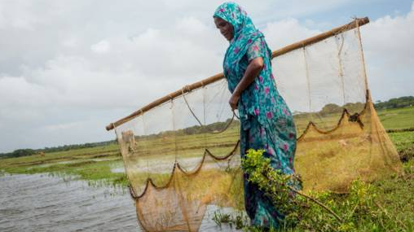
Thursday 14 March
“…be reconciled …then come back and present your offering.” Matthew 5:23-24
Many of God’s family live in extreme poverty due to unfair trade systems, conflict or the impacts of climate change.
We can help change this by prayer, speaking out, living simply, fundraising and supporting charities.
We pray for the Church throughout the world: that she may be a sign of God’s love for all people and a beacon of hope for all who are in need.
Idea: Tomorrow is Cafod Family Fast Day. Have a simple meal and give what you save to charity.

Slide 10

Friday 15 March
Today is CAFOD Family Fast Day
“…be reconciled …then come back and present your offering.” Matthew 5:23-24
Many of God’s family live in extreme poverty due to unfair trade systems, conflict or the impacts of climate change.
We can help change this by prayer, speaking out, living simply, and taking the challenge this Lent to give it up!
If you are giving up something for Lent, think how much money you are saving or get sponsored and donate the money to CAFOD or another charity.

Slide 11

Friday 15 March
Examen
Be silent and place yourself in God’s loving presence. Think about the good things that have happened this week and give thanks.​
Who have you left a good memory with this week?
Look back over your week. Where have you felt joy and what has been difficult and challenged you? In the quiet of your heart, tell God about your experiences.​ Give thanks for who you are.
As you look ahead, with what spirit will you enter next week?
Ask God to help you.

Slide 12
Afternoon Prayer and Reflection
Lord
Thank you for the morning, for watching over me and walking with me. May I find joy and understanding this afternoon, in all I do. Grant me the zest and the strength I need to work for you until nightfall. Amen
Let us pause for a few moments in silence and remember those family members and friends who need our prayers and support today…………
Let us ask Mary, our Mother, to join us in our prayers as we say:
Hail Mary, full of grace, the Lord is with thee. Blessed art thou amongst women and blessed is the fruit of thy womb, Jesus. Holy Mary, Mother of God, pray for us sinners now and at the hour of our death. Amen
We end our reflection with a prayer inspired by our foundress followed by the school prayer:
Loving Father, life-giving spirit – Marie Madeleine believed in your power, hoped in your promises and lived for your glory. We ask her to pray for us and be with us as we carry the FCJ spirit into the 21st century. Protect and guide the pupils and staff at Upton and at all FCJ schools in this country and around the world. Amen
May the Lord bless us and keep us from all evil and bring us to everlasting life. Amen

