Slide 1
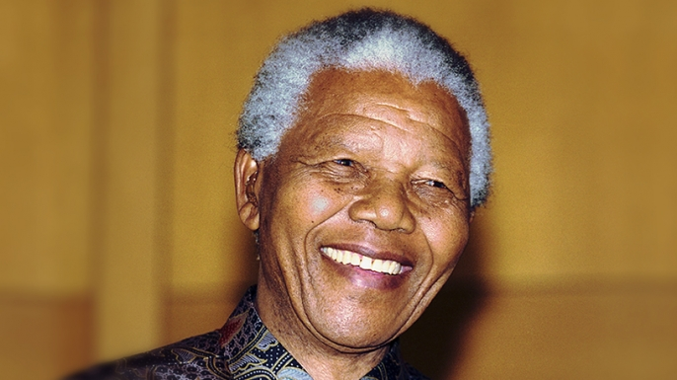
Prayers for the week 15-19 January 2018
The prayers for this week are inspired by Nelson Mandela (1918 – 2013), a South African anti-apartheid revolutionary, political leader and philanthropist.
He served as President of South Africa from 1994-1999.

Slide 2
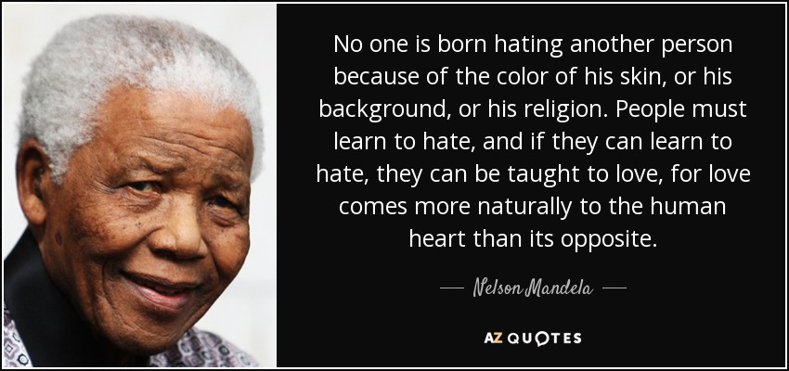
Monday 15 January
Lord God
Open our hearts and help us to respect the dignity of every person.
Open our eyes to see the injustices that exist all around us.
Open our ears to listen and learn from the experiences of people who suffer from prejudice.
Open our mouths to speak out against such prejudice and injustice.
Help us to commit ourselves to work for justice and peace within our school and our society.
We ask this through Christ Our Lord
Amen

Slide 3
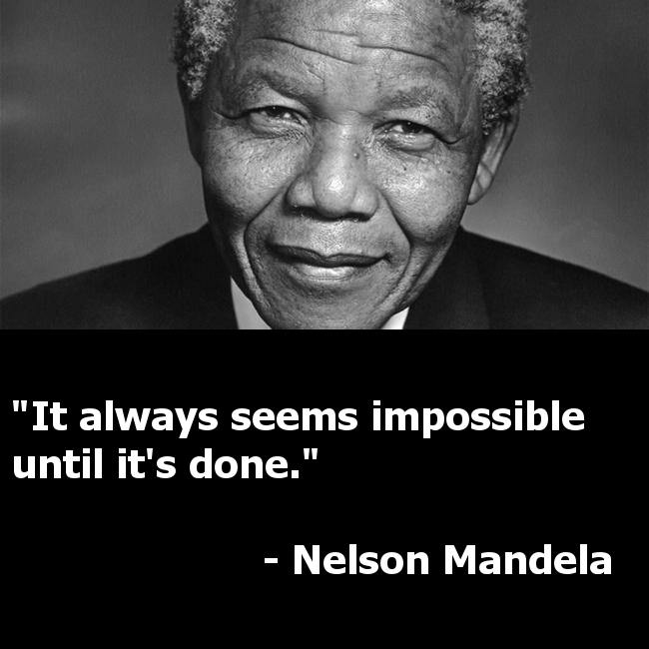
Tuesday 16 January
Lord
Grant us courage and confidence so that we can attempt what might seem to be impossible. Fill us with hope and optimism that will see us through to the end of any task. Allow us to draw strength from others when we need it and to be generous with our companionship when we are able to help someone else.
Amen

Slide 4
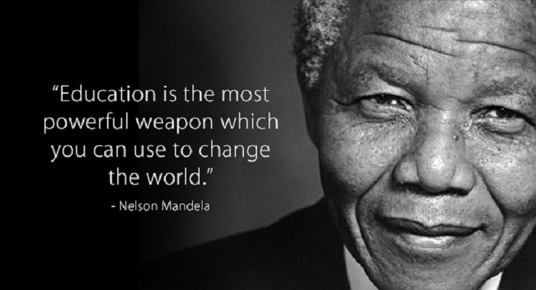
Wednesday 17 January
Lord
We give thanks for the many opportunities that we enjoy at Upton Hall. May we never take for granted the experience of education that we benefit from every day. Help us to be mindful of those, especially young women, who do not have access to any sort of education. Let us use our gifts and talents for the benefit of others in order to build a fairer and more just world
Amen

Slide 5
Thursday 18 January
Lord God
Teach us not to fear failure. Let us become risk-takers, able to learn from our mistakes. Grant us the resilience to persevere especially when the going gets tough. May we also have a generosity of spirit that allows us to help others to get back up again when they fall.
We make this prayer through Christ Our Lord
Amen

Slide 6
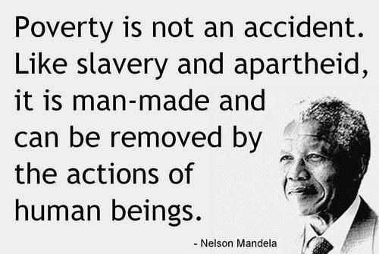
Friday 19 January
Lord
Help us to do all that we can to remove the scourge of poverty both from our own community and the wider world. We give thanks for the work we are doing to feed and clothe the homeless on Wirral and to support the education of pupils in Nairobi. May our hearts always be open to those in need. May we always answer a cry for help and may we spend our lives tipping the scales of justice towards those who have nothing.
Amen

Slide 7
Afternoon Prayer and Reflection
Lord
Thank you for the morning, for watching over me and walking with me. May I find joy and understanding this afternoon, in all I do. Grant me the zest and the strength I need to work for you until nightfall. Amen
Let us pause for a few moments in silence and remember those family members and friends who need our prayers and support today…………
Let us say together the prayer that Jesus taught his disciples:
Our Father who art in heaven, hallowed be thy name. Thy kingdom come. Thy will be done, on earth as it is in heaven. Give us this day our daily bread, and forgive us our trespasses, as we forgive those who trespass against us, and lead us not into temptation but deliver us from evil. Amen
May the Lord bless us and keep us from all evil and bring us to everlasting life. Amen

