Slide 1
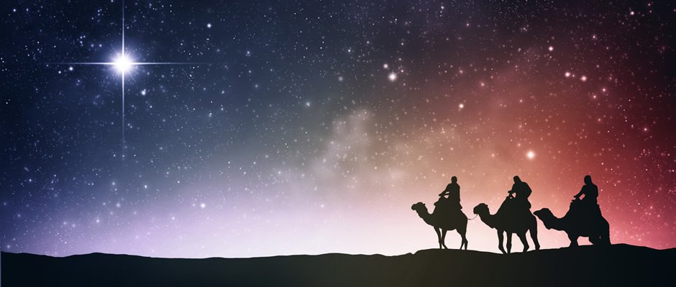
Prayers for the week 8 ⁻12 January 2018

Slide 2
Monday 8 January
Prayer on the feast of the Baptism of Christ
O God, we give thanks for your never-ending love and for the gift of the Christmas season.
Help us to believe in the infinite possibility of starting anew every day through the act of the baptism of Christ.
May we resolve to improve ourselves and the lives of others in this new year.
We make this prayer through Christ Our Lord
Amen

Slide 3
Tuesday 9 January
Lord God, You used the star to guide the wise men to the stable in Bethlehem. Give your guidance to every leader of every nation on earth, that they may serve their people with justice and integrity.
We make this prayer through Christ Our Lord
Amen.

Slide 4
Wednesday 10 January
Lord, with the dawn of this New Year, we are eternally grateful to you as we look forward to the hope and promise that it brings. Help us to use our time wisely this year, especially as we seek to improve the lives of those less fortunate than ourselves.
Amen

Slide 5
Thursday 11 January
Dear Lord,
Help me to remember to protect the reputation
of other people. May I recognise the good in others and not seek out the bad. Revenge and deceit do not bring peace which can only be found in one who is kind and charitable.
Help me to achieve peace through your grace.
Amen

Slide 6
Friday 12 January
Dear Lord,
Fill our lives with joy.
Fill our lives with love.
Fill our lives with peace.
We give thanks to you for the gift of life. May we have the courage and confidence to live it to the full.
Amen.

