Slide 1
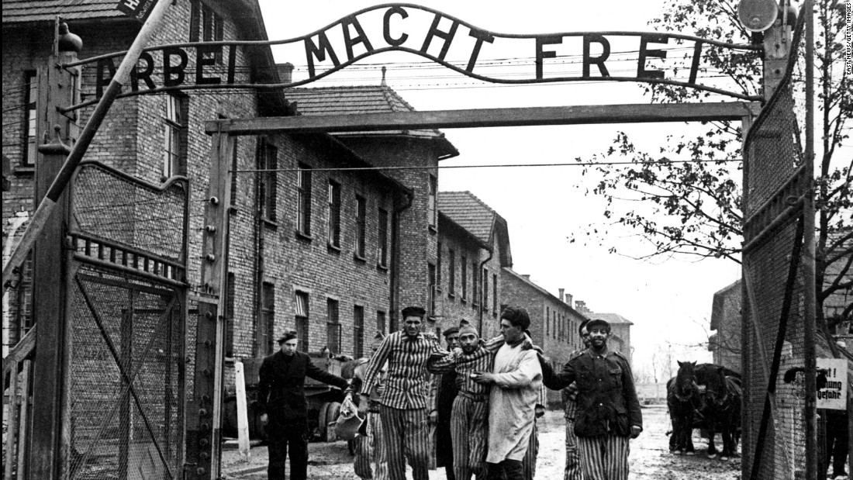
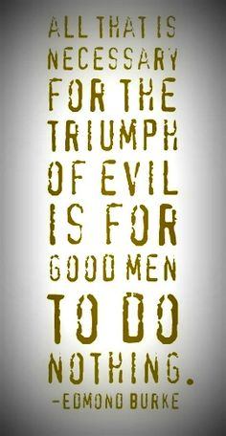
Prayers for the week 22-26 January 2018 Holocaust Memorial week
Saturday 27 January is National Holocaust Memorial day. In our assemblies and our prayers this week we remember this dark event that took place during the Second World War (1939-1945).

Slide 2
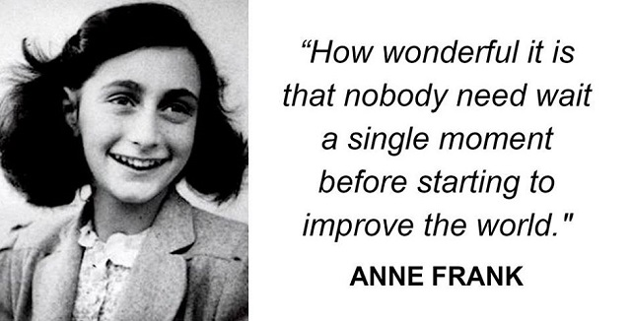
Monday 22 January
Born: 12 June 1929 in Frankfurt, Germany
Died: 12 March 1945 in Bergen-Belsen concentration camp aged 15
Her Diary of a Young Girl was published in 1950
Lord
We give thanks for the life and example of Anne Frank. Let us be inspired by her resilience and optimism. May we always look for ways to improve the lives of those around us. When we are presented with the opportunity to change something for the better, let us grasp it! In the end may we leave the world a better place than we found it.
Amen

Slide 3
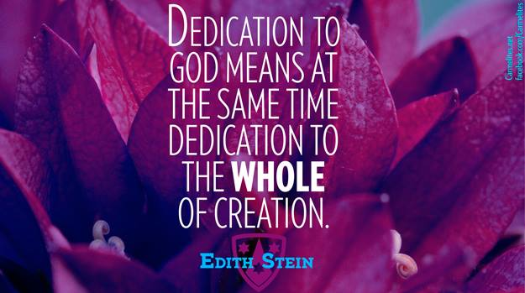
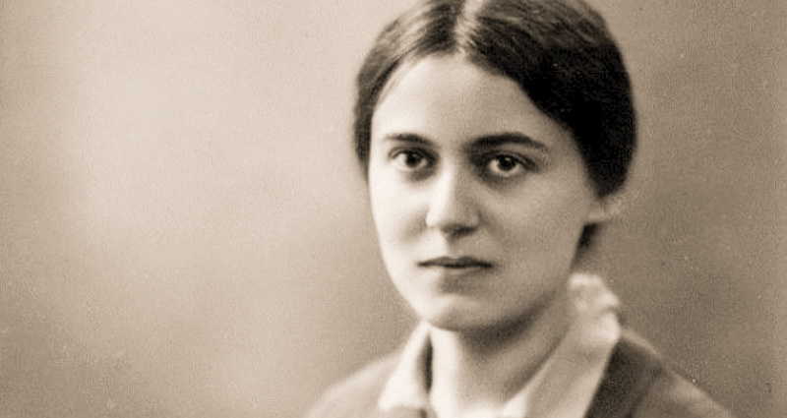
Tuesday 23 January
Edith Stein (12 October 1891 – 9 August 1942) is also known as St. Teresa Benedicta of the Cross. She was a German Jewish philosopher and academic who converted to Roman Catholicism and became a Carmelite nun. She was murdered in the gas chambers at Auschwitz in 1942. She is canonized as a martyr and saint of the Catholic Church.
Lord
We thank you for the life and example of Edith Stein. Let us, like her, ensure that we care for all of creation. Help us to avoid waste and excess in our daily lives and to appreciate the wonders of the natural world. As individuals and as a school community, help us to support and develop environmental projects that will leave a lasting legacy for the benefit of our earth.
Amen

Slide 4
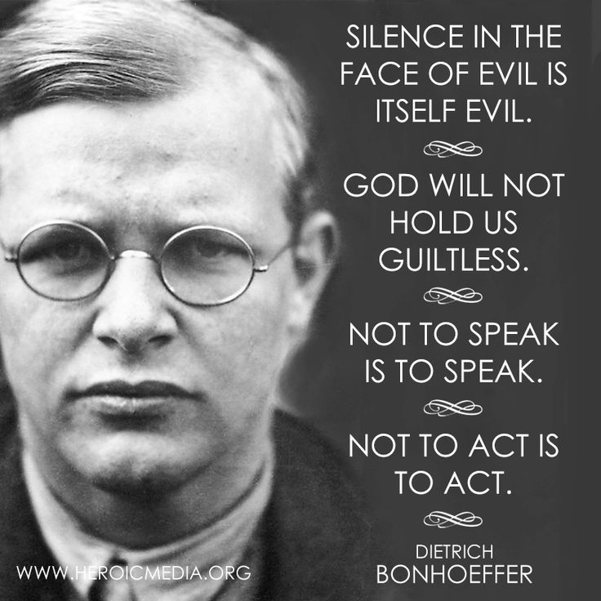
Wednesday 24 January
Born in 1906, Dietrich Bonhoeffer was a German pastor, theologian, writer and anti-Nazi protestor. He was executed by the Nazis at Flossenburg concentration camp in 1945, just one month before the end of the war.
Lord
Help us to follow the brave example of Dietrich Bonhoeffer. He understood that evil would thrive if good men did nothing. Give us the courage we need to break the silence and to speak out against any form of injustice or prejudice. May the weak and the oppressed always find in us a companion to support and encourage them in their hour of need
Amen

Slide 5
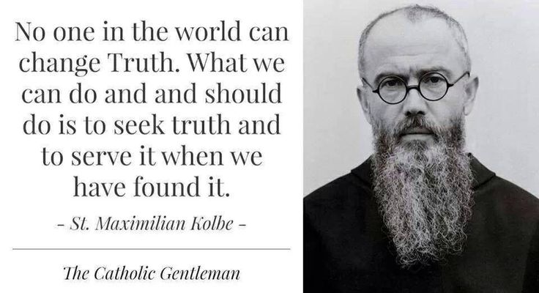
Thursday 25 January
Maximilian Kolbe (8 January 1894 – 14 August 1941) was a Polish Franciscan Friar who volunteered to die in place of a stranger in the German death camp of Auschwitz during World War II. He was active in promoting the veneration of the Immaculate Virgin Mary. Kolbe was canonized as a saint of the church in 1982 by Pope John Paul II
Lord God
May we always seek out what is true and good and beautiful in this life. Inspired by Maximillian Kolbe, let us turn away from lies, deceit and concealment and seek to walk always in the light of truth.
We make this prayer through Christ our Lord
Amen

Slide 6
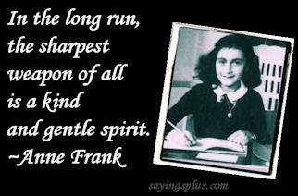
Friday 26 January
Lord
May we be armed with the sword of justice and the shield of truth but always wear a kind and gentle spirit. To be kind is not to patronise, to be gentle is not to be weak. May these virtues live and breathe within us, helping us to shine a light for all to see. Anne used the power of words to make a difference. Let our own words, spoken or written, change the world.
Amen

Slide 7
Afternoon Prayer and Reflection
Lord
Thank you for the morning, for watching over me and walking with me. May I find joy and understanding this afternoon, in all I do. Grant me the zest and the strength I need to work for you until nightfall. Amen
Let us pause for a few moments in silence and remember those family members and friends who need our prayers and support today…………
Let us say together the prayer that Jesus taught his disciples:
Our Father who art in heaven, hallowed be thy name. Thy kingdom come. Thy will be done, on earth as it is in heaven. Give us this day our daily bread, and forgive us our trespasses, as we forgive those who trespass against us, and lead us not into temptation but deliver us from evil. Amen
May the Lord bless us and keep us from all evil and bring us to everlasting life. Amen

