Slide 1
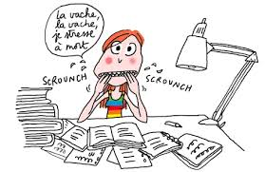
Y13 mocks November 2021
Component 1: Speaking: photo card discussion on Year 1 topics
Component 2: Listening/Reading/Translation
Year 1 and Year 2 topics
Component 3: critical writing on Intouchables (2 essays)

Slide 2
Revision list
Vocabulary
Revise all the vocab covered
Use vocab lists/ quizlet/Linguascope etc….
Grammar:
Tenses: present/perfect/imperfect/near future/simple future/conditional/
Pluperfect/conditional perfect/present subjunctive.
Negation
Adjectives
Pronouns (direct/indirect)
Si clauses
Passive
Agreements
Facts about France and French speaking world for speaking
Intouchables key vocabulary

