Slide 1
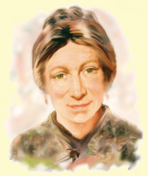

Prayers for the week
16-20 April 2018
Our prayers this week are inspired by Marie Madeleine D’Houet, the foundress of the FCJ Society and of our school. Marie Madeleine (1781–1858) was a French widow and single mother who, later in her life, was inspired by zeal and love for God and guided by the Ignatian spirituality of the Jesuits to found a religious society known as the Faithful Companions of Jesus. The FCJ sisters live and work in the UK and Ireland and in many countries around the world. They run schools and support social service operations. Our local community of FCJ sisters live in St Joseph’s parish in Birkenhead.
Marie Madeleine died in Paris on 5 April 1858. During the Easter Holidays, the 160th anniversary of her death was commemorated by FCJ communities around the world.

Slide 2
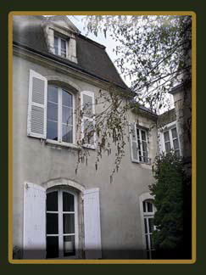
Monday 16 April
Marie Madeleine was born on September 21, 1781. In addition to her immediate family, she was surrounded by lots of aunts, uncles and cousins. It was a happy, secure family, long established in the Berry area of France, where various members held distinguished positions in both church and kingdom. Baptised Marie Madeleine Victoire, she was known as Gigi as a child. With the onset of the French Revolution in 1789, the family knew hardship, prison and exile. Marie Madeleine’s father was imprisoned during this period.
Loving God,
As we come together to pray, our hearts are full of gratitude. We celebrate with thanksgiving, the life and death of Marie Madeleine.
We praise you for all of your blessings and we ask that our hearts may be as open to you as was the heart of Marie Madeleine.
Give us the strength to strive daily to do all things for your honour and praise.
We make this prayer in Jesus' name.
Amen
The house in Châteauroux, France –
birthplace of Marie Madeleine in 1781

Slide 3
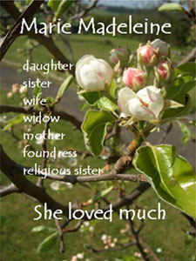
Tuesday 17 April
Allons, courage et confiance. Nous ne devons jamais dire : ‘Je ne puis pas aire cela, je ne suis pas capable de cette charge.’ Dieu ne manquera pas de vous donner la grâce de faire tout ce qu’il demandé de vous.
Have courage and confidence. We must never say ‘I cannot do that, I am not capable of doing this job’. God will not fail to give you the grace to do all that he has asked of you.
In later life the words Courage and Confidence were always on Marie Madeleine's lips, a motto she had learned through experience; not only in the face of death and widowhood and the challenge of bringing up her son alone, but also in the face of opposition to the development of the FCJ Society. ‘Say to each one courage, courage and confidence. That is all that is necessary’, she wrote to Mother Maria Lebesque in 1830. Courage and confidence, but above all great confidence was a variation on the theme which appears in almost every personal letter she wrote. Clearly it was a prayerful wish she offered to others.
Generous God,
You blessed this world with the life, faith and example of Marie Madeleine,
and inspired her to begin the FCJ community.
As we thank you for her, we pray for the FCJ family across the world.
Give us the courage and confidence to be faithful companions of Jesus, too,
through the way we choose to live, the words we choose to say,
the actions we choose to share, and the attitude we choose to take.
Amen.

Slide 4
Wednesday 18 April
Travaillons, disait-elle, comme si tout le succès de nos oeuvres dépendait de nous, mais ne comptons que sur Dieu.
Let us work, Marie Madeleine would say, as if all the success of works depended on us, but let us count on God alone.
When the FCJ Society began in 1820, Marie Madeleine was thirty-eight years of age and there were another thirty-eight years of life before her. The first half of her life had been spent as daughter, wife and widowed mother; the second half was spent as an apostolic religious, the joyful messenger of Jesus Christ, striving by every means in her power to make him known and loved. During this period Marie Madeleine made over 500 journeys spreading the word of God and establishing FCJ houses and schools.
Lord God
Help us to find our own purpose and place in life. May we find pleasure and joy in our lives and bring the same pleasure and joy to others. Let us commit our lives to worthwhile pursuits believing that all the success of the work depends on us. May we always be mindful of those living on the margins of society - the poor, the hungry, the dispossessed and the destitute. Like Marie Madeleine, let us leave the world a better place than we found it.
Amen

Slide 5
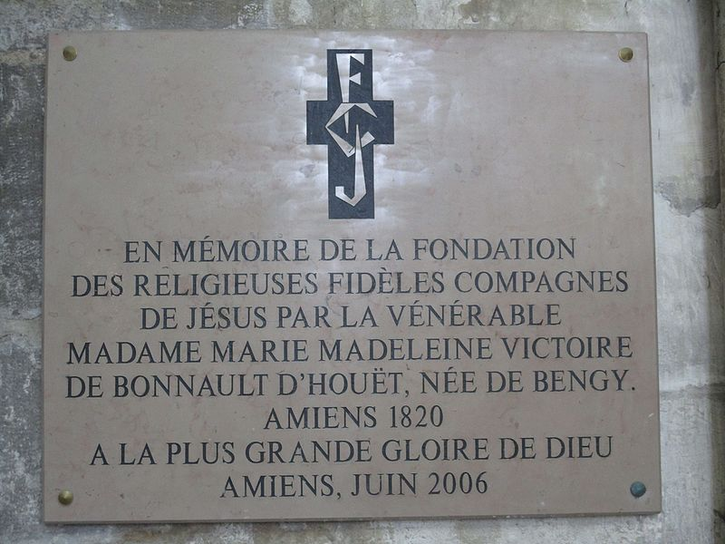
Thursday 19 April
The French city of Amiens holds a special place in the hearts of all those associated with the FCJ Society. It was in Amiens in 1820 that Marie Madeleine founded the order. From small beginnings, the FCJs spread rapidly with twenty-seven convents and schools founded in Marie Madeleine’s lifetime. The FCJs now live and work in fifteen countries and have worked on every continent.
Memorial in Amiens Cathedral
Lord God
We give thanks for the work of the FCJ sisters around the world, who live out the Gospel message in so many ways. We pray for them and for all young women, both at home and abroad, that we may be willing to follow the example of Marie Madeleine in the service of others.
We make this prayer through Christ our Lord
Amen

Slide 6
Friday 20 April
Lord
Help us to develop the combination of strength and gentleness that served Marie Madeleine so well. Give us the same resilience and energy to see each task through to the end: the courage and confidence to take on the big challenges and the humility needed to learn from our inevitable mistakes. In the end, may we be able to look back, like Marie Madeleine, on a life well lived, full of love and laughter
Amen
Marie Madeleine, by those who knew her
Mère Victorine writes: Although Notre Mère was so hard on herself,
nothing could equal her tenderness for others; to each one of us she
was like a mother with her only child, who fears to lose it... Yet this is the woman of whom it was said that in her, the Bishop of Nantes ‘who is very clever, has met his match’; the woman of whom Père de Ravignan said: ‘What audacity in a woman– she knows we are all against her and she is as calm as if this opposition was nothing.’ A doctor in Geneva said she had the head of fourteen generals. And after a visit to Rome a Jesuit said to Mère Marie de Bussy ‘Madame d’Houët has so strong a will that if she wished to be made Pope she would succeed!’

Slide 7
Afternoon Prayer and Reflection
Lord
Thank you for the morning, for watching over me and walking with me. May I find joy and understanding this afternoon, in all I do. Grant me the zest and the strength I need to work for you until nightfall. Amen
Let us pause for a few moments in silence and remember those family members and friends who need our prayers and support today…………
Let us say together the prayer that Jesus taught his disciples:
Our Father who art in heaven, hallowed be thy name. Thy kingdom come. Thy will be done, on earth as it is in heaven. Give us this day our daily bread, and forgive us our trespasses, as we forgive those who trespass against us, and lead us not into temptation but deliver us from evil. Amen
We end our reflection with a prayer inspired by our foundress followed by the school prayer:
Loving Father, life-giving spirit – Marie Madeleine believed in your power, hoped in your promises and lived for your glory. We ask her to pray for us and be with us as we carry the FCJ spirit into the 21st century. Protect and guide the pupils and staff at Upton and at all FCJ schools in this country and around the world. Amen
May the Lord bless us and keep us from all evil and bring us to everlasting life. Amen

