Slide 1
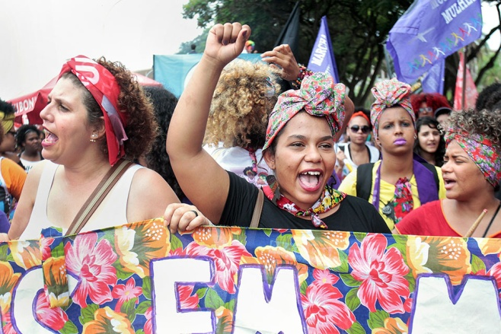
Prayers for the week 5 - 9 March 2018
International Women’s Day takes place on Thursday 8 March. Our sixth form History students, supported by Mrs Davies, will lead our assemblies this week. Our prayers are inspired by women who, through their lives and example, have made a difference to the world and to the place of women in society.
Women in Brazil march for women’s rights
The theme for International Women’s Day is “Time is Now: Rural and urban activists transforming women’s lives”.
This year, International Women’s Day comes on the heels of unprecedented global movement for women’s rights, equality and justice. Sexual harassment, violence and discrimination against women has captured headlines and public discourse, propelled by a rising determination for change.
People around the world are mobilizing for a future that is more equal. This has taken the form of global marches and campaigns, including #MeToo in the United States of America and its counterparts in other countries.
International Women’s Day 2018 is an opportunity to transform this momentum into action, to empower women in all settings, rural and urban, and celebrate the activists who are working relentlessly to claim women’s rights and realise their full potential.
Echoing the priority theme of the upcoming 62nd session of the UN Commission on the Status of Women, International Women’s Day will also draw attention to the rights and activism of rural women, who make up over a quarter of the world population and majority of the 43 per cent of women in the global agricultural labour force.
It is the fundraising week for Year 9

Slide 2
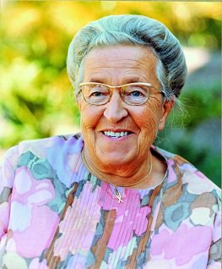
Monday 5 March
Cornelia "Corrie" ten Boom (15 April 1892 – 15 April 1983) was a Dutch watchmaker and Christian who, along with her father and other family members, helped many Jews escape the Nazi Holocaust during World War II by hiding them in her home. She was imprisoned for her actions. Her most celebrated book, The Hiding Place, is a biography that recounts the story of her family.
Lord,
Guide us in our pursuit of happiness. Help us to understand that true and lasting happiness cannot be found in money or material possessions. Instead of having more, we should seek to be more. To be better daughters, better sisters, better friends. Help us to create a well of peace and happiness within ourselves and to share it generously with others
Amen

Slide 3
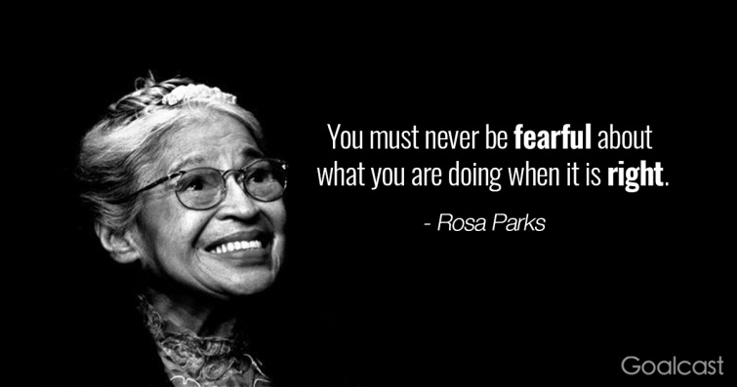
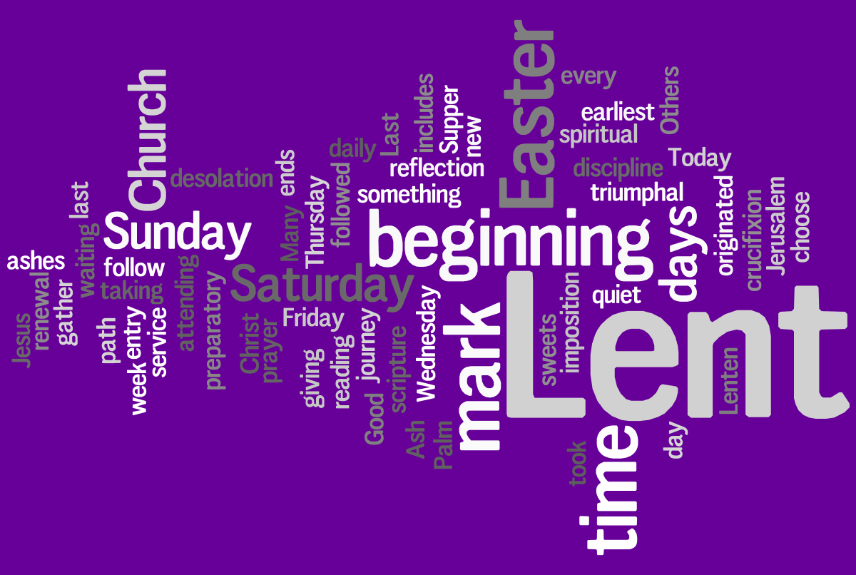
Tuesday 6 March
Rosa Parks (February 4, 1913 – October 24, 2005) was an activist in the Civil Rights Movement. The United States Congress called her "the first lady of civil rights" and "the mother of the freedom movement"
On December 1, 1955, in Montgomery, Alabama, Parks refused to obey the bus driver’s order to give up her seat in the "coloured section" of the bus to a white passenger, after the whites-only section was filled.
Parks' act of defiance and the Montgomery bus boycott became important symbols of the modern Civil Rights Movement. She became an international icon of resistance towards racial segregation. She organized and collaborated with civil rights leaders, including Martin Luther King, a new minister in town who gained international prominence in the civil rights movement.
Lord
Inspired by the example of Rosa Parks, may we always be prepared to stand up for what is right. Teach us to protect the reputation of each member of our school community and to ensure fair treatment for all. May we have the courage that is needed to challenge opinions and actions that contradict Gospel values. Let us always stand shoulder to shoulder with the oppressed.
Amen

Slide 4
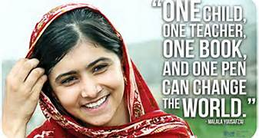
Wednesday 7 March
Malala Yousafzai (born 12 July 1997) is a Pakistani activist for female education and the youngest Nobel Prize winner. She is known for human rights advocacy, especially the education of women and children in her native Swat Valley in northwest Pakistan, where the local Taliban had banned girls from attending school. Malala was injured on 9 October 2012 by a Taliban gunman, who attempted to murder her as retaliation for her activism. Having been hit with a bullet, she remained unconscious and in critical condition. The murder attempt sparked an outpouring of support for Malala. Her advocacy has grown into an international movement.
Lord God
We give thanks for the example of Malala. Let her courage and dignity be an inspiration to us all. May we never underestimate our potential to bring about change. Give us the hope that inspires us to persevere in the face of difficulties and disillusionment. We pray that we will rise to the challenge of being that one person who can change the world.
We make this prayer through Christ our Lord
Amen

Slide 5
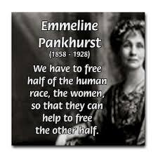
Thursday 8 March International Women’s Day
Emmeline Pankhurst (15 July 1858 – 14 June 1928) was a British political activist and leader of the British suffragette movement who helped women win the right to vote. In 1999 Emmeline Pankhurst was named as one of the 100 Most Important People of the 20th Century, "she shaped an idea of women for our time; she shook society into a new pattern from which there could be no going back". She was widely criticised for her militant tactics, but her work is recognised as a crucial element in achieving women's suffrage in Britain.
Lord,
The suffragettes demanded that the voice of women be heard. Female emancipation and equality remains a pressing issue in every corner of the world. As strong and confident Uptonians let us work tirelessly to promote equality and justice for women everywhere. May we share with Emmeline Pankhurst, the same resilience and determination to succeed in all that we undertake. Let us do this imbued with the spirit of FCJ gentleness, carrying a calm spirit and a peaceful heart throughout our lives.
Amen

Slide 6
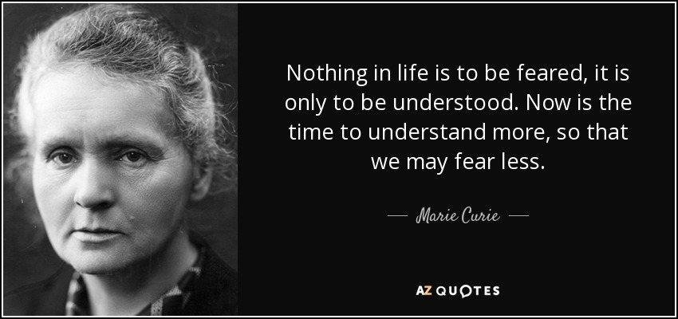
Friday 9 March
Lord God
Grant us the same thirst for knowledge that drove the genius of Marie Curie. Let us grow in a deeper understanding of ourselves, our relationships and the world around us. May we fully engage in our lessons and with our teachers in order to make the most of our time at Upton Hall. Teach us not to fear but to live every day filled with courage and confidence.
We make this prayer through Christ our Lord
Amen
Marie Curie (7 November 1867 – 4 July 1934) was a Polish and naturalized-French physicist and chemist who conducted pioneering research on radioactivity. She was the first woman to win a Nobel Prize, the first person and only woman to win twice and the only person to win a Nobel Prize in two different sciences. She was also the first woman to become a professor at the University of Paris, and in 1995 became the first woman to be interred in the Panthéon in Paris.

Slide 7
Afternoon Prayer and Reflection
Lord
Thank you for the morning, for watching over me and walking with me. May I find joy and understanding this afternoon, in all I do. Grant me the zest and the strength I need to work for you until nightfall. Amen
Let us pause for a few moments in silence and remember those family members and friends who need our prayers and support today…………
Let us say together the prayer that Jesus taught his disciples:
Our Father who art in heaven, hallowed be thy name. Thy kingdom come. Thy will be done, on earth as it is in heaven. Give us this day our daily bread, and forgive us our trespasses, as we forgive those who trespass against us, and lead us not into temptation but deliver us from evil. Amen
May the Lord bless us and keep us from all evil and bring us to everlasting life. Amen

