Slide 1
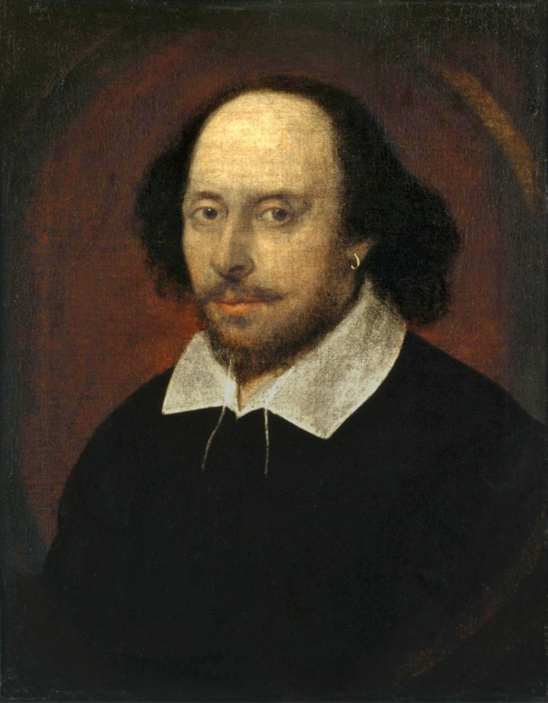
Prayers for the week 23-27 April 2018
Born on 23 April 1564 in Stratford-Upon-Avon, William Shakespeare was an English poet, playwright and actor, widely regarded as the greatest writer in the English language and the world's pre-eminent dramatist. He is often called England's national poet and the "Bard of Avon". His extant works, consist of 37 plays, 154 sonnets and two long narrative poems . His plays have been translated into every major living language and are performed more often than those of any other playwright.
Shakespeare produced most of his known work between 1589 and 1613.His early plays were primarily comedies and histories, which are regarded as some of the best work ever produced in these
Shakespeare – The Chandos Portrait
genres. He then wrote mainly tragedies until about 1608, including Hamlet, Othello, King Lear and Macbeth, considered some of the finest works in the English language. In his last phase, he wrote tragicomedies, also known as romances and collaborated with other playwrights. Many of his plays were published in editions of varying quality and accuracy during his lifetime. However, in 1623 John Heminges and Henry Condell, two friends and fellow actors of Shakespeare, published the most definitive text known as the First Folio.

Slide 2
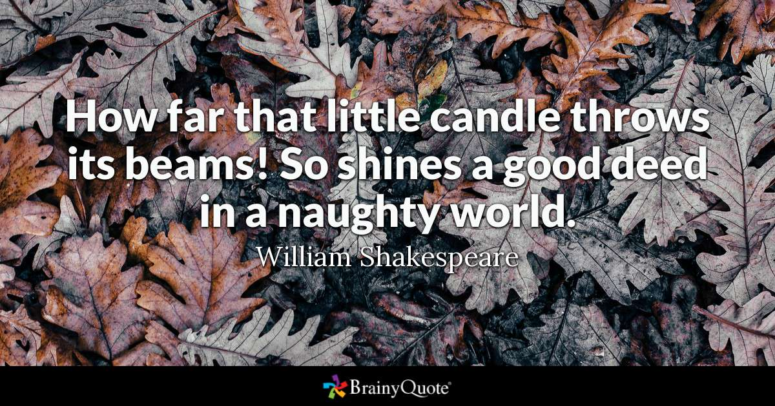
Monday 23 April Shakespeare’s birthday
Happy St George’s Day!
Lord
Grant us courage and confidence so that we can attempt what might seem to be impossible. May we always seek to do good in the world. Fill us with hope and optimism that will see us through to the end of any task. Allow us to draw strength from others when we need it and to be generous with our companionship when we are able to help someone else.
Amen

Slide 3
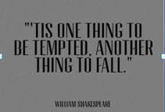
Tuesday 24 April
Lord,
I desire to be faithful, but I have yielded to temptation on so many occasions and though I have tried hard to live up to the highest standards, each time I have failed and fallen short. Lord, I know that I have tried to resist using my own strength and I confess that I cant do this by myself any more. I pray that You will teach me to draw my strength from You rather than to rely on my own limited means. Teach me to entrust my life into Your hands completely and to submit to the leading of the Holy Spirit in my life, so that I may always be guided by Your spirit and truth.
Amen

Slide 4
Wednesday 25 April
Lord God Please help me to rest in your love, To allow a smile to linger on my lips, To dwell within a wonderful memory, To walk back through sunlit places. Please help me to awake with hope, To engage with life in all its variety, To take in the beauty of the world, To touch the souls of those I meet with thankfulness. Please help me to sing with faith, To carry the truth close in my heart always, To rejoice in each moment And to drink in the great joy of life.
Amen

Slide 5
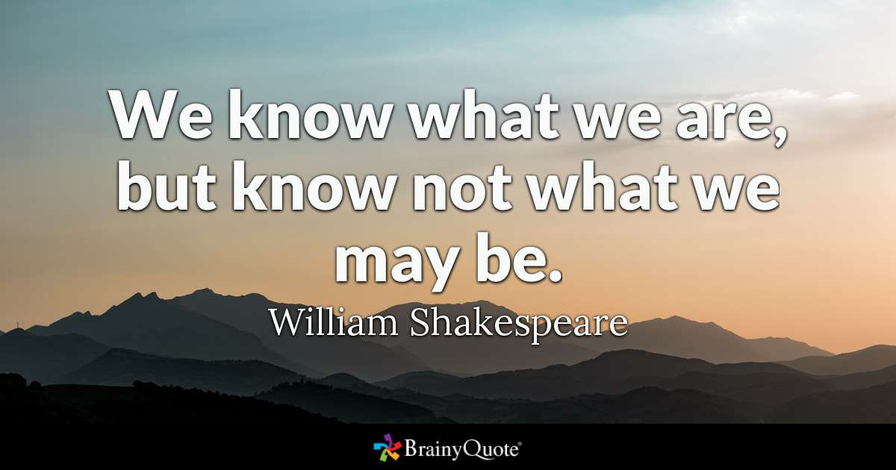
Thursday 26 April
Lord
We fear the label ordinary. It seems that every voice tells us to pursue greatness. Discover the dream and journey towards success. Along the way, we find that our definitions of dreams and success differ from Yours.
We weary ourselves for the label extraordinary. You see the extra hours we work for perfection. You know all the anxieties that fill our lives Provide us with the ambition to give grace to those closest to us.
Jesus, infuse in our hearts a healthy ambition. Teach how to live through excellence in worship. May our ambition start with what You have done in us And help us to find grace in our weaknesses
Amen

Slide 6
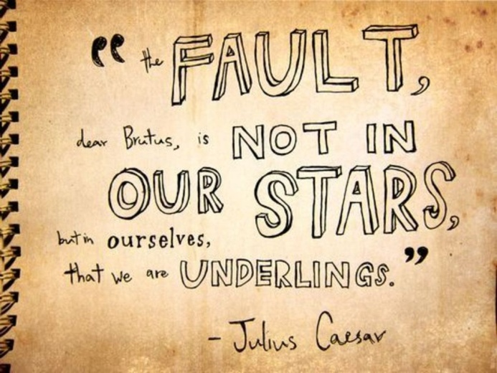
Friday 27 April
Lord God
May we always accept responsibility for our actions. When things go wrong, or when we make mistakes, help us resist blaming other people. Teach us to be honest with ourselves and in our relationships with others. May we learn from our mistakes and failures and look upon them as opportunities for growth. May we always seek out what is true and good and beautiful in this life and seek to walk always in the light of truth.
We make this prayer through Christ our Lord
Amen

Slide 7
Afternoon Prayer and Reflection
Lord
Thank you for the morning, for watching over me and walking with me. May I find joy and understanding this afternoon, in all I do. Grant me the zest and the strength I need to work for you until nightfall. Amen
Let us pause for a few moments in silence and ask ourselves this question “Who have you left a good memory with today?”................
Let us say together the prayer that Jesus taught his disciples:
Our Father who art in heaven, hallowed be thy name. Thy kingdom come. Thy will be done, on earth as it is in heaven. Give us this day our daily bread, and forgive us our trespasses, as we forgive those who trespass against us, and lead us not into temptation but deliver us from evil. Amen
We end our reflection with a prayer inspired by our foundress followed by the school prayer:
Loving Father, life-giving spirit – Marie Madeleine believed in your power, hoped in your promises and lived for your glory. We ask her to pray for us and be with us as we carry the FCJ spirit into the 21st century. Protect and guide the pupils and staff at Upton and at all FCJ schools in this country and around the world. Amen
May the Lord bless us and keep us from all evil and bring us to everlasting life. Amen

