Slide 1
Prayers for the week 12- 16 February 2018
The season of Lent begins this week on Ash Wednesday. This is the period of 40 days of preparation as we approach the great Christian feast of Easter. The focus of this preparation falls into three distinct areas. They are prayer, fasting and alms-giving (fundraising for charity). At Upton Hall during Lent, the charity that we support is known as Caritas, sometimes called The Good Shepherd. This charity is run by the diocese of Shrewsbury and it supports families in need and vulnerable young people across the north-west including here on the Wirral. Fundraising on behalf of Caritas will begin in the week after half-term.

Slide 2
Monday 12 February
A prayer for a better world
Generous God
We thank you: For the gifts you have given us, the abundance of your Creation, and the beauty that surrounds us.
For the people whose lives have touched ours, for the love they show, the burdens they lift and the hopes we share.
Compassionate God, we ask you: to fill us with your love, to place in our hearts a spirit of courage, to move us to reach out to others in need.
Lead us to play our part, so that now and for generations to come all of your children may share in our hope for a better world.
We ask this through Christ our Lord,
Amen.

Slide 3
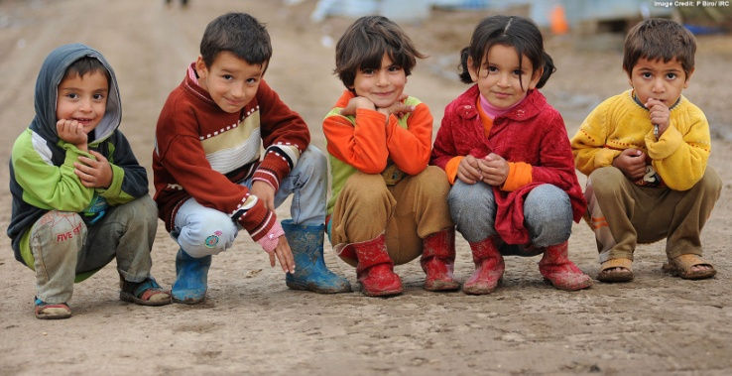
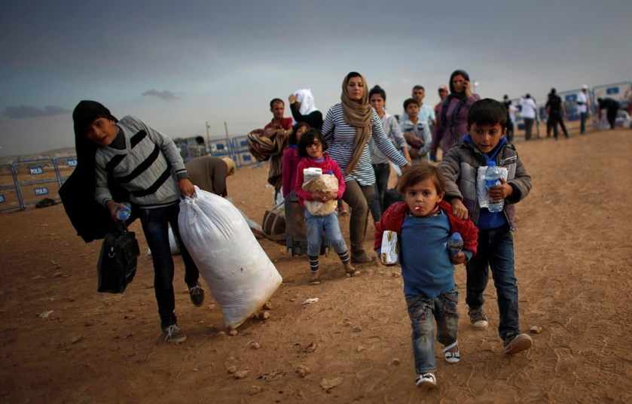
Tuesday 13 February
A prayer of mercy for refugees
Abba Father look down with mercy on all refugees.
Remember your son, our Lord Jesus Christ, had to leave his homeland and flee to Egypt, when he was a baby, with his parents Mary and Joseph.
Help us to be aware of the fears and anxiety, pain and sorrow,
difficulties and uncertainty that all refugees have to face:
and to remember that we all belong to the same human family.
Holy Spirit,
please grant us the compassion and courage we need to help them in any way we can.
Mary, Mother of God, pray for us. St. Joseph, pray for us.

Slide 4
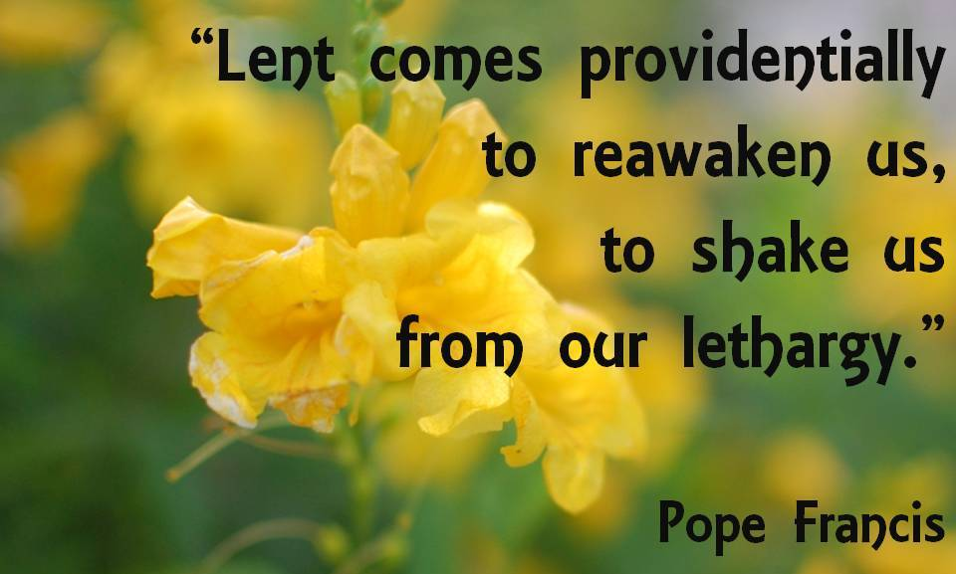
Wednesday 14 February
Ash Wednesday
Lord God
As we begin this season of Lent, teach us to use the time wisely. Let us be reawakened to new possibilities in our lives. Help our prayer life to grow in depth and meaning. May we be generous with our fund-raising efforts on behalf of young people and families in our community who need our support. Let us find a way to improve ourselves during Lent so that we may truly live out our FCJ values
We make this prayer through Christ our Lord
Amen

Slide 5
Thursday 15 February
Lord
We thank you for the work of this half-term and for the growth in our knowledge and understanding. We thank you for the support of our teachers, our families and our friends. May we keep our Lenten promises in our search to become better people. Let us enjoy the half-term break and return to school renewed and refreshed.
During this holiday, help us to notice nature waking up into Spring and to take pleasure in the new life and beauty of the natural world. Teach us to do all that we can to nurture and protect it.
Amen

Slide 6
Afternoon Prayer and Reflection
Lord
Thank you for the morning, for watching over me and walking with me. May I find joy and understanding this afternoon, in all I do. Grant me the zest and the strength I need to work for you until nightfall. Amen
Let us pause for a few moments in silence and remember those family members and friends who need our prayers and support today…………
Let us say together the prayer that Jesus taught his disciples:
Our Father who art in heaven, hallowed be thy name. Thy kingdom come. Thy will be done, on earth as it is in heaven. Give us this day our daily bread, and forgive us our trespasses, as we forgive those who trespass against us, and lead us not into temptation but deliver us from evil. Amen
May the Lord bless us and keep us from all evil and bring us to everlasting life. Amen

